Slide 1
Reducing Budget Shortfalls in Clinical Trials: Accurate Cost Projections for CT Scans
Bonita Feinstein &
Carolyn Stefanski
EMORY UNIVERSITY
OFFICE FOR CLINICAL RESEARCH

Slide 2
Team Members
EMORY UNIVERSITY
OFFICE FOR CLINICAL RESEARCH

Slide 3
Background
Office for Clinical Research, Pre-Award division - responsible for budget development & negotiation for all University clinical trials
Research charges are set by EHI Contracting office based on EUH Chargemaster
Research Fee schedule is revised twice yearly for FY and Medicare changes
OCR Lead Finance Managers act independently in using the research fee schedules and clinical knowledge to develop budgets for all university clinical trials.
Leads negotiate budget with many industry sponsors – all different ideas of what is FMV
EMORY UNIVERSITY
OFFICE FOR CLINICAL RESEARCH

Slide 4
Background CON’T.
Concern 1: No standardized process exists for determining costs for procedures with multiple CPT codes/components or ancillary costs
Concern 2: No feedback loop exists for verifying adequacy of clinical trials budgets
EMORY UNIVERSITY
OFFICE FOR CLINICAL RESEARCH

Slide 5
Background CON’T.
Decided to limit investigation to charges for CT scans of the head, neck, chest, abdomen, and pelvis performed by the Emory Department of Radiology as part of an industry funded clinical trial conducted FY15 to present (studies opened 9/1/2014 – 3/1/2016)
EMORY UNIVERSITY
OFFICE FOR CLINICAL RESEARCH

Slide 6
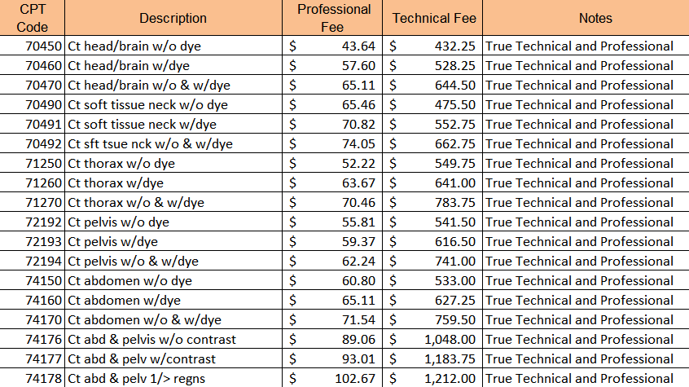
Background CON’T.
Fee schedule at left provides basic costs;
EUH clinic bills below show multiple costs associated with CT scans.
EMORY UNIVERSITY
OFFICE FOR CLINICAL RESEARCH

Slide 7
Current (baseline) conditions
EMORY UNIVERSITY
OFFICE FOR CLINICAL RESEARCH

Slide 8
Current (baseline) conditions
FOCUS: Pre-award budget development
Nine different Lead CRFMs prepare CT budgets
All operate independently and autonomously
There is no standardized process for cost calculations for CT scans in clinical trial budgets negotiated by the Pre-Award group in the Office for Clinical Research.
EMORY UNIVERSITY
OFFICE FOR CLINICAL RESEARCH

Slide 9
Aim statement
Aim Statement: Accurate Cost Projections for CT Scans
Implement a standardized process that will simplify the budgeting of CT scans
Reduce variability
Improve the ability of OCR Pre-Award to accurately project costs
Prospective budgets will cover charges for CT scans and all ancillary charges in industry-funded clinical trials for the duration of the study.
EMORY UNIVERSITY
OFFICE FOR CLINICAL RESEARCH

Slide 10
Goal
Our Goal: Reduce Budget Shortfalls in Clinical Trials
100% compliance with the process for budget development by all CRFMs by September 1, 2016.
Benefit: Clinical Trial budgets will cover actual costs of CT scans, thus reducing or eliminating deficits during future conduct of research studies.
EMORY UNIVERSITY
OFFICE FOR CLINICAL RESEARCH

Slide 11
Problem analysis
EMORY UNIVERSITY
OFFICE FOR CLINICAL RESEARCH

Slide 12
Problem analysis
Data collection: multi-step process
Data requested from IT:
1)ERMS (Emory Research Tracking System): System used to track patient visits, triggers patient bills to be held for bill review by post-award
Data requested from Invoicing division of OCR:
2)Hospital billing system (technical component)
3)Clinic billing system (professional component)
EMORY UNIVERSITY
OFFICE FOR CLINICAL RESEARCH

Slide 13
Problem analysis – Tally Sheet
EMORY UNIVERSITY
OFFICE FOR CLINICAL RESEARCH

Slide 14
Problem analysis
Use your improvement tools (one slide per tool)
Fishbone
Tally sheets
Pareto chart
Value stream map
EMORY UNIVERSITY
OFFICE FOR CLINICAL RESEARCH

Slide 15
Problem analysis
EMORY UNIVERSITY
OFFICE FOR CLINICAL RESEARCH

Slide 16
Problem analysis
Data actually showed SURPLUS rather than deficit in CT scan budgets.
EMORY UNIVERSITY
OFFICE FOR CLINICAL RESEARCH

Slide 17
Problem analysis
Use your improvement tools (one slide per tool)
Fishbone
Tally sheets
Pareto chart
Value stream map
EMORY UNIVERSITY
OFFICE FOR CLINICAL RESEARCH

Slide 18
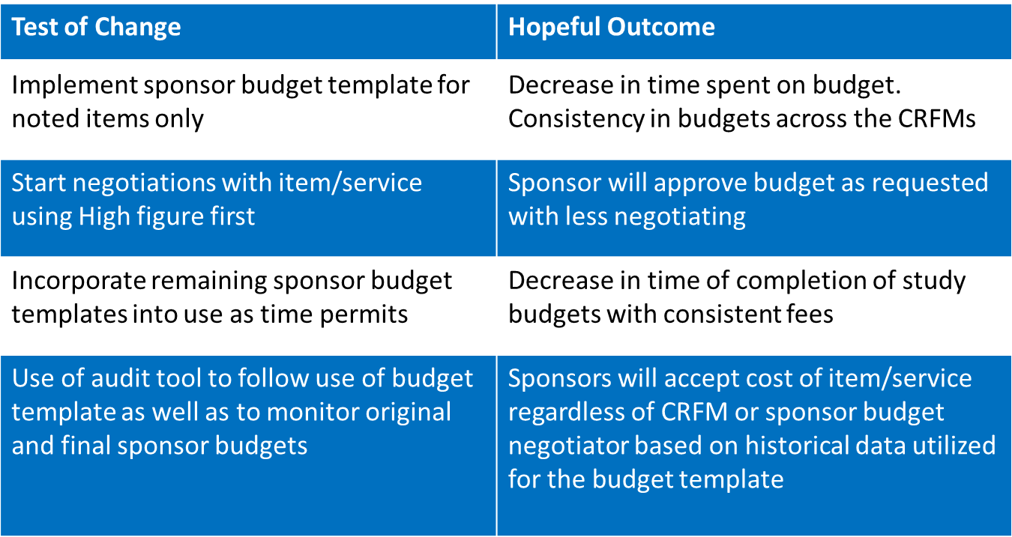
Planned Test of Change
EMORY UNIVERSITY
OFFICE FOR CLINICAL RESEARCH

Slide 19
Mobilizing Commitment
EMORY UNIVERSITY
OFFICE FOR CLINICAL RESEARCH

Slide 20
Metrics/results
Indicate what metric(s) you are following
Show an annotated run chart of your data
EMORY UNIVERSITY
OFFICE FOR CLINICAL RESEARCH

Slide 21
Follow up/Next steps
EMORY UNIVERSITY
OFFICE FOR CLINICAL RESEARCH

Slide 22
Project scoring
Category | Points available | Criteria
Aim statement | 2 | How much, by when, on whom = 2, Two of these = 1
Metrics | 2 | Annotated data on run chart = 1 Use of >1 PI tools (flow, fishbone, etc.)= 1
Tests of change | 2 | One TOC = 1 > 1 TOC = 2
Reliability | 2 | Use of Reliability Design Strategy = 1 Use of human factors in design to achieve >95% reliability = 1
Effective use of tools | 2 | Used A3 format correctly = 1 Use of quantitative data to drive TOCs = 1
EMORY UNIVERSITY
OFFICE FOR CLINICAL RESEARCH

