Slide 1
Emory OnCore OnCore Superuser Training *Note: This PPP can be used for existing users.
Version 7, 12/10/24

Slide 2
Course Layout
Learning Outcomes
Pre-Requisites and OnCore Tips
Module 1 [Widgets/Task Lists/Staff Roles]
Module 2 [CRA Console, RPE Console, Subject Console]
Module 3 [Financial Console, Closeout, Reports, and Amendments]
Module 4 [Advarra Training]
Module 5 [What’s Next and Final Steps]

Slide 3
Welcome
Welcome to the OnCore Superuser Training!
Each of you has signed up as a superuser to train your new and existing staff, starting December 3, 2024.
Please be sure you have completed the following:
OnCore CTMS Training, 1.0
Training Verification and Attestation Form
View the OCR website on OnCore.
This session will be 3 hours long with a five-minute break each hour.

Slide 4
Learning Outcomes
Users will demonstrate proficiency using OnCore for data entry, management, and reporting clinical trial information.
Users will learn to document and update study visit activities and subject data for invoicing and payment.
Users will learn to manage financials for clinical studies using OnCore tools, like reports.

Slide 5
Course Pre-requisites
Listed on the Office for Clinical Research’s OnCore webpage for Superusers, Existing Users, and New Users.

Slide 6
Why are we Optimizing?
Emory has decided to leverage the OnCore system’s capabilities to optimize the clinical research process by centralizing data, automating workflows, and providing advanced analytics to improve overall study efficiency and compliance.
We are using Advarra’s best practices for OnCore.

Slide 7
What’s New for CRCs in OnCore 2.0
PI Sign-off for Calendar Review
OnCore Auto Notifications
Task Lists for Amendments and Closeout
SAEs documentation
Deviation documentation - OPTIONAL
Reporting

Slide 8
Definitions
PI Sign-off is site-specific. Emory requests that all PIs or their designees review and approve the Pre-Award OnCore calendar.
An "OnCore calendar" refers to a calendar within the OnCore Clinical Trial Management System (CTMS) that details the schedule of study visits and procedures for participants in a clinical trial. It essentially outlines when each subject should be seen for specific assessments and treatments throughout the study, allowing researchers to track progress effectively and manage data collection across all participants. We will review more in Module 2 of the PPP.

Slide 9
Definitions
OnCore Auto Notifications is an automated email alert sent through the OnCore clinical trial management system. It notifies users about important updates or actions related to a research study, such as when a protocol receives IRB approval, a subject reaches a specific study milestone, or a document needs review. It essentially acts as a reminder or status update within the system and is triggered by events.
You will start seeing these notifications in your emails after go-live.

Slide 10
Definitions
OnCore Task Lists: This feature within the OnCore Clinical Trial Management System (CTMS) allows users to create and manage lists of tasks related to a clinical research study.
This allows study teams to track individual responsibilities, deadlines, and progress on various aspects of the trial, acting as a centralized to-do list for the research process.
Study teams must only copy the task list template for Amendments and Closeouts.

Slide 11
MODULE 1

Slide 12
Module 1
In this OnCore CTMS 2.0 course, you will learn your role and responsibilities in the OnCore CTMS system for the Enterprise library.
In Module 1, you will learn the following:
Review the Study Team Workflow in OnCore
Importance of and how to use an OCR CR eForm
How to use Widgets for Task Lists
How to add Staff Roles

Slide 13
Enterprise Study Team Workflow
View on OCR's webpage at https://ocr.emory.edu/resources/systems/oncore.html.
CRC Workflow, version 11-27-2024
Pre-Award
Post-Award – Invoicing
Closeout
Amendments

Slide 14
OCR CR eForm
The OCR Clinical Research eForm is a new electronic platform implemented by the Office for Clinical Research (OCR) to replace the paper format of several forms used for submissions to various departments at Emory University for clinical research.
Note: This is how your study gets into OnCore CTMS.
OCR PreAward Submission
Coverage Analysis Only
Coverage Analysis and Budget
Budget only (either PreAward or Invoicing)
Undetermined – Pending OCR Review
Amendments of any kind listed in #1.

Slide 15
OCR CR eForm Access
To access the OCR CR eForm, click on the OCR webpage > Resources.
For more information about the OCR CR eForm Application:
View the OCR Clinical Research eForm Guide (v2).
View the OCR Clinical Research eForm Video.
Contact OCR@Emory.edu.

Slide 16
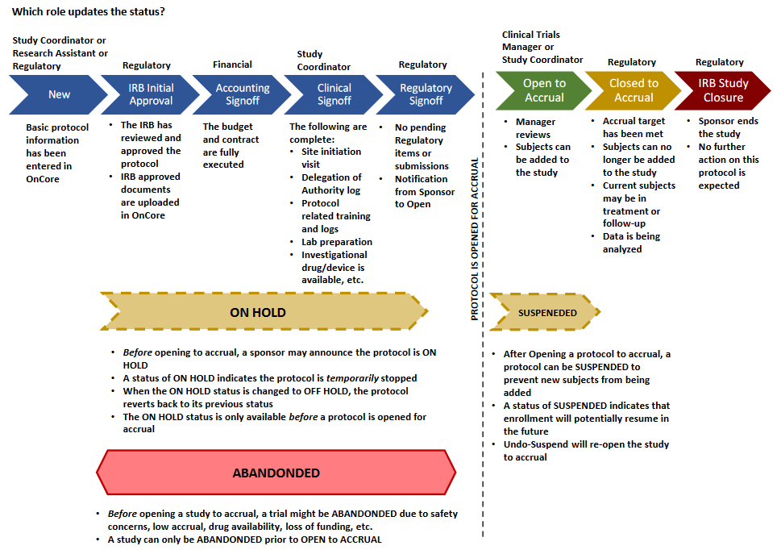
Study Statuses in OnCore

Slide 17
PC Console
OnCore 100 - Navigation Guide
The Protocol Coordinator Console is a central repository for protocol information in OnCore.
Displays Protocol Number and Title
Study type
Staff assigned to the protocol
Protocol sponsor
Participating Institutions
Regulatory information
Investigational drug and device information
OCR enters all the data you provided on the OCR CR eForm into OnCore.
However, you will continue to update the staff information after submission. Several roles can be entered.

Slide 18
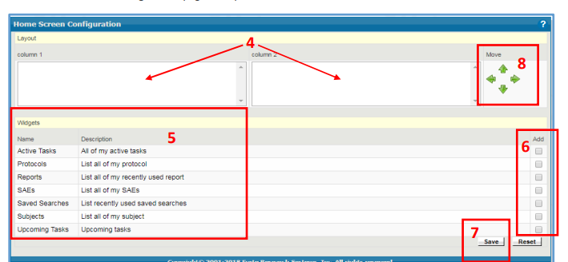
Widgets
Users can set up their home screen to display relevant protocols, subjects, and events in “widgets.”
Each user configures the information and links in each widget. You only need to set up widgets once, but you can always revise them later to suit your needs.

Slide 19
Demonstration
https://emory-oncore-train.advarra.app

Slide 20
Break – 5 mins

Slide 21
MODULE 2

Slide 22
Module 2
This module covers workflows to view and manage subjects using the CRA, Subject, and RPE Consoles.
Viewing the Protocol Calendar
Registering a subject
Viewing Accrual Details
Financial Events – Review in Module 3
SAEs
Deviations
Notes:
t

Slide 23
OnCore 210 - View and Manage Participants in the CRA Console
CRA Console
The CRA Console is a dedicated section where staff can access and manage detailed information about individual study participants (subjects) within a specific protocol, including demographics, consent status, eligibility, visit details, and adverse events.
This allows you to effectively monitor the progress of a clinical trial at the subject level.

Slide 24
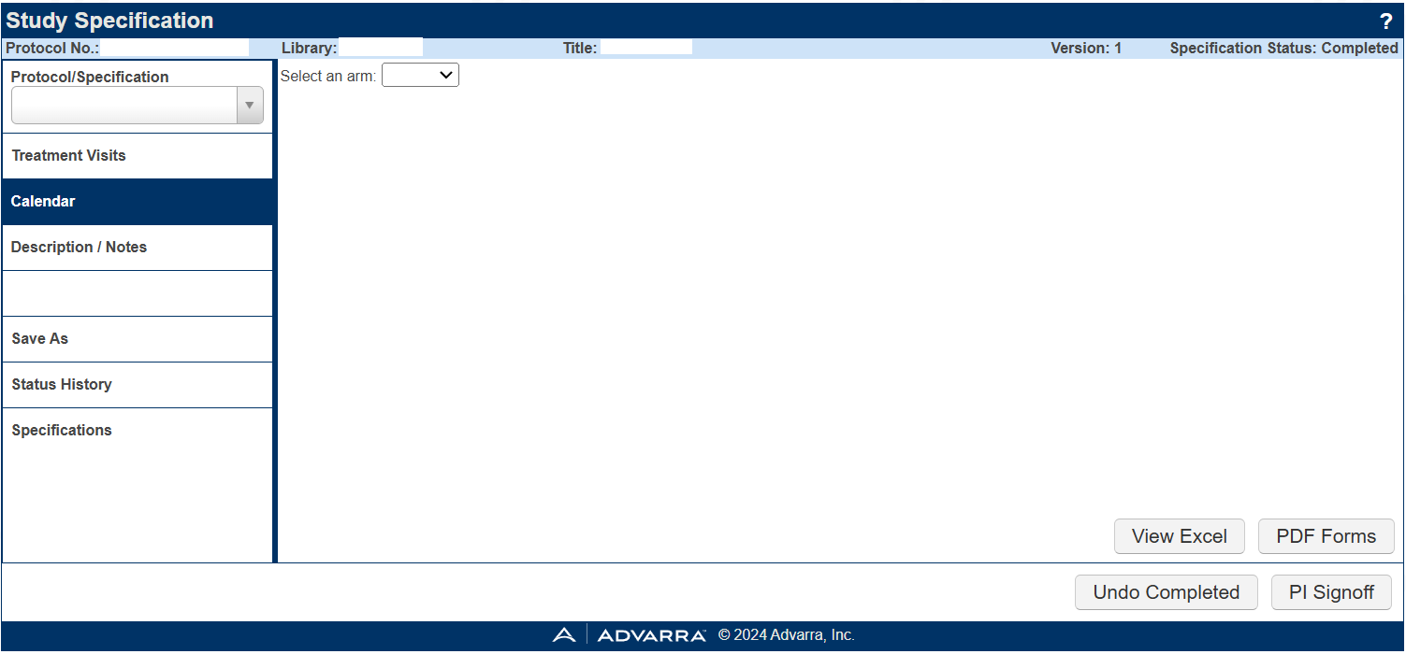
OnCore Calendar
OnCore 260 - Subject Calendars
When the OCR/WISC Pre-Award team releases your study's calendar OnCore, the PI or PI designee must sign off in OnCore. However, the PI must designate/delegate someone on the team to sign off on calendars placed in OnCore.
Note: If you are the PI designee, you will receive a notification on your calendar requesting a quality check and approval.

Slide 25
CRA Console – Protocol Calendar
It shows the expected schedule of events for subjects enrolled in the protocol. The legend indicates who will pay for the procedures listed in the calendar grid. At Emory University, we have the following billing designations:
R = Bill to Research or Sponsor S (if it is an approved document before October 2022)
C = Bill to the Carrier (Patient or Patient’s Insurance) M (if it is an approved document before October 2022)
N/A = Not Billable to Patient/Insurance/Sponsor

Slide 26
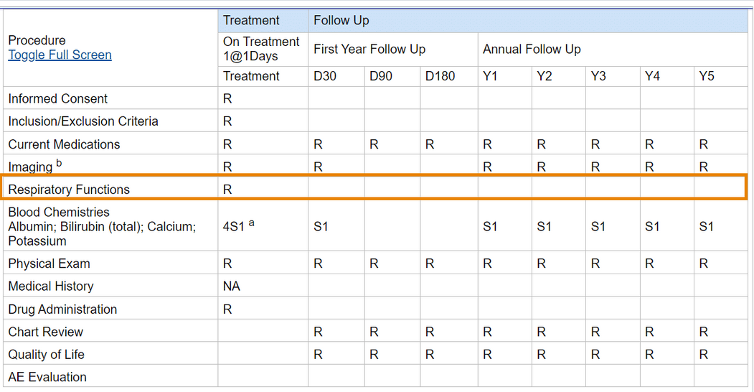
Assessment #1
On the CRA Console, on which visit(s) will you need to assess each subject’s respiratory functions, and who is to pay for it?

Slide 27
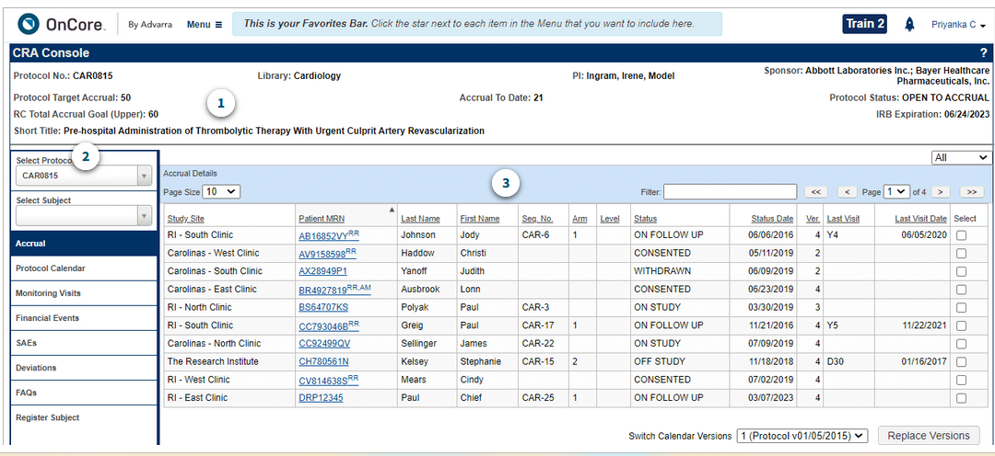
Assessment #4:
Q1: From the Advarra OnCore 210 eLearning module, how many subjects have been accrued to this study, and why?
60
21
50
N/A

Slide 28
Register a Subject
OnCore 230 - Subject Registration
All required fields must be entered.
MRNs are in Emory Healthcare’s medical record system – Epic.
Do not have OnCore and Epic open simultaneously when looking up the MRN.
Names must match what is in Epic.
VA, CHOA, Grady must, submit the MRN Request Form.

Slide 29
Epic – ADT Refresh
When a subject has an MRN, but you are unable to pull the patient up in OnCore, try completing an ADT REFRESH in Epic to push the subject's MRN into OnCore.
Research Coordinator logs into Hyperspace, click the Patient Station Button on the toolbar.
Search for the patient - enter the patient’s Name/MRN and/or Birth Date.
Once the patient chart opens, click Resend Msg button on the Patient Station Activity.

Slide 30
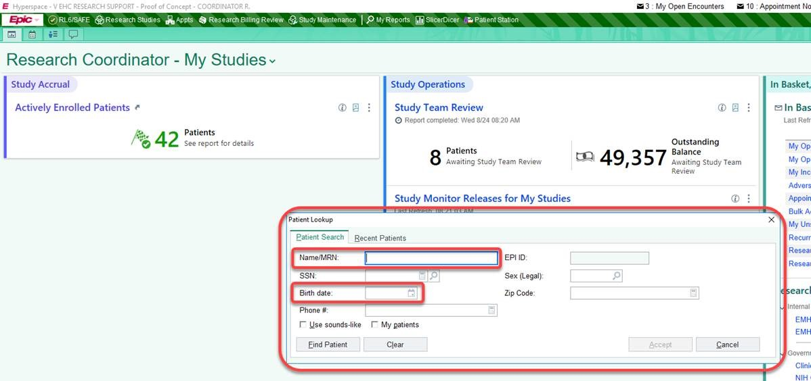
Epic – Patient Station

Slide 31
Subject Registration
After finding the subject and verifying the information, you will be directed to the Subject Console. A message will appear that you have added the subject to the protocol.

Slide 32
Subject Console
OnCore 220: Subjects Console and Companion Protocols
The Subject Console is a tool used in subject management to view and update information about a subject in a clinical trial or health research study.
View subject information: See a subject's demographic information, eligibility status, and consent forms.
Update subject information: Update a subject's demographic information and document their consent.
View subject calendar: Track study visits using the subject calendar.

Slide 33
Subject Console
OnCore 240: Consent and Eligibility OnCore 250: On Study
Select the Main Consent, then enter the date the subject signed and the status.
Note: Consents pullover from eIRB. If you have an external IRB approval of the ICF, the study team must enter both study and consent approval documents as a comment in eIRB. This helps IT verify the information so that it can be updated manually in OnCore. Please rely on the eIRB system as the record of truth for the study and consent approval documents. If you have concerns or the incorrect consent is in OnCore, submit a Service Now ticket.

Slide 34
Subject Console
Complete the following fields for the registered subject:
Eligibility
Eligible or not?
On-Study
The sequence # can be unique if needed.
Treatment
You must add a Treatment arm based on your coverage analysis results.
Follow-up, when applicable

Slide 35
RPE Console
Each time you update the subject registration statuses in OnCore, the subject status should automatically push into Emory Healthcare’s medical records system, Epic.
Follow guidance using the RPE Subject Push Instructions Guide for steps and how to address failed pushes.

Slide 36
Subject Documentation
Site (Emory)
Sponsor
Document the following: (OnCore, Epic)
Subject Visit
Track visits for Invoicing
Subject SAEs
Subject Deviations
Document the following: (OnCore, Epic)
Subject Visit
Track visits for Payment
Subject SAEs
Subject Deviations
Transparency
Compliance

Slide 37
Subject Console – Subject Visit
Indicate visit details as planned, occurred or missed.
If a procedure item did not occur that day, indicate N/A.

Slide 38
Subject Console – Subject Visit
Orphaned Visits can be used to see what was previously tracked from a revised calendar.

Slide 39
Additional Visits
OnCore 330: Additional and Unscheduled Calendar Events
Additional visits are used for the following:
Visit Track unscheduled visits.
Tracking items/services that could not be tracked on the calendar. Invoicing completes invoicing every 30 days, and the calendar cannot be revised.
Studies that do not have visits, but tracking is needed for milestone activities.

Slide 40
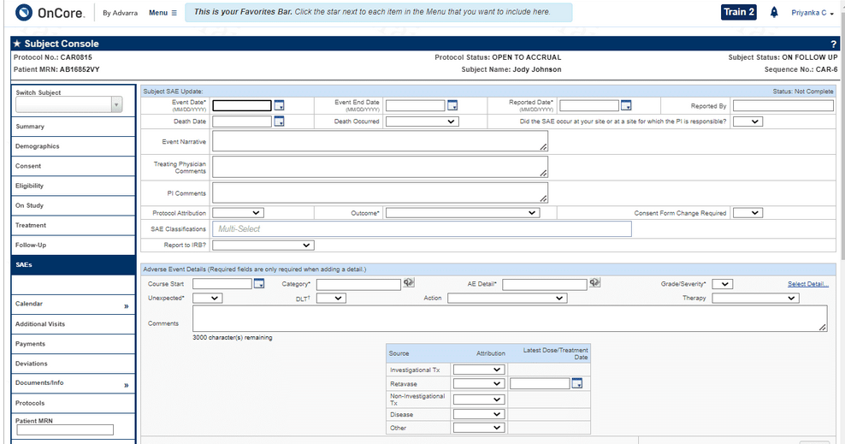
CRA Console – SAEs
If there are ever any billable SAEs that occur in your trial, it's important to keep clear and reportable records of them to document in OnCore. You will be required to enter the following information, at a minimum, to submit a new SAE.
Event Date
Reported Date
Outcome

Slide 41
SAEs
OnCore 270: Other Subject Visit Tools
Enter three required fields.
For Enterprise, this information will flow to the Financial Console, where the OCR Invoicing team will invoice the Sponsor for an SAE per the contract.

Slide 42
CRA Console – Deviations
OnCore provides a place for study teams to record, display, and update subject deviations that might need to be reported to the IRB and/or the sponsor.

Slide 43
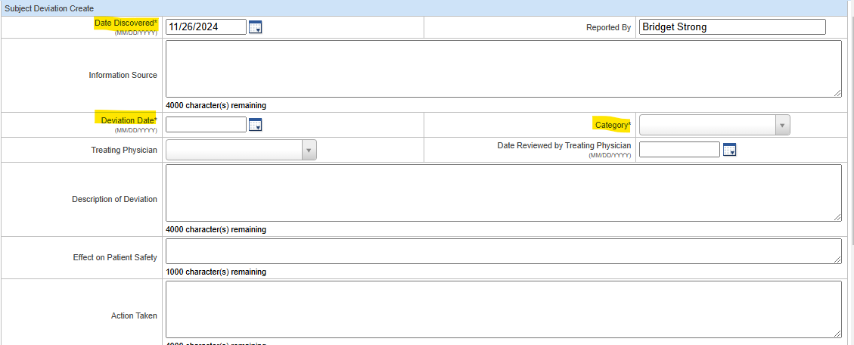
Deviations
OnCore 270: Other Subject Visit Tools
You can track your deviations in OnCore if preferred, as it is an optional entry. You would enter the three required fields.
However, the data should match the information provided to the Sponsor.

Slide 44
Study Statuses in OnCore

Slide 45
Off-Tx, Follow-Up, and Off-Study
As study milestones are met, the subject will enter a status of:
Off Treatment: When the subject is no longer on a treatment drug/device and is in follow-up. Is the subject Off-Treatment Arm as well?
Follow-up: When the subject is Off-Treatment and being followed until Off-Study.
Off-Study: When the subject has finished all study visits.

Slide 46
Off-Tx
Entering the Off Treatment Date and Reason will activate the treatment segments of the subject calendar that use it as their Start Date.
You can enter details about those visits with this part of the calendar activated. The subject’s status will be changed to Off Treatment.

Slide 47
Off Study
Entering the Off Study Date will activate the segments of the subject calendar that use it as their Start Date. You can enter details about those visits with this part of the calendar activated. Note: OnCore will check to ensure that the Off Study Date is later than the On Study Date entered on the Subject Console > On Study tab; if not, you will be prompted to confirm the Off Study date.

Slide 48
Demonstration
https://emory-oncore-train.advarra.app

Slide 49
Break – 5 mins

Slide 50
MODULE 3

Slide 51
Module 3
This module covers workflows for viewing and managing subject information using the Financial Console, as well as how to run Reports, process Study Closeout, and update subject data due to Amendments.

Slide 52
Financial Console
OnCore Financial Console is a module within OnCore that allows researchers to review all financial aspects of a clinical trial including budgeting, invoicing, payment reconciliation, and tracking costs associated with study subject visits.
This console is where OCR Invoicing will process invoices for your Sponsor per the contract (CTA) based on the study visits tracked that you learned in Module 2.

Slide 53
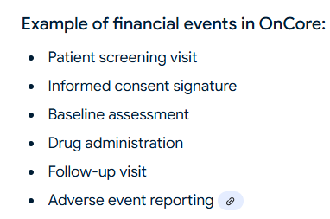
Sponsor Invoices
Any significant occurrence within a clinical trial that generates a billable cost, such as a patient visit, specific procedure, lab test, or any other milestone, is tracked and accounted for within the study budget. OnCore allows study teams to generate accurate invoices to sponsors based on the recorded events.

Slide 54
Financial Events
Users can select protocol-related budget events in the CRA Console > Financial Events tab. OCR/WISC utilizes an outside vendor named BOS to develop calendar items, such as dry ice, monitoring visits, etc., for you to track as financial events based on the contract (CTA).

Slide 55
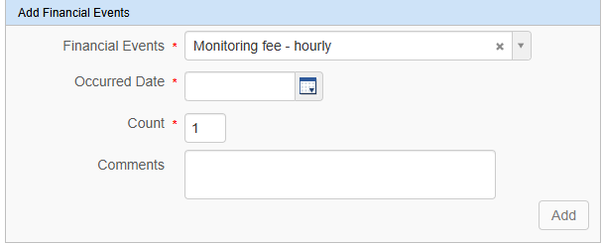
Financial Events
For monitoring visits, the OCR Invoicing would like study teams to indicate the number of hours spent as the count for that specific occurrence date.
For instance, 6 hours spent on October 1 should be indicated in the count as 6. Place any comments needed.

Slide 56
Financial Events - Fees
For OnCore 2.0, study teams will have to track specific administrative fees that OCR Invoicing no longer automatically invoices for but would require your tracking for an invoice to be paid.
Study teams must check this often to ensure they have tracked everything per the contract (CTA).

Slide 57
Financial Events - Fees
For OnCore 2.0, study teams must track specific administrative fees if listed in the Financial Events tab.
Study teams will NOW be responsible for tracking the financial events listed below.
WIRB amendment prep
WIRB renewal prep
IRB amendment
IRB renewal
IDS Pharmacy Maintenance
OCR amendment fee

Slide 58
Financial Events - Auto-Invoiced Fees
OCR Invoicing will auto-invoice for the following administrative fees for the study teams.
Administrative Start-up Costs (inclusive of initial IRB, initial pharmacy, radiology process, and user authorization fees) Must receive Emory’s eNOA. Administrative Study Close-out Costs (inclusive of record retention) Must receive close-out notification from Sponsor.

Slide 59
Financial Events – Attachments
Track visits information will flow to the Financials Console so the OCR Invoicing team can create Sponsor invoices.
Statements of Transactions (SOTs)
Invoices
Remittances

Slide 60
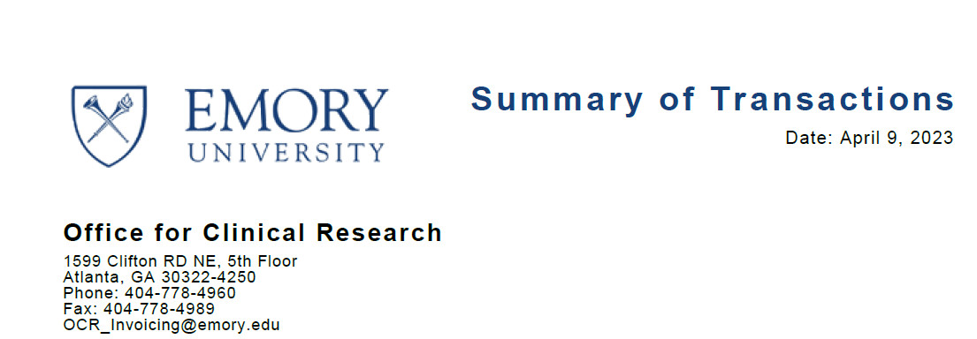
Financial Events – Attachments
Summary of Transactions
Payments received Invoiceable Non-Invoiceable Unapplied
Study Expenses/Subject Reimbursement Complete the Emory Research Participant Payment Forms on the OCR website.
Outstanding Unpaid Invoices
Questions on SOT? Contact your OCR Invoicing CRFM.

Slide 61
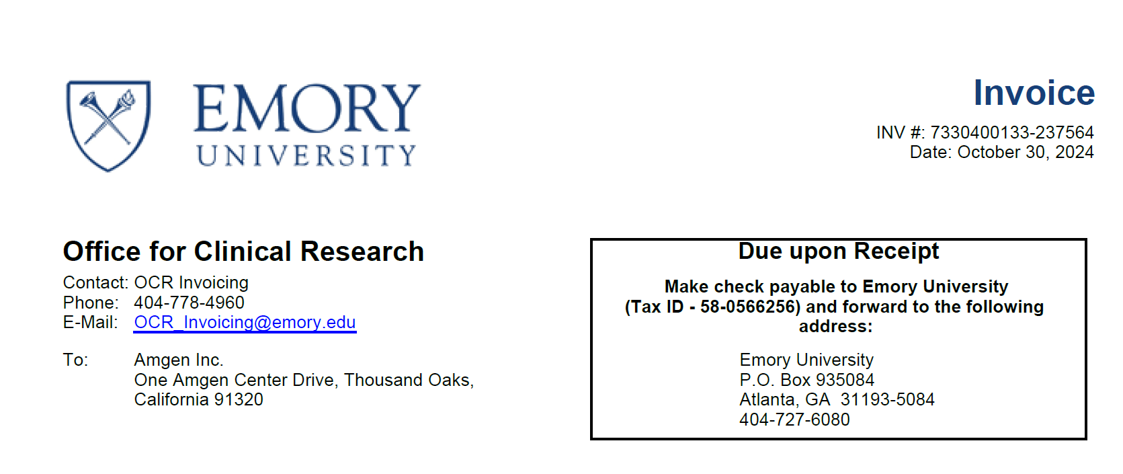
Financial Events – Attachments
Invoices
Sponsor
WIRB
Grady
Most Sponsors pay every 30 days, and we reconcile every 30 days. However, some invoices are due upon receipt, especially for Startup and Closeout. All checks and wires are sent to the Emory Finance Department. RGC will ensure the funds are credited to the account in Compass.

Slide 62
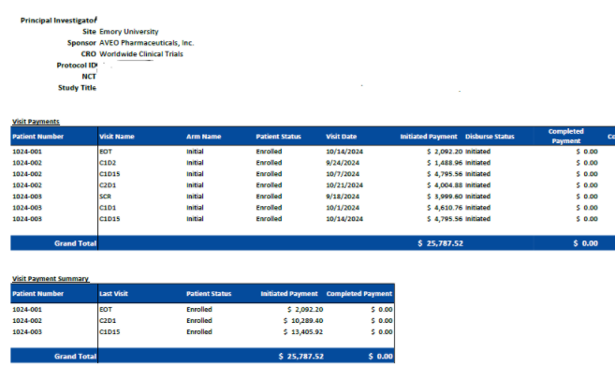
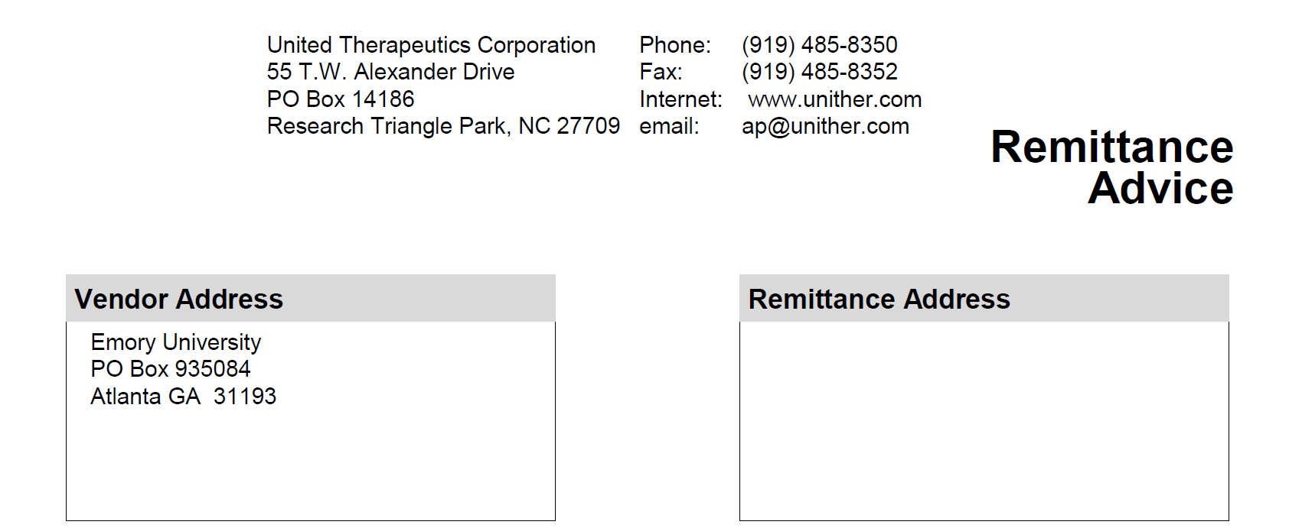
Financial Events – Attachments
Remittances Sometimes, they are sent with details; sometimes, they are not. OCR Invoicing relies heavily on the tracked visit information to aid in discovery.
With details
Without details

Slide 63
Again … Subject Documentation is Important
Site (Emory)
Sponsor
Document the following: (OnCore, Epic)
Subject Visit
Track visits for Invoicing
Subject SAEs
Subject Deviations
Document the following: (OnCore, Epic)
Subject Visit
Track visits for Payment
Subject SAEs
Subject Deviations
Transparency
Compliance

Slide 64
Closeout
Closeout refers to the process of formally concluding a clinical research study within OnCore. It involves documenting that all study activities, data collection, and regulatory compliance are complete, and the study is ready to be closed with the IRB and Sponsor, marking the end of the trial lifecycle within the OnCore platform.

Slide 65
Study Statuses in OnCore

Slide 66
Task Lists
OnCore 570: Task Lists Overview
Study Teams will only need to copy the Task List template for each study once. You will copy the Closeout Task List template.

Slide 67
Closeout Letter & Documentation
Upload documentation in the PC Console.
Ensure all subjects are Off-Study in OnCore.
Ensure all subjects were moved Off-Study in Epic.
A notification must be sent to OCR_Invoicing@Emory.edu to begin the closeout process of financials.
OCR Invoicing will notify RAS with a final SOT after all payments have been reconciled and confirmed. This final SOT will assist RAS and RGC with closing out the grant account in Compass.

Slide 68
Reports Console
Reports Console is a dedicated section within OnCore where study teams can access a variety of pre-built and customizable reports that pull data from different aspects of a clinical trial, allowing them to analyze and visualize information related to study participants, protocol progress, adverse events, and other key metrics, all within a single interface; essentially, it's the hub for generating and viewing data summaries from your clinical trial data stored in OnCore.

Slide 69
Reports
RPE Discrepant Subjects Report
Administrative > RPE Discrepant Subjects
Subject Visit Tracking Report
Subjects > Subject Visit Tracking
Invoice Items Report
Financials > Invoiceable Items
Any custom reports needed will have to be developed by the OnCore Research Informatics team via a request through Service Now.

Slide 70
Amendments
Amendments occur as the protocol, staff, or activities change. This will require a modification submission to the IRB, OCR/WISC, etc.
If there are changes that will affect the flow of the protocol or financials, you must submit a new OCR Clinical Research eForm for either one of the changes:
Coverage Analysis Only
Coverage Analysis and Budget
Budget Only - PreAward
Budget Only - Invoicing

Slide 71
Task Lists
OnCore 570: Task Lists Overview
Study Teams will only need to copy the Task List template for each study once. You will copy the Amendment Task List template.

Slide 72
Demonstration
https://emory-oncore-train.advarra.app

Slide 73
Break – 5 mins

Slide 74
MODULE 4

Slide 75
Advarra Training
Emory Brainer Step #15 for OnCore Superusers Advarra will complete the sessions below on system-specific steps in January. Dates are available on Brainer, so please sign up for both sessions.
Session 1: OnCore Overview for Study Staff | 2 hrs
Session 2: Patient Management | 2 hrs

Slide 76
MODULE 5

Slide 77
What’s Next …
OnCore Superusers must train their staff before January 6, 2025.
For existing users, use this PPP as a guide and modify it for your staff. Again, OnCore Tip Sheets are available on our website at https://ocr.emory.edu/resources/systems/oncore.html.
New users who have never had OnCore training before must be taught using the “New OnCore User” PPP as a guide.
OnCore does have a TRAIN environment. If you would like to use it to teach your staff, please contact us at OCR@Emory.edu.
If you leave this role as an OnCore Superuser or would like to modify who that person is, contact the OnCore Research Informatics team by submitting a Service Now ticket after January 21, 2025.

Slide 78
Final Step
At Emory Brainer, all users must complete an eLearning module for OnCore 2.0 as a Simulation Check-off of various tasks required within the OnCore system for Emory University.
Training will be verified by the OnCore Research Informatics team for continued or new access.
Investigators must identify a PI designee if needed.

Slide 79
Thank you, Study Teams. It has been a pleasure training you in OnCore, and we wish you well moving forward! Contact us at OCR@Emory.edu if you should have any questions. Review OnCore Tip Sheets and Workflows.

