Slide 1
Emory OnCore
OnCore Investigator User Training
Version17JAN25

Slide 2
Course Layout
Learning Outcomes
Pre-Requisites and OnCore Tips
Module 1 [Widgets/Task Lists/Staff Roles]
Module 2 [CRA Console, Coverage Analysis Console, eCRF/Calendar, RPE Console, Subject Console]
Module 3 [Financial Console, Closeout, Reports, and Amendments]
Module 4 [Simulations Assessment in Emory Brainer LMS ]

Slide 3

Welcome
Welcome to the OnCore 2.0 Training! This training may take 120 minutes (3 hours) to complete.
This Photo by Unknown Author is licensed under CC BY-SA-NC

Slide 4
Learning Outcomes
Users will demonstrate proficiency using OnCore for data entry, management, and reporting clinical trial information.
Users will learn to document and update study visit activities and subject data for invoicing and payment.
Users will learn to manage financials for clinical studies using OnCore tools, like reports.

Slide 5
What is OnCore?
OnCore is a web-based enterprise-wide clinical trials management system (CTMS) that will simplify clinical research management and integrate multiple functions, including protocol administration, participant tracking, and sponsor invoicing.
The OnCore CTMS will align with the Emory Healthcare Epic electronic medical record system to reduce redundancy across the enterprise and enhance patient safety and research billing compliance.

Slide 6
OnCore Libraries
A library is a customized environment for clinical research and data management for different units of an organization utilizing the same CTMS.
There are two libraries in OnCore:
Enterprise – indicated by “Enterprise” for all non-cancer-related studies.
Winship – indicated by “Oncology” for all cancer studies. Some of these are a hybrid between both libraries.

Slide 7
Studies in OnCore
Studies requiring management in OnCore are the following:
  All studies with Emory Healthcare or Grady billable items or services - regardless of sponsor/funder - requiring a Prospective Reimbursement Analysis (PRA) or Coverage Analysis (CA)
  All studies that meet the NIH clinical trial definition regardless of billables (including interventional)
  All studies where the Office for Clinical Research (OCR) performs the invoicing (mainly industry/hybrids)
  All cancer-related, prospectively enrolling studies
If your study is not listed in the categories above, you can enter a shell protocol in OnCore CTMS. Shell Protocols can be created with no calendar, coverage analysis (CA), or budget but allow study/subject coordination as needed.

Slide 8
Definitions
PI Sign-off is site-specific. Emory requests that all PIs or their designees review and approve the Pre-Award OnCore calendar.
An "OnCore calendar" refers to a calendar within the OnCore Clinical Trial Management System (CTMS) that details the schedule of study visits and procedures for participants in a clinical trial. It essentially outlines when each subject should be seen for specific assessments and treatments throughout the study, allowing researchers to track progress effectively and manage data collection across all participants. We will review more in Module 2 of the PPP.

Slide 9
Definitions
OnCore Auto Notifications is an automated email alert sent through the OnCore clinical trial management system. It notifies users about important updates or actions related to a research study, such as when a protocol receives IRB approval, a subject reaches a specific study milestone, or a document needs review. It essentially acts as a reminder or status update within the system and is triggered by events.
  You will start seeing these notifications in your emails after go-live.

Slide 10
Definitions
OnCore Task Lists: This feature within the OnCore Clinical Trial Management System (CTMS) allows users to create and manage lists of tasks related to a clinical research study.
This allows study teams to track individual responsibilities, deadlines, and progress on various aspects of the trial, acting as a centralized to-do list for the research process.
Study teams will only need to copy the task list template for Amendments.

Slide 11
Definitions
OnCore Task Lists: This feature within the OnCore Clinical Trial Management System (CTMS) allows users to create and manage lists of tasks related to a clinical research study.
This allows study teams to track individual responsibilities, deadlines, and progress on various aspects of the trial, acting as a centralized to-do list for the research process.
Study teams will need to copy and release the task list template for Amendments and Closeouts.

Slide 12
MODULE 1

Slide 13
Module 1
In this OnCore CTMS 2.0 course, you will learn your role and responsibilities in the OnCore CTMS system for the Enterprise library.
In Module 1, you will learn the following:
  Review the Study Team Workflow in OnCore
  Importance of and how to use an OCR CR eForm
  Review the Navigation –Home Screen and Favorites Bar
  How to use Widgets for Task Lists
  How to add Staff Roles

Slide 14
Enterprise Study Team Workflow
View on OCR's webpage at https://ocr.emory.edu/resources/systems/oncore.html.
  CRC Workflow, version 11-27-2024
  Pre-Award
  Post-Award – Invoicing
  Closeout
  Amendments

Slide 15
OCR CR eForm
The OCR Clinical Research eForm is an electronic platform implemented by the Office for Clinical Research (OCR) to replace the paper format of several forms used for submissions to various departments at Emory University for clinical research.
Note: This is how your study gets into OnCore CTMS.
OCR PreAward Submission
  Coverage Analysis Only
  Coverage Analysis and Budget
  Budget only (either PreAward or Invoicing)
  Undetermined – Pending OCR Review
Amendments of any kind listed in #1.

Slide 16
OCR CR eForm Access
To access the OCR CR eForm, click on the OCR webpage > Resources.
  For more information about the OCR CR eForm Application:
  View the OCR Clinical Research eForm Guide (v2).
  View the OCR Clinical Research eForm Video.
  Contact OCR@Emory.edu.

Slide 17
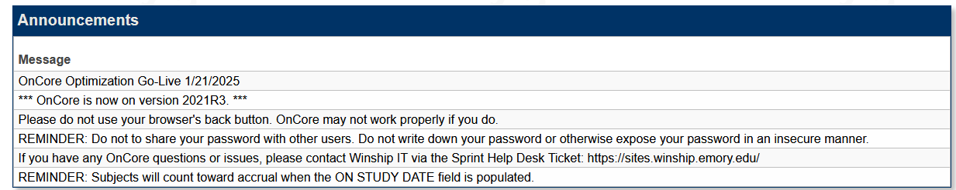
OnCore Login
View OCR’s webpage – https://ocr.emory.edu/resources/systems/oncore.html
Always view the Announcements when you sign in to OnCore.

Slide 18
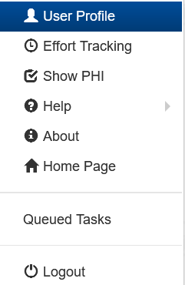
OnCore Login
Underneath your name, you can access the following areas in OnCore:
Note:
Enterprise does NOT use “Effort Reporting.”
You can always show PHI or not, especially if you are training someone or showing data to a Sponsor.
Help is a learner portal that is a quick user guide built within the system. Use it often to understand a specific field in OnCore.
Help also provides access to the Onsemble community, which is a social thread from other sites that use OnCore.
Queued tasks allow you to view the progress of tasks like reports and data imports.

Slide 19
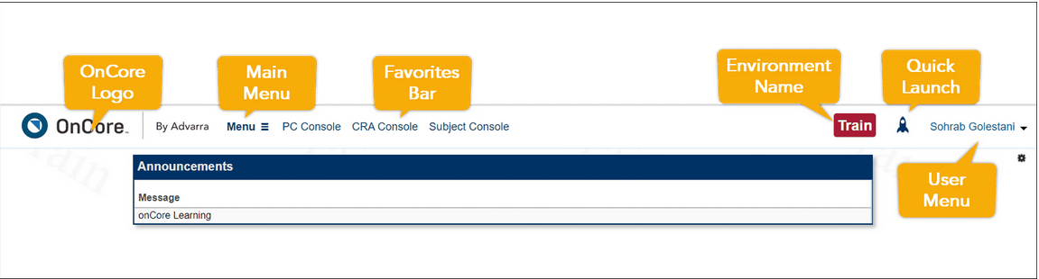
Home Screen and Favorites Bar
Customize your workspace to make OnCore more convenient for you.

Slide 20

OnCore Jump-To Icon
The rocket icon in the upper right corner of any page in OnCore allows you to move quickly between pages and jump to any location within OnCore.

Slide 21

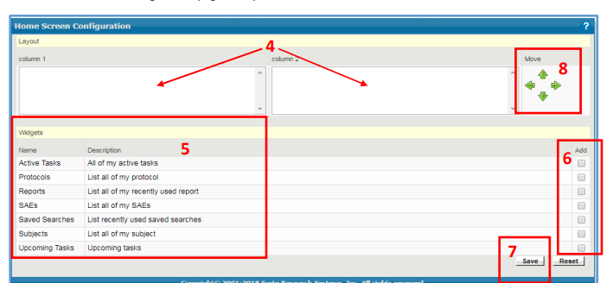

Widgets
Users can set up their home screen to display relevant protocols, subjects, and events in “widgets.”
Each user configures the information and links in each widget. You only need to set up widgets once, but you can always revise them later to suit your needs.

Slide 22
Task Lists
OnCore 570: Task Lists Overview
Study Teams need to copy and release the Task List template for each study once.
Two types of task lists will be need to be added to a study when needed:
    1. Amendment Task List
    2. Close out Task List
An amendment task list is needed when there is a change to the study that will affect the budget. A close out task list is needed to begin the process for financial close out of the study. Make sure to create the Active Task and Upcoming Tasks widgets on the home screen to see your task lists.

Slide 23
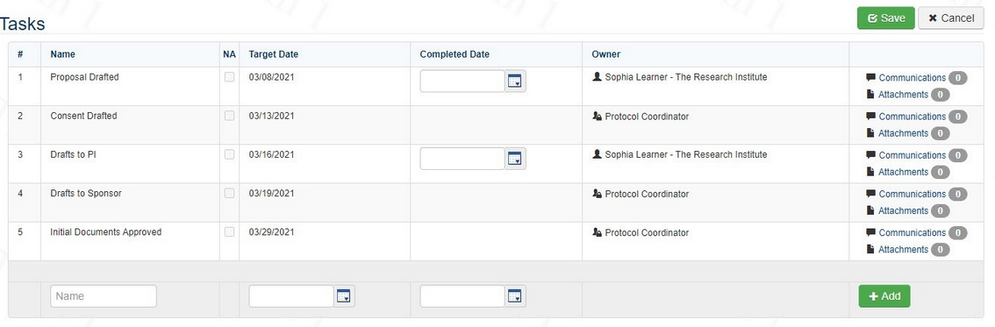
Task Lists
OnCore 570: Task Lists Overview
Once a task list has been added to a study, simply enter the target date and the completed date to indicate task completion.
When entering a target date for the first task, Oncore will automatically generate the remaining target dates on the task list.

Slide 24
Consoles
You will use several consoles in OnCore to complete objectives for administrative tasks within your studies.
PC Console – study demographics
Coverage Analysis Console – coverage analysis results
eCRFs/Calendars – budget details
CRA Console – register subject
RPE Console – release subject to Epic
Subject Console – update subject visit details
Financials Console – view SOTs and invoiceables
Reports – run specific reports for studies and subjects
Save them to your favorites bar for easy navigation.

Slide 25

Module 1 Quick Tips
Be sure to work with OCR/WISC for studies they manage that meet the OnCore criteria.
Set up widgets and favorites in OnCore.
Add specific Task Lists as needed.

Slide 26
MODULE 2

Slide 27
Module 2
This module covers workflows for viewing and managing subjects using the PC, Coverage Analysis, CRA, eCRF/Calendar, Subject, and RPE Consoles.
Uploading IRB documents
Viewing the Protocol Calendar
Registering a subject
  Viewing Accrual Details
Financial Events
SAEs
Deviations
Notes:
t

Slide 28
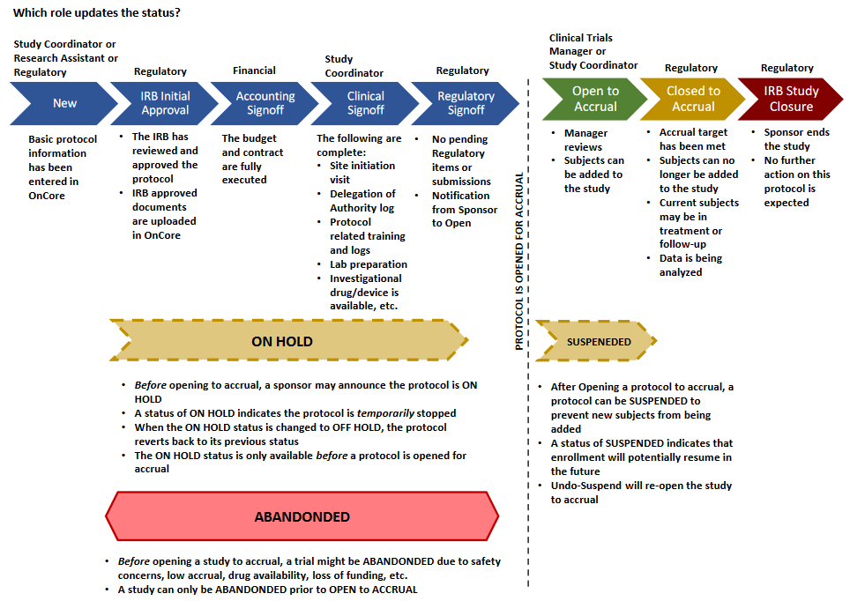
Study Statuses in OnCore

Slide 29
Study Status – Open to Accrual
An eNOA must be received for OCR to open a study to accrual. The Emory IRB will interface with OnCore to provide the following –
Study Approval dates
Continuing Review dates
Informed Consent version dates
Note: The Emory IRB is the source of truth for all IRB-approved documents.

Slide 30
Emory eIRB to OnCore
For external IRB studies only: If you do not see your updated expiration date or approved informed consent in OnCore, please ensure to upload all approval letters and consents into the Emory eIRB system using the comment box.
Then, contact the OnCore Research Informatics team via a Service Now ticket to manually update your information in OnCore.

Slide 31
PC Console
OnCore 100 - Navigation Guide
The Protocol Coordinator Console is a central repository for protocol information in OnCore.
Displays Protocol Number and Title
Study type
Staff assigned to the protocol
Protocol sponsor
Participating Institutions
Regulatory information
Investigational drug and device information
OCR enters all the data you provided on the OCR CR eForm into OnCore.
However, you will continue to update the staff information after submission. Several roles can be entered.

Slide 32
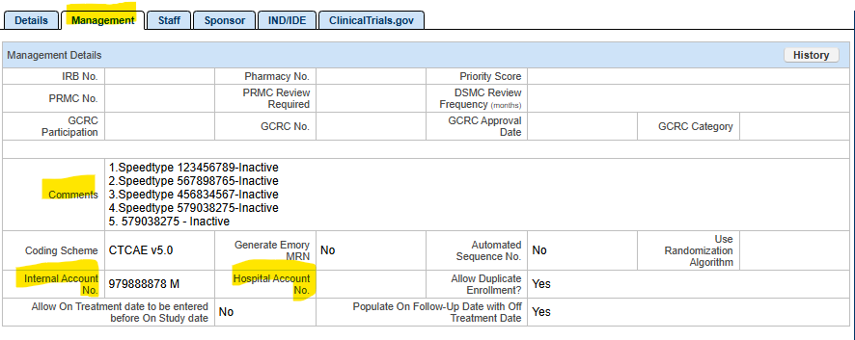
PC Console – Required Fields
PC Console > Main
Management: Multiple Speedtypes are entered under comments. Enter Inactive Speedtypes in the Comments section.
Internal Account No: is the “Active” Speedtype. Never delete speedtypes.

Slide 33
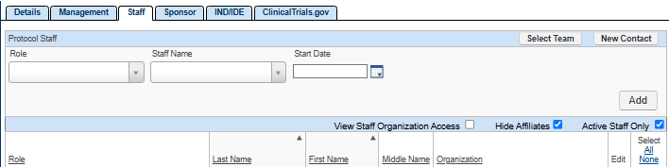
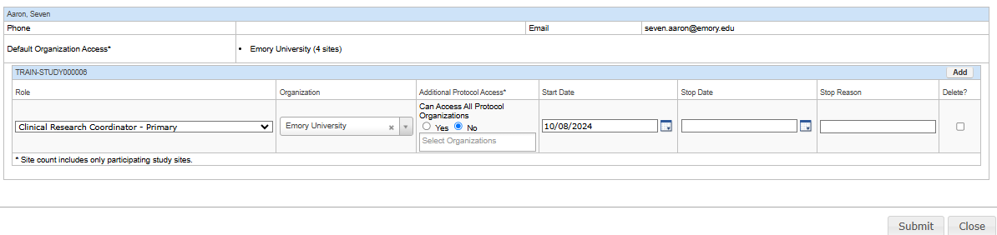
PC Console – Required Fields
PC Console > Main
Staff: Add new staff and roles per DOA log. Enter a stop date for staff that are no longer on the DOA log.

Slide 34
PC Console – Required Fields
PC Console > Main
Staff: Study Team members can have multiple roles in OnCore.
Example: Study Team, PI designee, Research Coordinator Primary can all be assigned to one person.

Slide 35
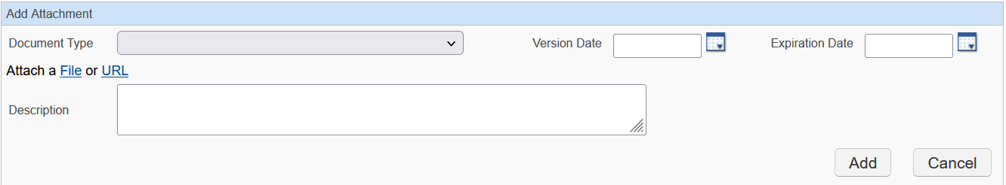
PC Console – Required Fields
PC Console > Documents/Info
Documents/Info
  You can upload closeout letter documents here.
  Click Add and select the Document Type.

Slide 36
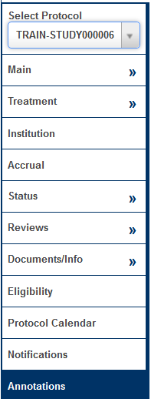
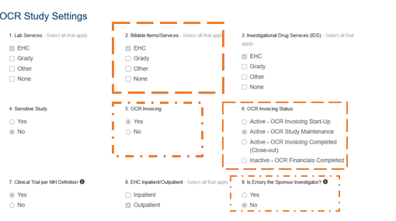
PC Console – Annotations Tabs
OCR Study Settings contain protocol-level information regarding study management.

Slide 37
Coverage Analysis Console
The Coverage Analysis Console is the process of reviewing a clinical trial protocol within OnCore to determine how each study-related item or service should be billed, whether to the patient's insurance, the research sponsor, or considered a study cost, ensuring accurate billing and compliance with Medicare guidelines; essentially, it's a systematic review to identify who is financially responsible for each aspect of a clinical trial within the OnCore platform.

Slide 38
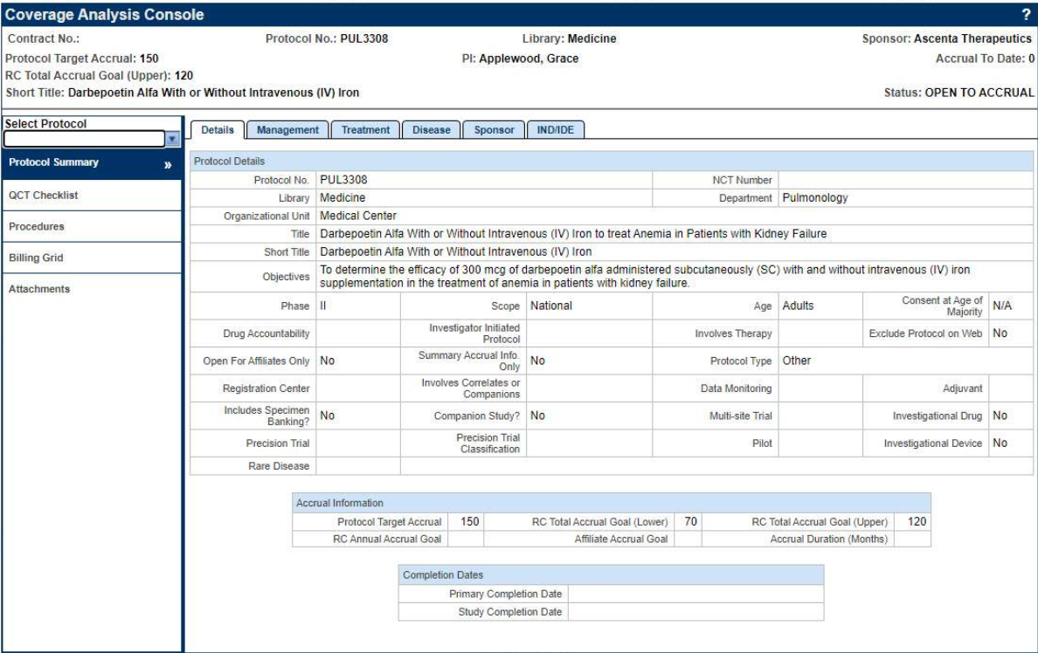
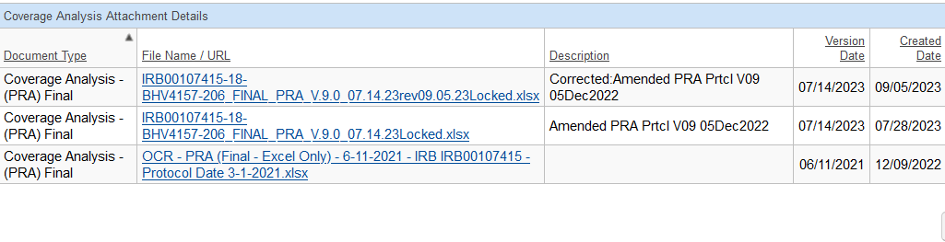
Coverage Analysis Console
The Coverage Analysis Console is found under attachments. The information entered will flow to the budget and other financial consoles in OnCore, ensuring everyone works off the same information.

Slide 39
OnCore 210 - View and Manage Participants in the CRA Console
CRA Console
The CRA Console is a dedicated section where staff can access and manage detailed information about individual study participants (subjects) within a specific protocol, including demographics, consent status, eligibility, visit details, and adverse events.
This allows you to effectively monitor the progress of a clinical trial at the subject level.

Slide 40
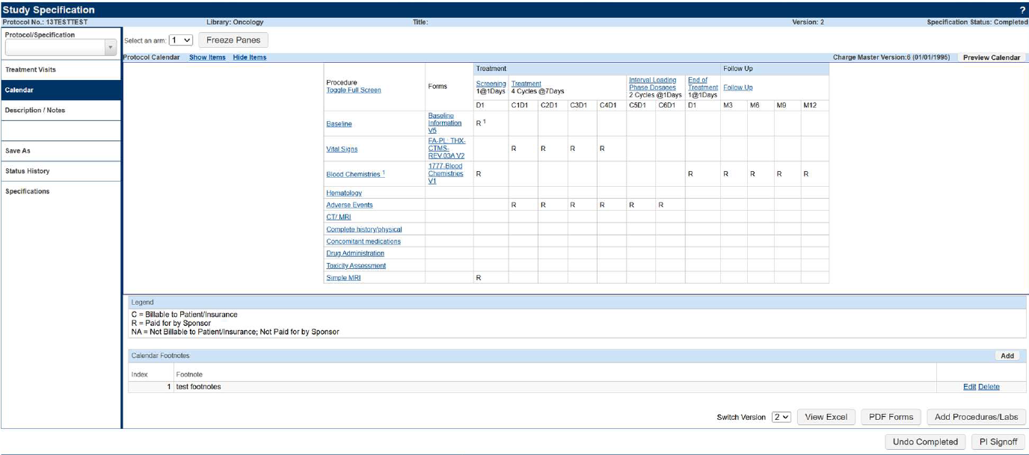
OnCore Calendar
OnCore 260 - Subject Calendars
Whenever the study needs a PI Signoff, Investigators or their designees can then proceed to eCRFs/Calendars->Specifications for the study in question the button should be found in the lower-right hand corner, like this screenshot below.
The PI or PI designee must sign off on the calendar in OnCore within 3 business days. The PI is the only person who can assign a designee.

Slide 41
OnCore Calendar
OnCore 260 - Subject Calendars
Note: Failure to complete sign off in 3 business days will result in a hard stop in activating the protocol in OnCore. You must be assigned as the PI designee on the staff tab.
For the study/studies where a staff member will be serving as a PI designee, they should go to the study and assign themself the staff role (in addition to any pre-existing staff roles they have) of PI Designee.
If you are the PI and/or PI designee, you will receive an auto notification email requesting a quality check and approval.

Slide 42
CRA Console – Protocol Calendar
The Calendar shows the expected schedule of events for subjects enrolled in the protocol. The legend indicates who will pay for the procedures listed in the calendar grid. At Emory University, we have the following billing designations:
R = Bill to Research or Sponsor
S (if it is an approved document before October 2022)
C = Bill to the Carrier (Patient or Patient’s Insurance)
M (if it is an approved document before October 2022)
N/A = Not Billable to Patient/Insurance/Sponsor

Slide 43
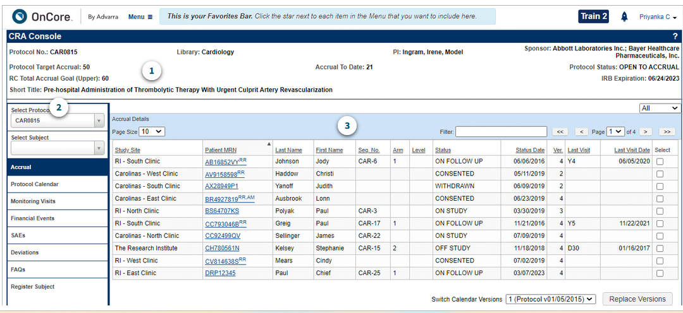
Assessment #4:
Q1: From the Advarra OnCore 210 eLearning module, how many subjects have been accrued to this study, and why?
60
21
50
N/A

Slide 44
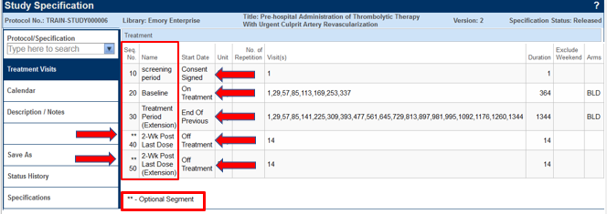
Study Specifications
You can review study specifications to determine the following:
If the calendar has been Released for study team view.
If the calendar utilizes Optional Segments.
Review start dates that will trigger the calendar to open for visit tracking.
Study specifications can be found by proceeding to eCRFs/Calendars->Specifications

Slide 45
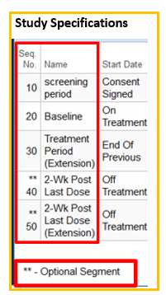
Optional Segments
Optional Segments are used for special scenarios, e.g., (additional screening visits or medication washouts).
These segments are NOT automatically added to subjects’ calendars.
Once a status trigger has been entered in a subject’s record, optional segments can be added.
The following milestones can be used as a trigger:
a. Consent signed
b. On Study
c. Off Treatment
d. Off Study

Slide 46
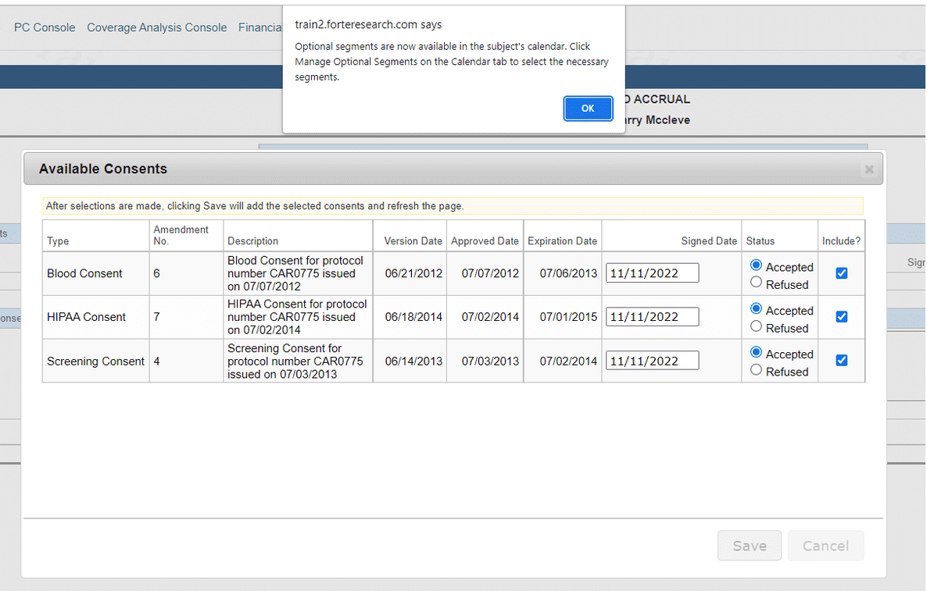
Adding an Optional Segment
When a subject is consented, and if a calendar includes optional segments, OnCore alerts the study staff member.

Slide 47
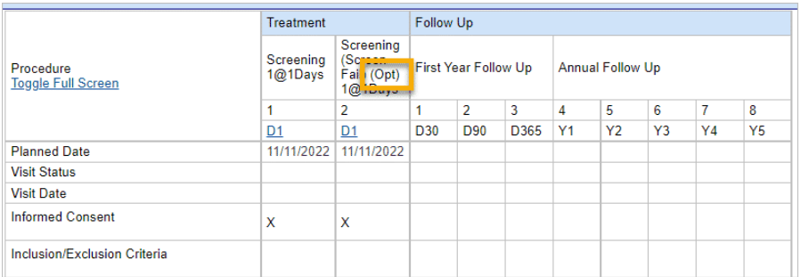
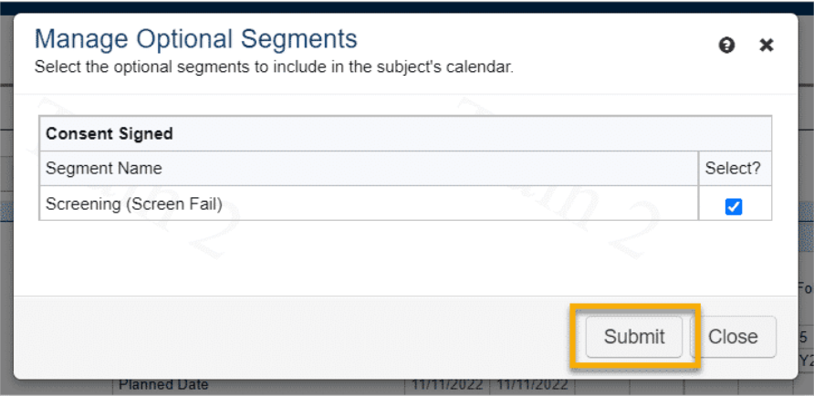
Adding an Optional Segment
The optional segment is added to the subject calendar.
Optional segments are indicated by (Opt).
You can click the Manage Optional Segments button again to select and add a different optional calendar segment or to de-select and remove a particular segment.

Slide 48
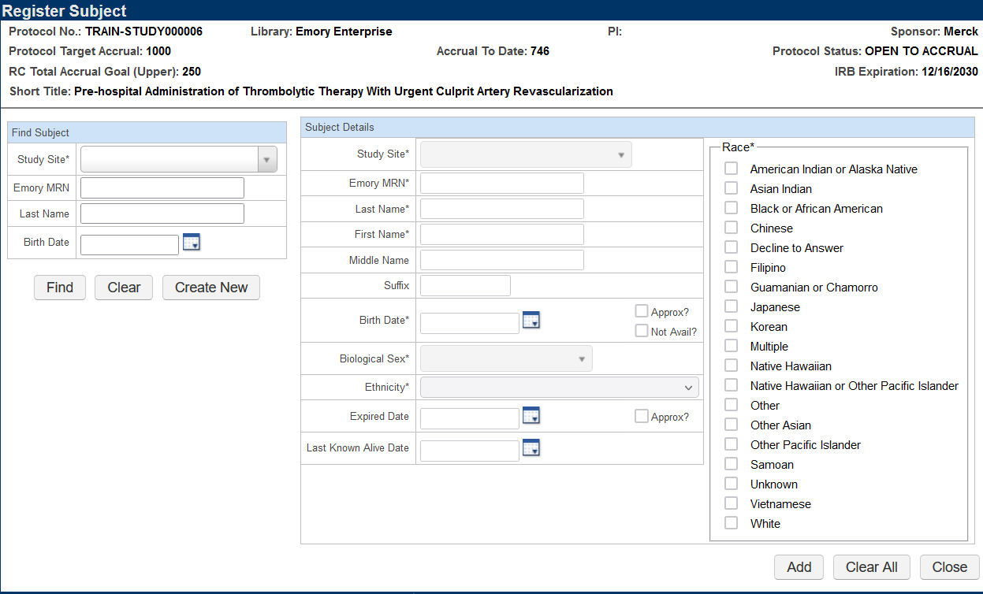
Register a Subject
OnCore 230 - Subject Registration
Enter the Study Site, Emory MRN and click Find.
MRNs are in Emory Healthcare’s medical record system – Epic.
Do not have OnCore and Epic open simultaneously when looking up the MRN.
Names must match what is in Epic.
If there is no MRN #, submit the MRN Request Form.
Know your site locations, as this determines how you will see and enter data for each site.
Never click the Create New button. Subjects must come from EPIC only where all demographic information is housed. Subjects must be enrolled in OnCore the same day they sign consent.

Slide 49
Epic – ADT Refresh
When a subject has an MRN, but you are unable to pull the patient up in OnCore, try completing an ADT REFRESH in Epic to push the subject's MRN into OnCore.
Research Coordinator logs into Hyperspace, click the Patient Station Button on the toolbar.
Search for the patient - enter the patient’s Name/MRN and/or Birth Date.
Once the patient chart opens, click Resend Msg button on the Patient Station Activity.

Slide 50
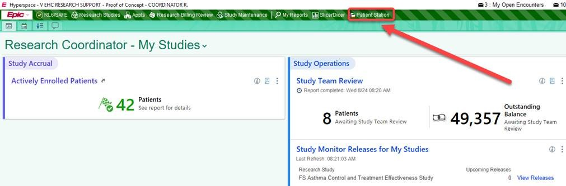
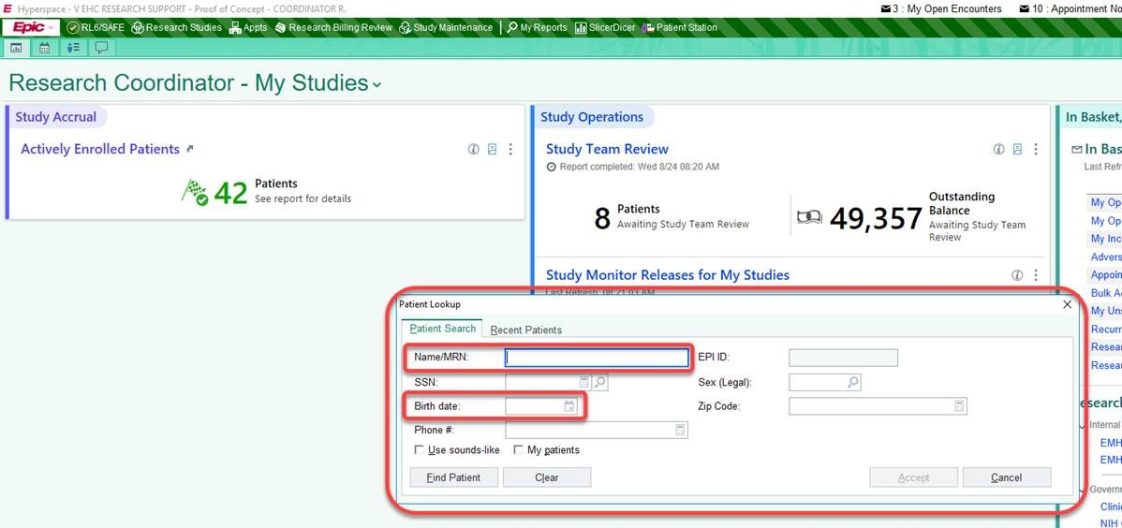
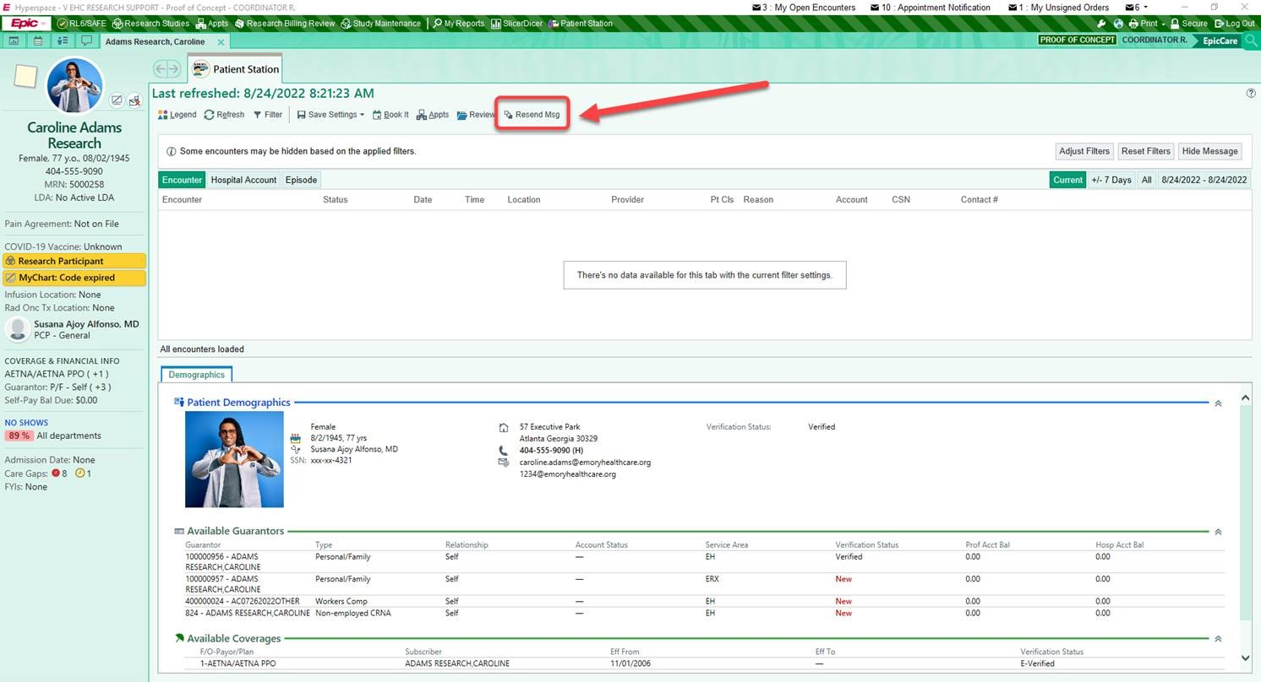
Epic – Patient Station

Slide 51

Subject Registration
After finding the subject and verifying the information, you will be directed to the Subject Console. A message will appear that you have added the subject to the protocol.

Slide 52
Subject Console
OnCore 220: Subjects Console and Companion Protocols
The Subject Console is a tool used in subject management to view and update information about a subject in a clinical trial or health research study.
View subject information: See a subject's demographic information, eligibility status, and consent forms.
Update subject information: Update a subject's demographic information and document their consent.
View subject calendar: Track study visits using the subject calendar.

Slide 53
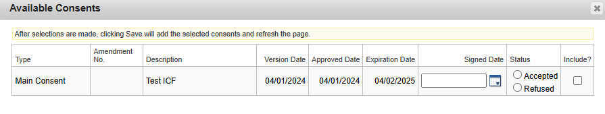
Subject Console
OnCore 240: Consent and Eligibility
OnCore 250: On Study
Select the Main Consent, then enter the date the subject signed and the status.
Note: Consents pullover from
eIRB. If you have an external IRB approval of the ICF, the study team must enter both study and consent approval documents as a comment in eIRB. This helps IT verify the information so that it can be updated manually in OnCore. Please rely on the eIRB system as the record of truth for the study and consent approval documents. If you have concerns or the incorrect consent is in OnCore, submit a Service Now ticket.

Slide 54
Subject Console
Complete the following fields for the registered subject:
Eligibility
  Eligible or not?
On-Study
  The sequence # can be unique if needed.
Treatment
  You must add a Treatment arm & on Treatment date and off arm date.
Follow-up
  Enter an Off Treatment date, Off-study or Follow up date as needed.

Slide 55
RPE Console
After entering all subject registration data, the data will automatically push into Emory Healthcare’s medical records system, Epic.
If subject information does not appear in EPIC follow guidance using the RPE Protocol Push Instructions Guide for steps and how to address failed pushes.

Slide 56
Subject Documentation
Site (Emory)
Sponsor
Document the following: (OnCore, Epic)
  Subject Visit
    Track visits for Invoicing
  Subject SAEs
  Subject Deviations
Document the following: (OnCore, Epic)
  Subject Visit
    Track visits for Payment
  Subject SAEs
  Subject Deviations
Transparency
Compliance

Slide 57
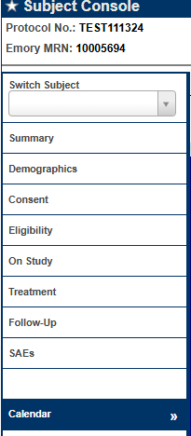
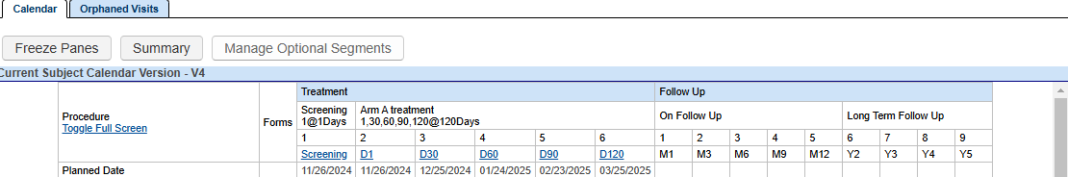
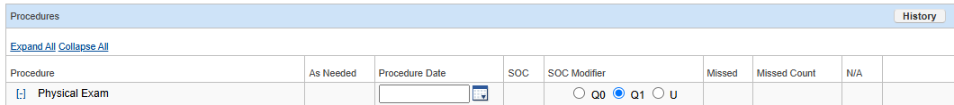
Subject Console – Subject Visit
When viewing the calendar, indicate visit details as planned, occurred or missed.
Procedure dates are only needed if they occur on a different date than the visit date. If a procedure item did not occur that day, indicate Missed or N/A.

Slide 58
Subject Console – Subject Visit
Note: Any procedures that are not performed during the visit must be marked as missed or N/A or the invoice will be incorrect and denied by the sponsor.

Slide 59
Subject Console – Subject Visit
Orphaned Visits can be used to see what was previously tracked from a revised calendar.

Slide 60
Additional Visits
OnCore 330: Additional and Unscheduled Calendar Events
Additional visits are used for the following:
Visit Track unscheduled visits.
Tracking items/services that could not be tracked on the calendar. Invoicing completes invoicing every 30 days, and the calendar cannot be revised.
Studies that do not have visits, but tracking is needed for milestone activities.

Slide 61

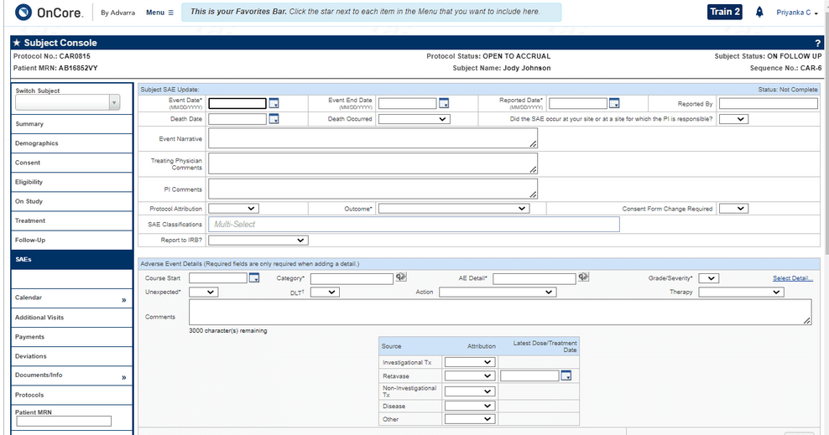
CRA Console – SAEs
If there are billable SAEs that occur in your trial, it's important to keep clear and reportable records of them to document in OnCore. You will be required to enter the following information, at a minimum, to submit a new SAE.
Event Date
Reported Date
Outcome

Slide 62
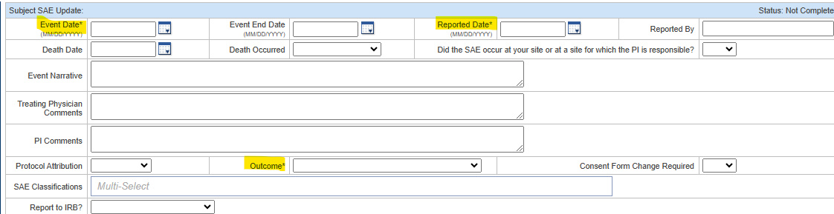
SAEs
OnCore 270: Other Subject Visit Tools
Enter three required fields.
For Enterprise, this information will flow to the Financial Console, where the OCR Invoicing team will invoice the Sponsor for an SAE per the contract.

Slide 63
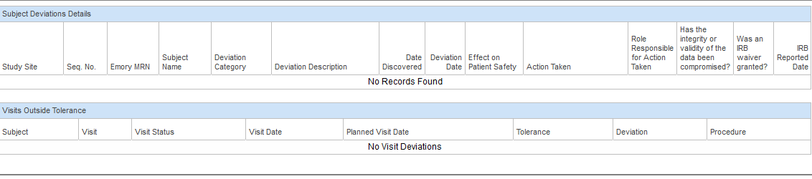
OPTIONAL CRA Console – Deviations
OnCore provides a place for study teams to record, display, and update subject deviations that might need to be reported to the IRB and/or the sponsor. However, the data does not flow into eIRB. Study teams will still need to report deviations to the IRB and to the sponsor.

Slide 64
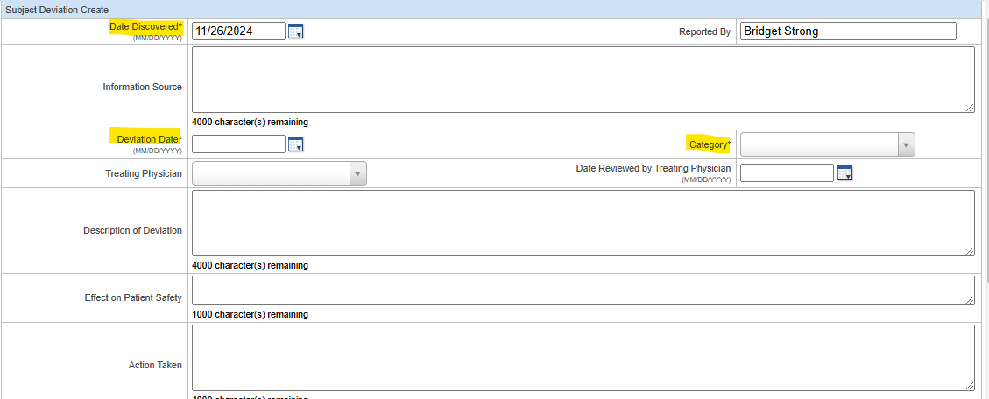
Deviations
OnCore 270: Other Subject Visit Tools
You can track your deviations in OnCore if preferred, as it is an optional entry. You would enter the three required fields.
However, the data should match the information provided to the Sponsor.

Slide 65

Assessment #4:
Q2: True or False?
You can document new SAEs and Deviations in the CRA Console.

Slide 66
Study Statuses in OnCore

Slide 67
Off-Tx, Follow-Up, and Off-Study
As study milestones are met, the subject will enter a status of:
Off Treatment: When the subject is no longer on a treatment drug/device.
Follow-up: When the subject is Off-Treatment and being followed until Off-Study.
Off-Study: When the subject has finished all study visits.

Slide 68
Off-Tx
Entering the Off Treatment Date and Reason will activate the treatment segments of the subject calendar.
You can enter details about those visits with this part of the calendar activated. The subject’s status will be changed to Off Treatment.

Slide 69
Off Study
Entering the Off Study Date will activate the segments of the subject calendar if applicable. You can enter details about those visits with this part of the calendar activated.
Note: OnCore will check to ensure that the Off Study Date is later than the On Study Date entered on the Subject Console > On Study tab; if not, you will be prompted to confirm the Off Study date.

Slide 70

Module 2 Quick Tips
Be sure your name is added to the Staff tab in OnCore.
Update Speedtypes from eNOA if applicable.
Enter the subject in OnCore on the SAME DAY of consenting.
For external IRB-approved documents, enter in Emory eIRB as a Comment and submit a Service Now ticket to notify OnCore Research Informatics if the OnCore dates and documents are incorrect or missing. Emory eIRB is the source of truth for approved documents.
No two calendars are the same. Contact OCR@Emory.edu for calendar-specific concerns.
Be sure to match what you do for the Sponsor.
7. Track study visits on the SAME DAY of the visit.

Slide 71
MODULE 3

Slide 72
Financials Console
OnCore Financials Console is a module within OnCore that allows researchers to review all financial aspects of a clinical trial, including budgeting, invoicing, payment reconciliation, and tracking costs associated with study subject visits.
This console is where OCR Invoicing will process invoices for your Sponsor per the contract (CTA) based on the study visits tracked that you learned in Module 2.

Slide 73
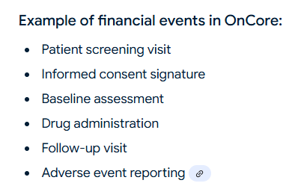
Sponsor Invoices
Any significant occurrence within a clinical trial that generates a billable cost, such as a patient visit, specific procedure, lab test, or any other milestone, is tracked and accounted for within the study budget. OnCore allows the Invoicing Team to generate accurate invoices to sponsors based on the recorded events.

Slide 74
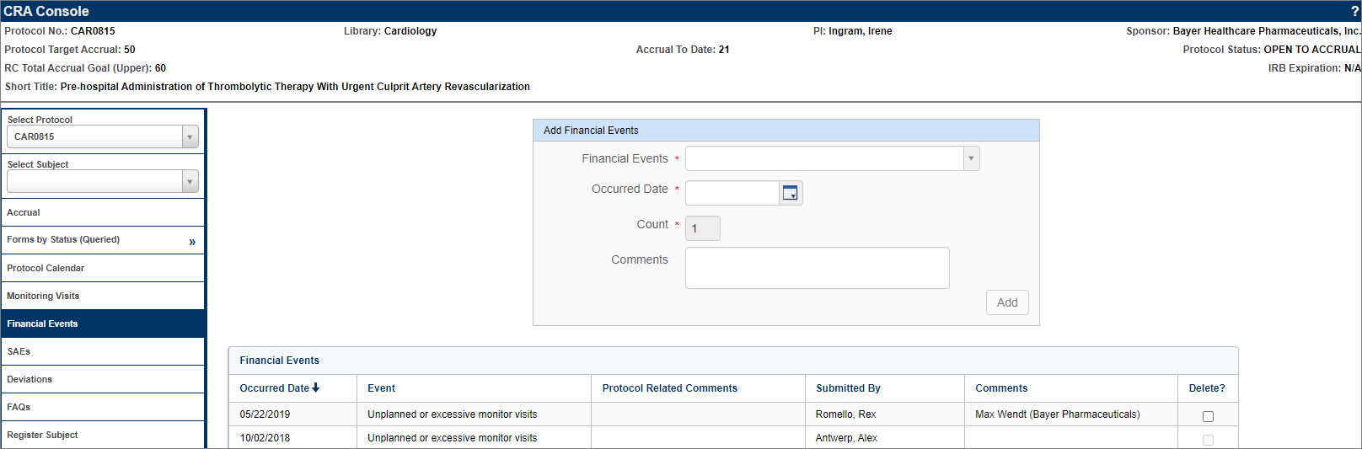
Financial Events
The Protocol Related tab on the Financials Console identifies all the events that relate to the operation of the protocol as a whole (IRB Amendment fees, Advertising fees, and Monitoring fees). These are fees that are incurred even without a single subject accrued.
On the CRA Console > Financial Events tab, users can select protocol-related budget events that have been assigned the CRA Console trigger type in the Financials Console.

Slide 75
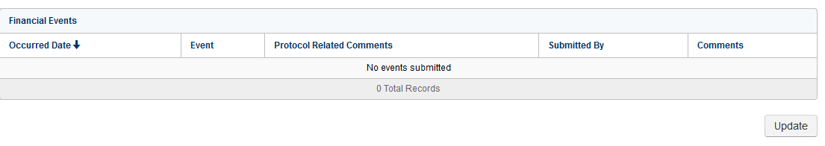
Financial Events
Anything assigned as a CRA Console trigger type on the Financials Console, can be tracked on the Financial Events tab on the CRA Console.
OCR/WISC utilizes an outside vendor, Advarra BOS to develop calendar items, such as dry ice, monitoring visits, etc., for you to track as financial events based on the contract (CTA).

Slide 76
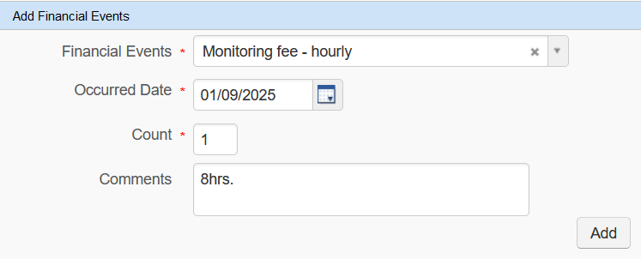
Financial Events
For monitoring visits, the OCR Invoicing would like study teams to indicate the number of hours spent in the comments section and to leave the count as 1.
Example: If the monitor reviews binders for 5 days, then each day enter the number of hours monitored in the comments section.

Slide 77
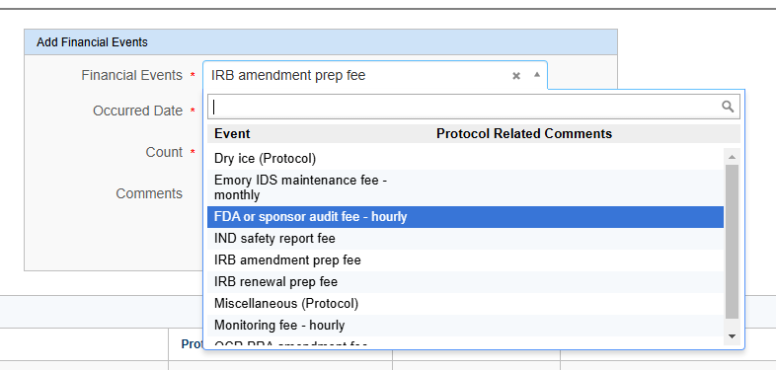
Financial Events - Fees
For OnCore 2.0, study teams will have to track specific administrative fees that OCR Invoicing no longer automatically invoices for but would require your tracking for an invoice to be paid.
Study teams must check this often to ensure they have tracked everything per the contract (CTA).

Slide 78
Financial Events - Fees
For OnCore 2.0, study teams must track specific administrative fees if listed in the Financial Events tab.
Study teams will NOW be responsible for tracking the financial events listed below.
WIRB amendment prep
WIRB renewal prep
IRB amendment
IRB renewal
IDS Pharmacy Maintenance
OCR amendment fee

Slide 79
Financial Events - Auto-Invoiced Fees
OCR Invoicing will auto-invoice for the following administrative fees for the study teams.
Administrative Start-up Costs (inclusive of initial IRB, initial pharmacy, radiology process, and user authorization fees)
Must receive Emory’s eNOA.
Administrative Study Close-out Costs (inclusive of record retention)
Must receive close-out notification from Sponsor.

Slide 80
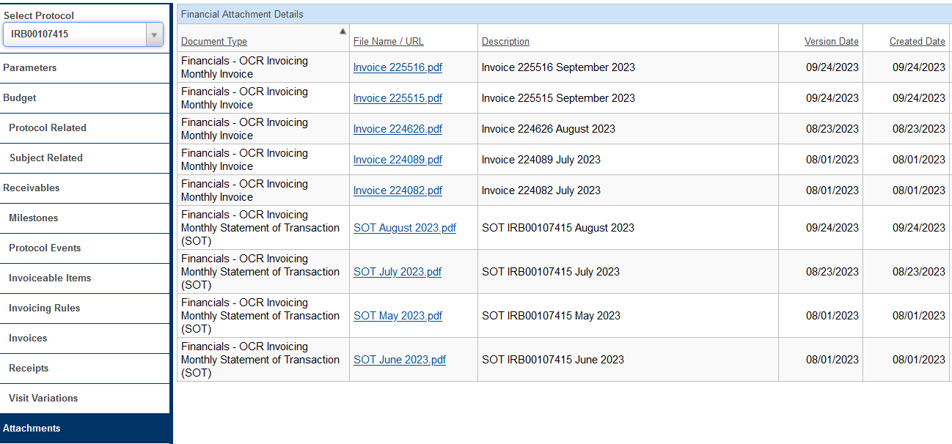
Financial Events – Attachments
Tracked visit information will flow to the Financials Console so the OCR Invoicing team can create Sponsor invoices.
Statements of Transactions (SOTs)
Invoices
Remittances

Slide 81
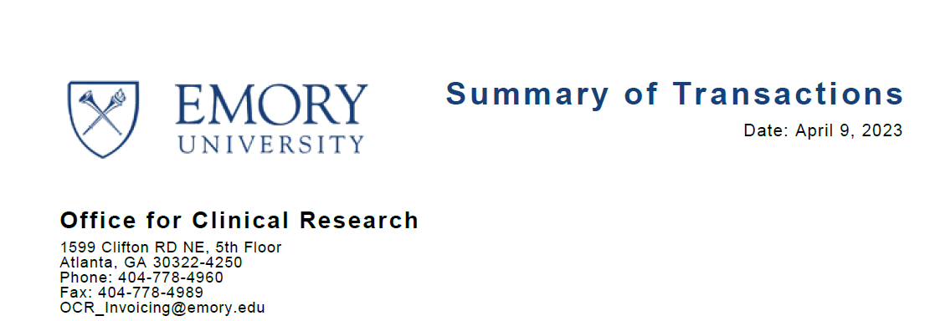
Financial Events – Attachments
Summary of Transactions
Payments received
Invoiceable
Non-Invoiceable
Unapplied
Study Expenses/Subject Reimbursement
Complete the Emory Research Participant Payment Forms on the OCR website.
Outstanding Unpaid Invoices

Slide 82
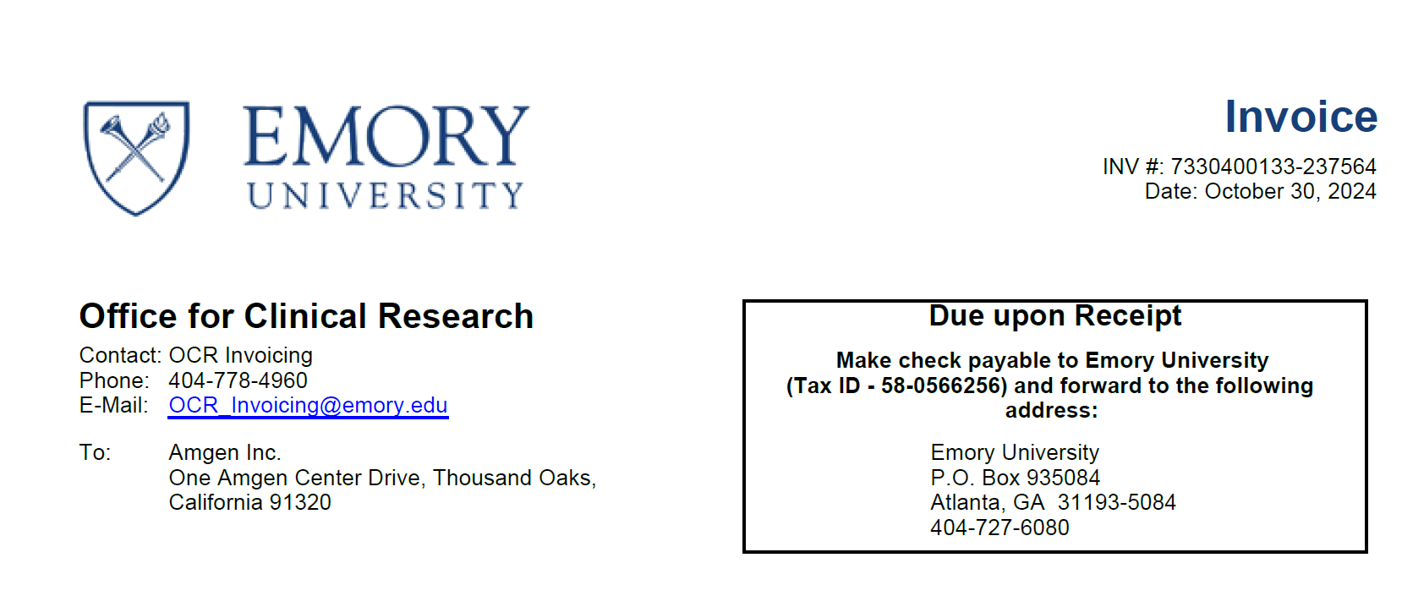
Financial Events – Attachments
Invoices
Sponsor
WIRB
Grady
Most Sponsors pay every 30 days, and we reconcile every 30 days. However, some invoices are due upon receipt, especially for Startup and Closeout. All checks and wires are sent to the Emory Finance Department. RGC will ensure the funds are credited to the account.

Slide 83
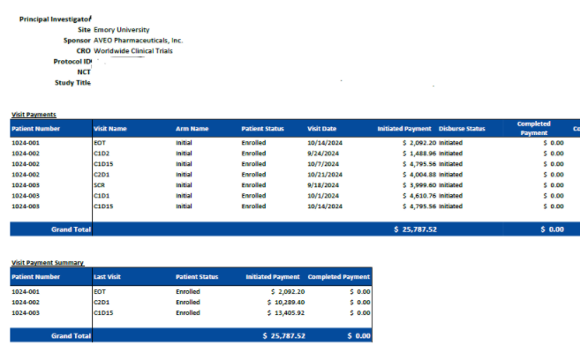
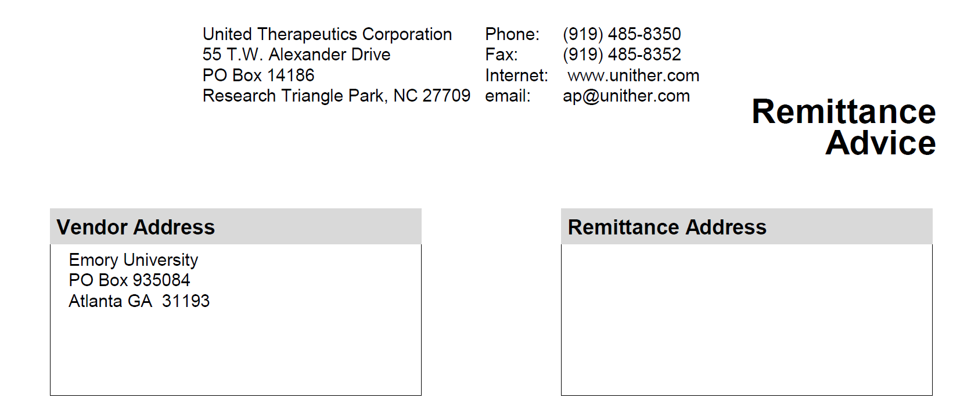
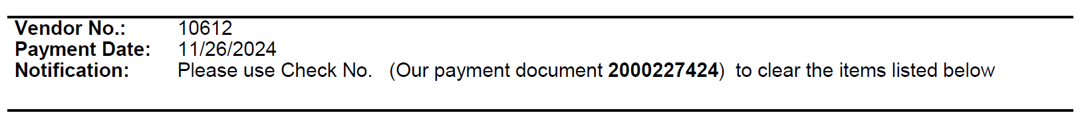
Financial Events – Attachments
Remittances
Sometimes, they are sent with details; sometimes, they are not. OCR Invoicing relies heavily on the tracked visit information to aid in discovery.
With details
Without details

Slide 84
Again … Subject Documentation is Important
Site (Emory)
Sponsor
Document the following: (OnCore, Epic)
  Subject Visit
    Track visits for Invoicing
  Subject SAEs
  Subject Deviations
Document the following: (OnCore, Epic)
  Subject Visit
    Track visits for Payment
  Subject SAEs
  Subject Deviations
Transparency
Compliance

Slide 85
Closeout
Closeout refers to the process of formally concluding a clinical research study within OnCore. It involves documenting that all study activities, data collection, and regulatory compliance are complete, and the study is ready to be closed with the IRB and Sponsor, marking the end of the trial lifecycle within the OnCore platform.

Slide 86
Study Statuses in OnCore

Slide 87
Task Lists
OnCore 570: Task Lists Overview
Study Teams will need to copy and release the Task List template for each study once. You will copy and release the Closeout Task List template. Enter a target date for the first task. Oncore will automatically add the rest of the target dates on the list. Enter the completed date for each task.

Slide 88
Closeout Letter & Documentation
Upload documentation in the PC Console.
Ensure all subjects are Off-Study in OnCore.
Ensure all subjects were moved Off-Study in Epic.
A notification must be sent to OCR_Invoicing@Emory.edu to begin the closeout process of financials.
  OCR Invoicing will notify RAS with a final SOT after all payments have been reconciled and confirmed. This final SOT will assist RAS and RGC with closing out the grant account in Compass.

Slide 89
Amendments
Amendments occur as the protocol, staff, or activities change. This will require a modification submission to the IRB, OCR/WISC, etc.
If there are changes that will affect the financials of the protocol, you must submit a new OCR Clinical Research eForm for either one of the changes:
  Coverage Analysis Only
  Coverage Analysis and Budget
  Budget Only - PreAward
  Budget Only - Invoicing

Slide 90
Task Lists
OnCore 570: Task Lists Overview
Study Teams will need to copy & release the Task List template for each study once. You will copy the Amendment Task List template. Enter the target date and completed date.
Once a target date is entered for the first task, Oncore will add all additional target dates automatically.

Slide 91
Reports Console
Reports Console is a dedicated section within OnCore where study teams can access a variety of pre-built and customizable reports that pull data from different aspects of a clinical trial, allowing them to analyze and visualize information related to study participants, protocol progress, adverse events, and other key metrics, all within a single interface; essentially, it's the hub for generating and viewing data summaries from your clinical trial data stored in OnCore.

Slide 92
Reports
RPE Discrepant Subjects Report
  Administrative > RPE Discrepant Subjects
Subject Visit Tracking Report
  Subjects > Subject Visit Tracking
Invoice Items Report
  Financials > Invoiceable Items
Any custom reports needed will have to be developed by the OnCore Research Informatics team.

Slide 93

Module 3 Quick Tips
Be sure both the EDC and OnCore match for OCR Invoicing before submitting an invoice to the Sponsor for payment.
Document monitoring visits and fees for payment per the contract (CTA).
Upload close-out letters and notify OCR Invoicing at OCR_Invoicing@Emory.edu.
Review reports to verify information that has been tracked, submitted invoices, and payment status.
Submit OCR CR eForm for Amendments, if it affects the financials.
For any Amendments, copy & release the OnCore Amendment Task List and complete all required steps.

Slide 94
MODULE 4

Slide 95

Final Steps
Investigator Users can request OnCore access by contacting the EHI Research Informatics team via Service Now or contacting OCR@Emory.edu.
Training completion will be verified in Brainer for access.

Slide 96

It has been a pleasure training you in OnCore, and we wish you well moving forward!
Contact us at OCR@Emory.edu if you should have any Pre-Award, Post-Award, or Invoicing questions. For OnCore issues or concerns, submit a Service Now ticket.
Don’t forget to review the OnCore Tip Sheets and Workflows.
THANK YOU!

