Slide 1
Emory OnCore
OnCore New User Training
Version 1, 12/3/24

Slide 2
Course Layout
Learning Outcomes
Pre-Requisites and OnCore Tips
Module 1 [Widgets/Task Lists/Staff Roles]
Module 2 [CRA Console, Coverage Analysis Console, eCRF/Calendar, RPE Console, Subject Console]
Module 3 [Financial Console, Closeout, Reports, and Amendments]
Module 4 [Simulations Assessment in Emory Brainer LMS ]

Slide 3
Welcome
Welcome to the OnCore New User Training!
Please be sure you have completed the following:
  Emory Brainer LMS registration and steps.
  View the OCR website on OnCore.

Slide 4
Learning Outcomes
Users will demonstrate proficiency using OnCore for data entry, management, and reporting clinical trial information.
Users will learn to document and update study visit activities and subject data for invoicing and payment.
Users will learn to manage financials for clinical studies using OnCore tools, like reports.

Slide 5

Course Pre-requisites
Listed on the Office for Clinical Research’s OnCore webpage
for Existing Users and New Users.

Slide 6
What is OnCore?
OnCore is a web-based enterprise-wide clinical trials management system (CTMS) that will simplify clinical research management and integrate multiple functions, including protocol administration, participant tracking, and sponsor invoicing.
The OnCore CTMS will align with the Emory Healthcare Epic electronic medical record system to reduce redundancy across the enterprise and enhance patient safety and research billing compliance.

Slide 7
OnCore Libraries
A library is a customized environment for clinical research and data management for different units of an organization utilizing the same CTMS.
There are two libraries in OnCore:
Enterprise – indicated by “Enterprise” for all non-cancer-related studies.
Winship – indicated by “Oncology” for all cancer studies. Some of these are a hybrid between both libraries.

Slide 8
Studies in OnCore
Studies requiring management in OnCore are the following:
  All studies with Emory Healthcare or Grady billable items or services - regardless of sponsor/funder - requiring a Prospective Reimbursement Analysis (PRA) or Coverage Analysis (CA)
  All studies that meet the NIH clinical trial definition regardless of billables (including interventional)
  All studies where the Office for Clinical Research (OCR) performs the invoicing (mainly industry/hybrids)
  All cancer-related, prospectively enrolling studies
If your study is not listed in the categories above, you can enter a shell protocol in OnCore CTMS. Shell Protocols can be created with no calendar, coverage analysis (CA), or budget but allow study/subject coordination as needed.

Slide 9
Definitions
PI Sign-off is site-specific. Emory requests that all PIs or their designees review and approve the Pre-Award OnCore calendar.
An "OnCore calendar" refers to a calendar within the OnCore Clinical Trial Management System (CTMS) that details the schedule of study visits and procedures for participants in a clinical trial. It essentially outlines when each subject should be seen for specific assessments and treatments throughout the study, allowing researchers to track progress effectively and manage data collection across all participants. We will review more in Module 2 of the PPP.

Slide 10
Definitions
OnCore Auto Notifications is an automated email alert sent through the OnCore clinical trial management system. It notifies users about important updates or actions related to a research study, such as when a protocol receives IRB approval, a subject reaches a specific study milestone, or a document needs review. It essentially acts as a reminder or status update within the system and is triggered by events.
  You will start seeing these notifications in your emails after go-live.

Slide 11
Definitions
OnCore Task Lists: This feature within the OnCore Clinical Trial Management System (CTMS) allows users to create and manage lists of tasks related to a clinical research study.
This allows study teams to track individual responsibilities, deadlines, and progress on various aspects of the trial, acting as a centralized to-do list for the research process.
Study teams will only need to copy the task list template for Amendments.

Slide 12
Definitions
OnCore Task Lists: This feature within the OnCore Clinical Trial Management System (CTMS) allows users to create and manage lists of tasks related to a clinical research study.
This allows study teams to track individual responsibilities, deadlines, and progress on various aspects of the trial, acting as a centralized to-do list for the research process.
Study teams will only need to copy the task list template for Amendments and Closeouts.

Slide 13
MODULE 1

Slide 14
Module 1
In this OnCore CTMS 2.0 course, you will learn your role and responsibilities in the OnCore CTMS system for the Enterprise library.
In Module 1, you will learn the following:
  Review the Study Team Workflow in OnCore
  Importance of and how to use an OCR CR eForm
  Review the Navigation –Home Screen and Favorites Bar
  How to use Widgets for Task Lists
  How to add Staff Roles

Slide 15
Enterprise Study Team Workflow
View on OCR's webpage at https://ocr.emory.edu/resources/systems/oncore.html.
  CRC Workflow, version 11-27-2024
  Pre-Award
  Post-Award – Invoicing
  Closeout
  Amendments

Slide 16
OCR CR eForm
The OCR Clinical Research eForm is a new electronic platform implemented by the Office for Clinical Research (OCR) to replace the paper format of several forms used for submissions to various departments at Emory University for clinical research.
Note: This is how your study gets into OnCore CTMS.
OCR PreAward Submission
  Coverage Analysis Only
  Coverage Analysis and Budget
  Budget only (either PreAward or Invoicing)
  Undetermined – Pending OCR Review
Amendments of any kind listed in #1.

Slide 17
OCR CR eForm Access
To access the OCR CR eForm, click on the OCR webpage > Resources.
  For more information about the OCR CR eForm Application:
  View the OCR Clinical Research eForm Guide (v2).
  View the OCR Clinical Research eForm Video.
  Contact OCR@Emory.edu.

Slide 18
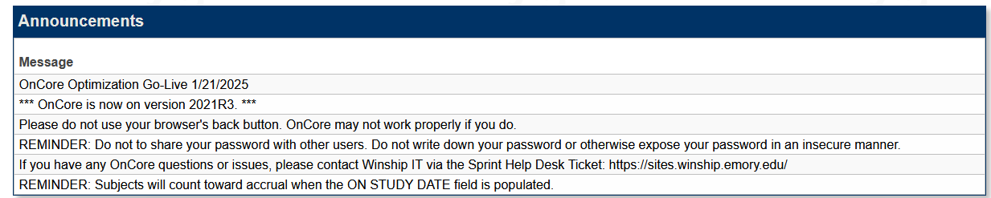
OnCore Login
View OCR’s webpage – https://ocr.emory.edu/resources/systems/oncore.html
Always view the Announcements when you sign in to OnCore.

Slide 19
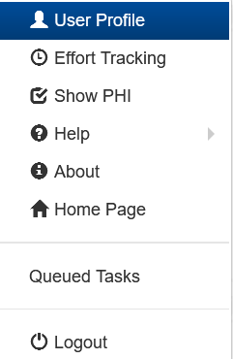
OnCore Login
Underneath your name, you can access the following areas in OnCore:
Note:
Enterprise does NOT use “Effort Reporting.”
You can always show PHI or not, especially if you are training someone or showing data to a Sponsor.
Help is a learner portal that is a quick user guide built within the system. Use it often to understand a specific field in OnCore.
Help also provides access to the Onsemble community, which is a social thread from other sites that use OnCore.
Queued tasks allow you to view the progress of tasks like reports and data imports.

Slide 20

OnCore Jump-To Icon
The rocket icon in the upper right corner of any page in OnCore allows you to move quickly between pages and jump to any location within OnCore.

Slide 21
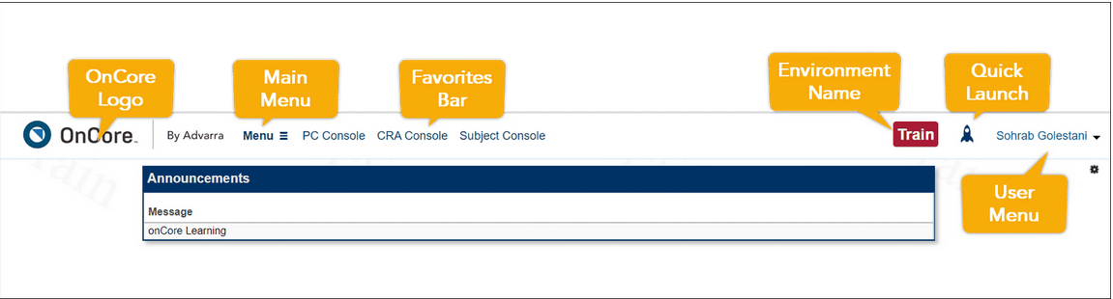
Home Screen and Favorites Bar
Customize your workspace to make OnCore more convenient for you.

Slide 22

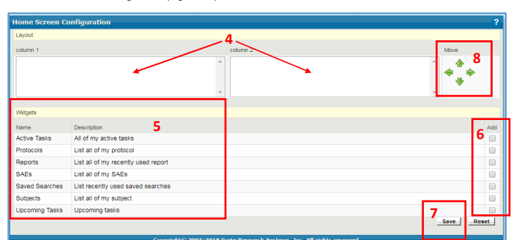

Widgets
Users can set up their home screen to display relevant protocols, subjects, and events in “widgets.”
Each user configures the information and links in each widget. You only need to set up widgets once, but you can always revise them later to suit your needs.

Slide 23
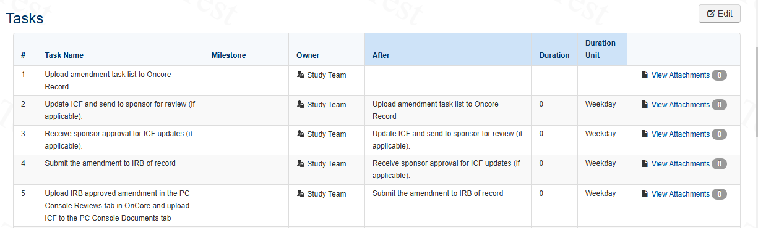
Task Lists
OnCore 570: Task Lists Overview
Study Teams will only need to copy the Task List template for each study once.
You will copy in the Amendments Task List only that has five tasks.

Slide 24
Consoles
You will use several consoles in OnCore to complete objectives for administrative tasks within your studies.
PC Console – study demographics
Coverage Analysis Console – coverage analysis results
eCRFs/Calendars – budget details
CRA Console – register subject
RPE Console – release subject to Epic
Subject Console – update subject visit details
Financials Console – view SOTs and invoiceables
Reports – run specific reports for studies and subjects
Save them to your favorites bar for easy navigation.

Slide 25

Module 1 Quick Tips
Be sure to work with OCR/WISC for studies they manage that meet the OnCore criteria.
Set up widgets and favorites in OnCore.
Add specific Task Lists as needed.

Slide 26
MODULE 2

Slide 27
Module 2
This module covers workflows for viewing and managing subjects using the PC, Coverage Analysis, CRA, eCRF/Calendar, Subject, and RPE Consoles.
Uploading IRB documents
Viewing the Protocol Calendar
Registering a subject
  Viewing Accrual Details
Financial Events
SAEs
Deviations
Notes:
t

Slide 28
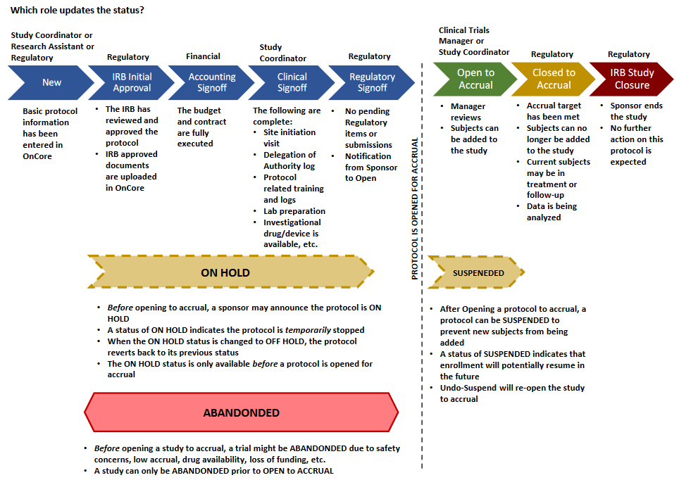
Study Statuses in OnCore

Slide 29
Study Status – Open to Accrual
An eNOA must be received for OCR to open this study to accrual. The Emory IRB will interface with OnCore to provide the following –
Study Approval dates
Continuing Review dates
Informed Consent version dates
Note: The Emory IRB is the source of truth for all IRB-approved documents.

Slide 30
Emory eIRB to OnCore
If you do not see your updated expiration date or approved informed consent in OnCore, please ensure to upload all approval letters and consents into the Emory eIRB system as a “Comment,” especially for external approvals.
Then, contact the OnCore Research Informatics team to manually update your information in OnCore.

Slide 31
PC Console
OnCore 100 - Navigation Guide
The Protocol Coordinator Console is a central repository for protocol information in OnCore.
Displays Protocol Number and Title
Study type
Staff assigned to the protocol
Protocol sponsor
Participating Institutions
Regulatory information
Investigational drug and device information
OCR enters all the data you provided on the OCR CR eForm into OnCore.
However, you will continue to update the staff information after submission. Several roles can be entered.

Slide 32
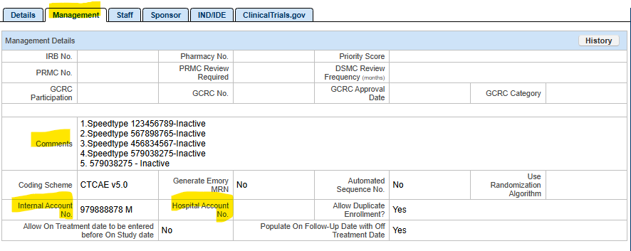
PC Console – Required Fields
PC Console > Main
Management: Enter Inactive Speedtypes in the Comments section.
Internal Account No: is the “Active” Speedtype.

Slide 33
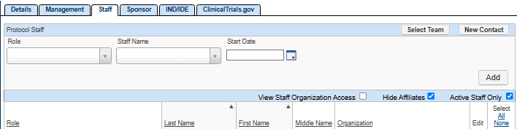
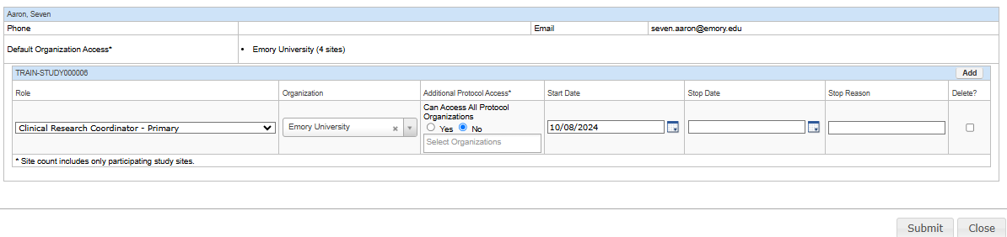
PC Console – Required Fields
PC Console > Main
Staff: Add/delete new staff and roles per DOA log.

Slide 34
PC Console – Required Fields
PC Console > Status > Task Lists
Task Lists
Study teams are to copy the “Amendments” Template when needed.

Slide 35
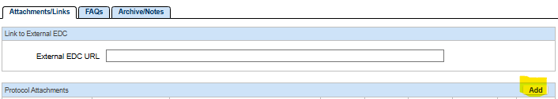
PC Console – Required Fields
PC Console > Documents/Info
Documents/Info
  You can upload documents such as signed consents, closeout letters, etc.

Slide 36
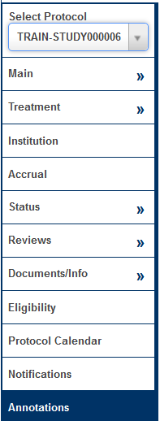
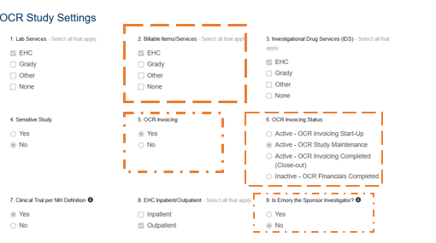
PC Console – Annotations Tabs
OCR Study Settings contain protocol-level information regarding study management.

Slide 37
Coverage Analysis Console
The Coverage Analysis Console is the process of reviewing a clinical trial protocol within the OnCore to determine how each study-related item or service should be billed, whether to the patient's insurance, the research sponsor, or considered a study cost, ensuring accurate billing and compliance with Medicare guidelines; essentially, it's a systematic review to identify who is financially responsible for each aspect of a clinical trial within the OnCore platform.

Slide 38
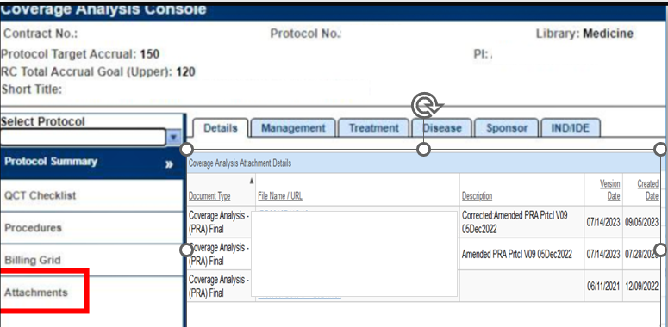
Coverage Analysis Console

Slide 39
OnCore 210 - View and Manage Participants in the CRA Console
CRA Console
The CRA Console is a dedicated section where staff can access and manage detailed information about individual study participants (subjects) within a specific protocol, including demographics, consent status, eligibility, visit details, and adverse events.
This allows you to effectively monitor the progress of a clinical trial at the subject level.

Slide 40
OnCore Calendar
OnCore 260 - Subject Calendars
When the OCR/WISC Pre-Award team releases your study's calendar OnCore, the PI or PI designee must sign off in OnCore. However, the PI must designate/delegate someone on the team to sign off on calendars placed in OnCore.
Note: If you are the PI designee, you will receive a notification on your calendar requesting a quality check and approval.

Slide 41
CRA Console – Protocol Calendar
It shows the expected schedule of events for subjects enrolled in the protocol. The legend indicates who will pay for the procedures listed in the calendar grid. At Emory University, we have the following billing designations:
R = Bill to Research or Sponsor
S (if it is an approved document before October 2022)
C = Bill to the Carrier (Patient or Patient’s Insurance)
M (if it is an approved document before October 2022)
N/A = Not Billable to Patient/Insurance/Sponsor

Slide 42
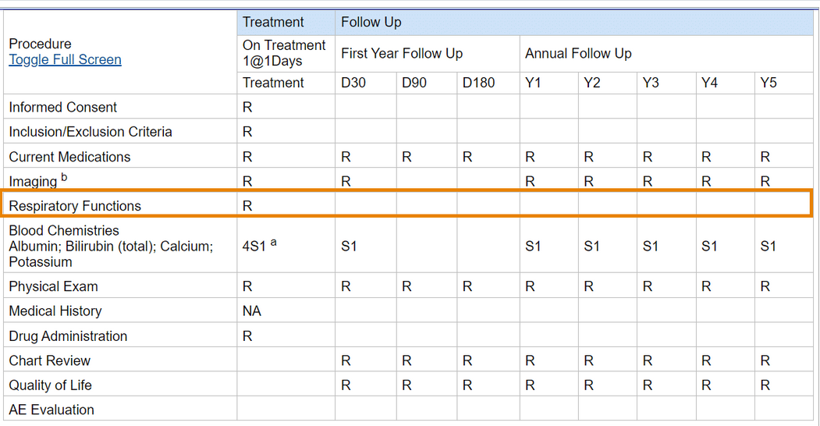
Assessment #1
On the CRA Console, on which visit(s) will you need to assess each subject’s respiratory functions, and who is to pay for it?

Slide 43
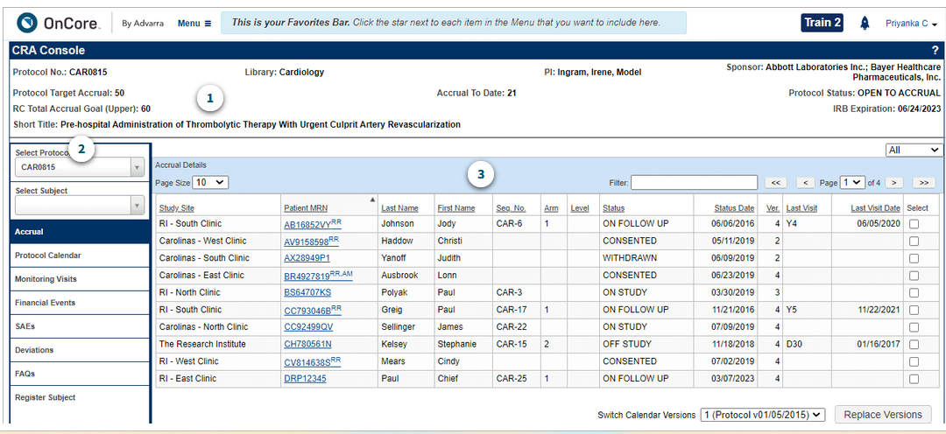
Assessment #4:
Q1: From the Advarra OnCore 210 eLearning module, how many subjects have been accrued to this study, and why?
60
20
50
N/A

Slide 44
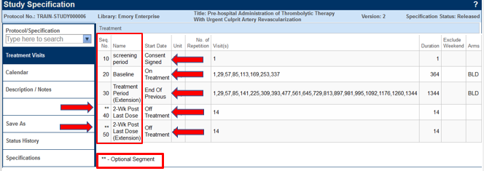
Study Specifications
You can review the study specifications to determine if your study calendar has been Released and if there are Optional Segments.

Slide 45
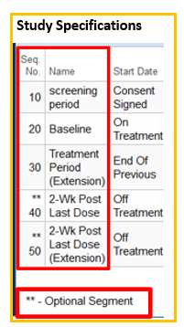
Optional Segments
Optional Segments are used for special scenarios, e.g., (additional screening visits or medication washouts).
These segments are NOT automatically added to subjects’ calendars.
Once a status trigger has been entered in a subject’s record, optional segments can be added.
The following milestones can be used as a trigger:
a. Consent signed
b. On Study
c. Off Treatment
d. Off Study

Slide 46
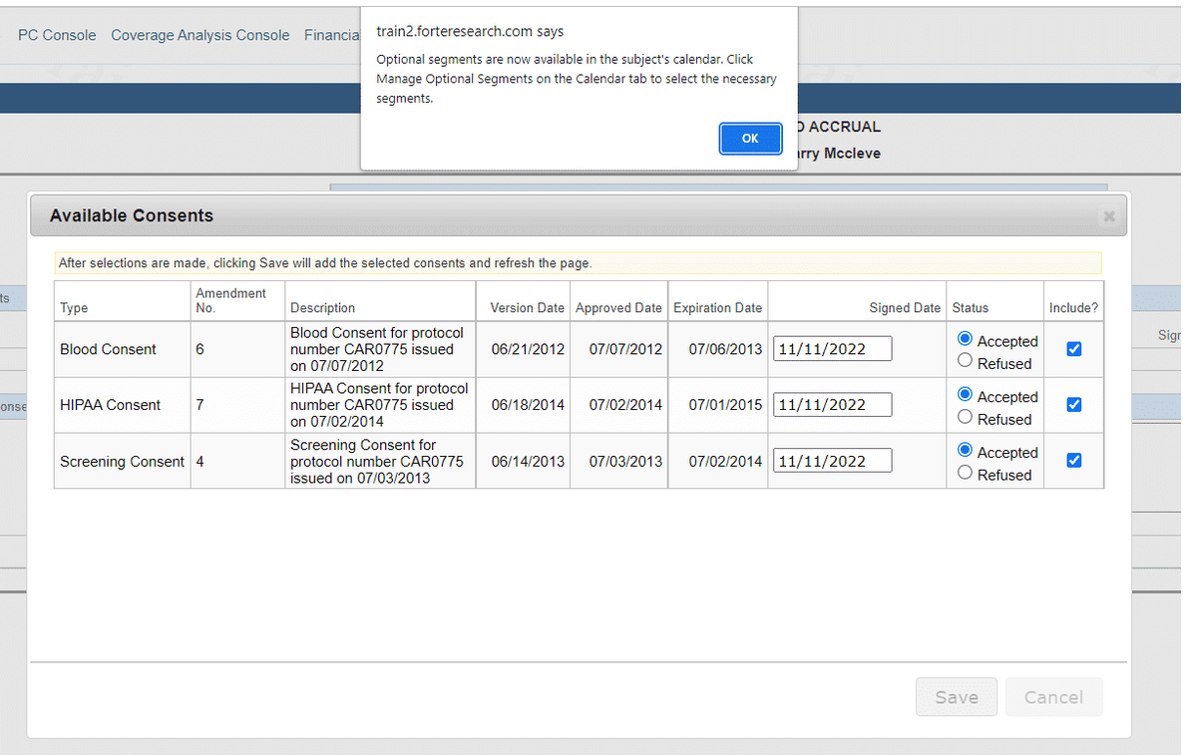
Adding an Optional Segment
When a subject reaches the subject status for an optional event, OnCore alerts the study staff member.

Slide 47
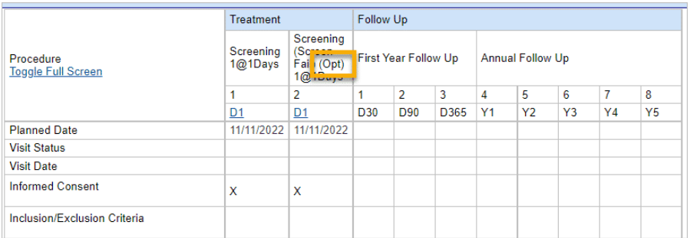
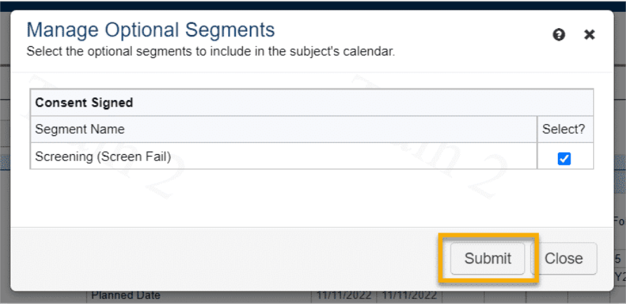
Adding an Optional Segment
The optional segment is added to the subject calendar.
Optional segments are indicated by (Opt).
You can click the Manage Optional Segments button again to select and add a different optional calendar segment or to de-select and remove a particular segment.

Slide 48
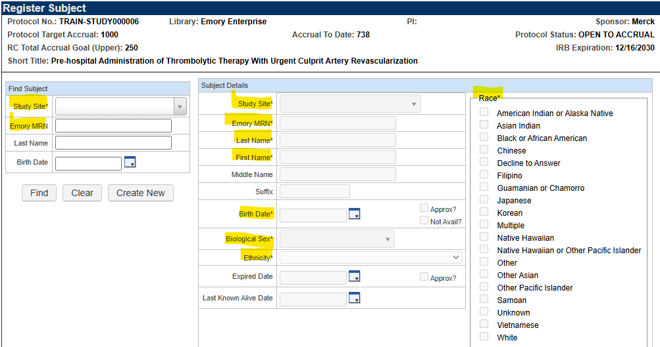
Register a Subject
OnCore 230 - Subject Registration
All required fields must be entered.
MRNs are in Emory Healthcare’s medical record system – Epic.
Do not have OnCore and Epic open simultaneously when looking up the MRN.
Names must match what is in Epic.
If there is no MRN #, submit the MRN Request Form.
Know your site locations, as this determines how you will see and enter data for each site.

Slide 49
Epic – ADT Refresh
When a subject has an MRN, but you are unable to pull the patient up in OnCore, try completing an ADT REFRESH in Epic to push the subject's MRN into OnCore.
Research Coordinator logs into Hyperspace, click the Patient Station Button on the toolbar.
Search for the patient - enter the patient’s Name/MRN and/or Birth Date.
Once the patient chart opens, click Resend Msg button on the Patient Station Activity.

Slide 50
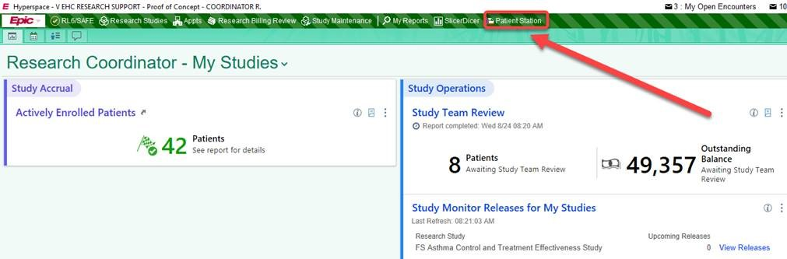
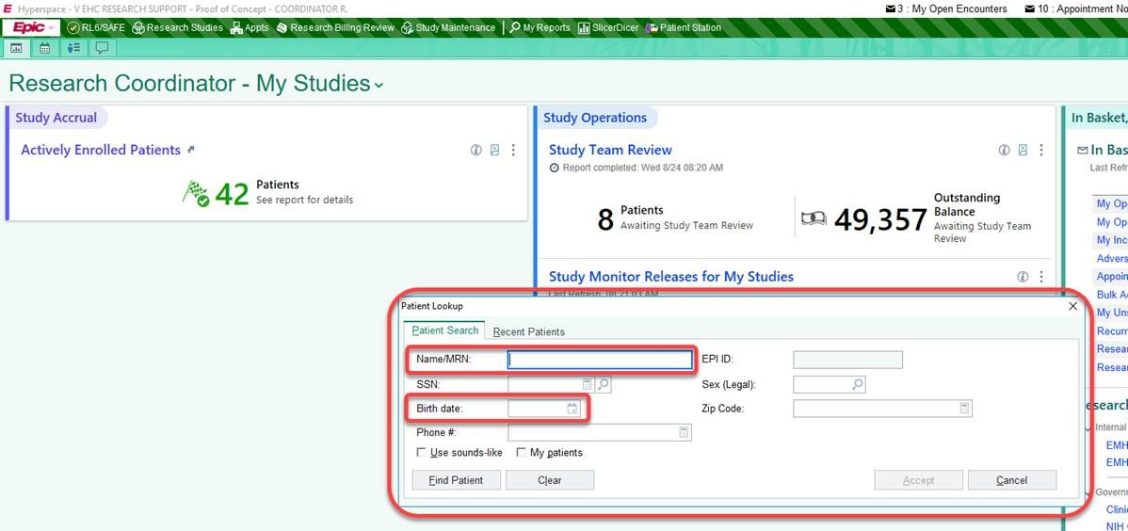
Epic – Patient Station

Slide 51

Subject Registration
After finding the subject and verifying the information, you will be directed to the Subject Console. A message will appear that you have added the subject to the protocol.

Slide 52
Subject Console
OnCore 220: Subjects Console and Companion Protocols
The Subject Console is a tool used in subject management to view and update information about a subject in a clinical trial or health research study.
View subject information: See a subject's demographic information, eligibility status, and consent forms.
Update subject information: Update a subject's demographic information and document their consent.
View subject calendar: Track study visits using the subject calendar.

Slide 53
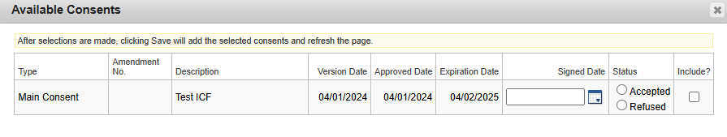
Subject Console
OnCore 240: Consent and Eligibility
OnCore 250: On Study
Select the Main Consent, then enter the date the subject signed and the status.
Note: Consents pullover from
eIRB. If you have an external IRB approval of the ICF, the study team must enter both study and consent approval documents as a comment in eIRB. This helps IT verify the information so that it can be updated manually in OnCore. Please rely on the eIRB system as the record of truth for the study and consent approval documents. If you have concerns or the incorrect consent is in OnCore, email OCR@emory.edu.

Slide 54
Subject Console
Complete the following fields for the registered subject:
Eligibility
  Eligible or not?
On-Study
  The sequence # can be unique if needed.
Treatment
  You must add a Treatment arm based on your coverage analysis results.
Follow-up, when applicable

Slide 55
RPE Console
After entering all subject registration data, you must push that information into Emory Healthcare’s medical records system, Epic.
Follow guidance using the RPE Protocol Push Instructions Guide for steps and how to address failed pushes.

Slide 56
Subject Documentation
Site (Emory)
Sponsor
Document the following: (OnCore, Epic)
  Subject Visit
    Track visits for Invoicing
  Subject SAEs
  Subject Deviations
Document the following: (OnCore, Epic)
  Subject Visit
    Track visits for Payment
  Subject SAEs
  Subject Deviations
Transparency
Compliance

Slide 57
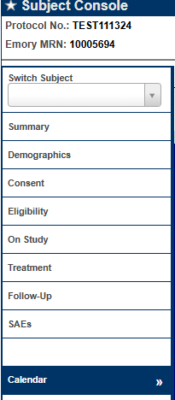
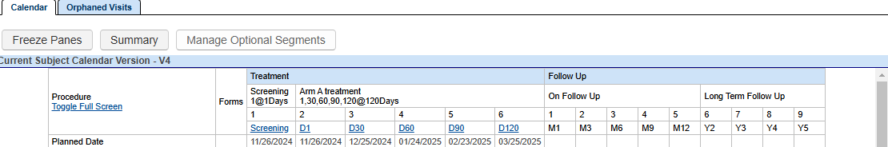
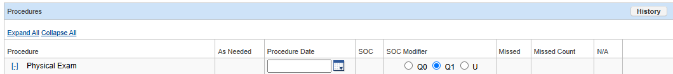
Subject Console – Subject Visit
Indicate visit details as planned, occurred or missed.
If a procedure item did not occur that day, indicate N/A.

Slide 58
Subject Console – Subject Visit
Orphaned Visits can be used to see what was previously tracked from a revised calendar.

Slide 59
Additional Visits
OnCore 330: Additional and Unscheduled Calendar Events
Additional visits are used for the following:
Visit Track unscheduled visits.
Tracking items/services that could not be tracked on the calendar. Invoicing completes invoicing every 30 days, and the calendar cannot be revised.
Studies that do not have visits, but tracking is needed for milestone activities.

Slide 60

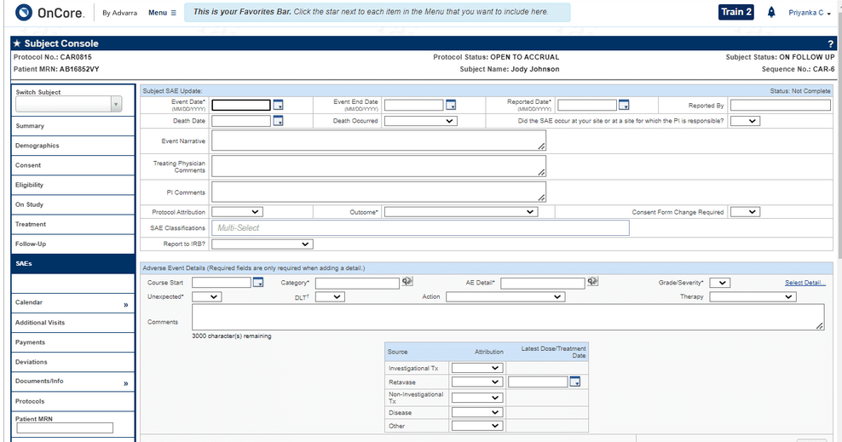
CRA Console – SAEs
If there are ever any SAEs that occur in your trial, it's important to keep clear and reportable records of them to document in OnCore. You will be required to enter the following information, at a minimum, to submit a new SAE.
Event Date
Reported Date: w-2
Outcome

Slide 61
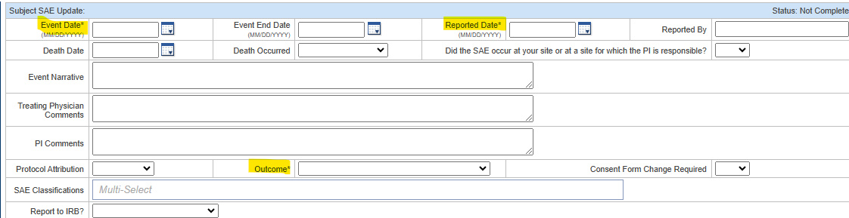
SAEs
OnCore 270: Other Subject Visit Tools
Enter three required fields.
For Enterprise, this information will flow to the Financial Console, where the OCR Invoicing team will invoice the Sponsor for an SAE per the contract.

Slide 62
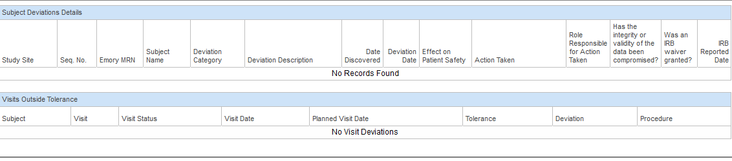
CRA Console – Deviations
OnCore provides a place for study teams to record, display, and update subject deviations that might need to be reported to the IRB and/or the sponsor.

Slide 63
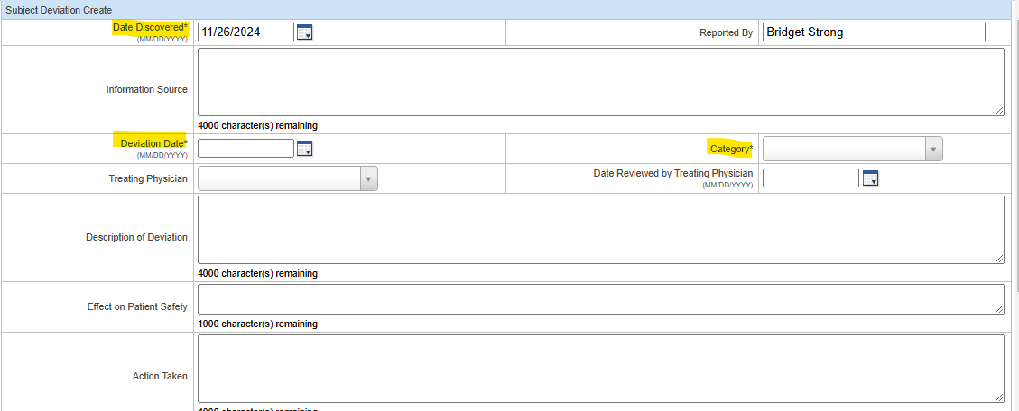
Deviations
OnCore 270: Other Subject Visit Tools
You can track your deviations in OnCore if preferred, as it is an optional entry. You would enter the three required fields.
However, the data should match the information provided to the Sponsor.

Slide 64

Assessment #4:
Q2: True or False?
You can document new SAEs and Deviations in the CRA Console.

Slide 65
Study Statuses in OnCore

Slide 66
Off-Tx, Follow-Up, and Off-Study
As study milestones are met, the subject will enter a status of:
Off Treatment: When the subject is no longer on a treatment drug/device and is in follow-up.
Is the subject Off-Treatment Arm as well?
Follow-up: When the subject is Off-Treatment and being followed until Off-Study.
Off-Study: When the subject has finished all study visits.

Slide 67
Off-Tx
Entering the Off Treatment Date and Reason will activate the treatment segments of the subject calendar that use it as their Start Date.
You can enter details about those visits with this part of the calendar activated. The subject’s status will be changed to Off Treatment.

Slide 68
Off Study
Entering the Off Study Date will activate the segments of the subject calendar that use it as their Start Date. You can enter details about those visits with this part of the calendar activated.
Note: OnCore will check to ensure that the Off Study Date is later than the On Study Date entered on the Subject Console > On Study tab; if not, you will be prompted to confirm the Off Study date.

Slide 69

Module 2 Quick Tips
Be sure your name is added to the Staff tab in OnCore.
Update Speedtypes from eNOA as applicable.
Enter the subject in OnCore on the SAME DAY of consenting and push the subject to Epic.
For external IRB-approved documents, enter in Emory eIRB as a “Comment” and notify OnCore Research Informatics if the OnCore dates and documents are incorrect or missing. Emory eIRB is the source of truth for approved documents.
No two calendars are the same. Contact OCR@Emory.edu for calendar-specific concerns.
Be sure to match what you do for the Sponsor. Also, enter in OnCore for the Site.
7. Track study visits on the SAME DAY of the visit.

Slide 70
MODULE 3

Slide 71
Financial Console
OnCore Financial Console" is a module within OnCore that allows researchers to review all financial aspects of a clinical trial, including budgeting, invoicing, payment reconciliation, and tracking costs associated with study subject visits.
This console is where OCR Invoicing will process invoices for your Sponsor per the contract (CTA) based on the study visits tracked that you learned in Module 2.

Slide 72
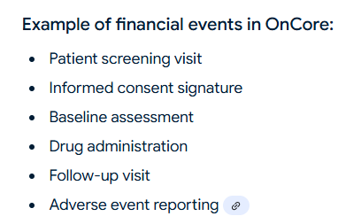
Financial Events
Any significant occurrence within a clinical trial that generates a billable cost, such as a patient visit, specific procedure, lab test, or any other milestone, is tracked and accounted for within the study budget. OnCore allows study teams to generate accurate invoices to sponsors based on the recorded events.

Slide 73
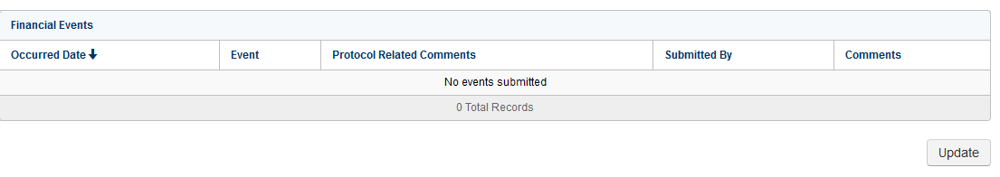
Financial Events
Users can select protocol-related budget events in the CRA Console > Financial Events tab.
OCR/WISC utilizes an outside vendor named BOS to develop calendar items, such as dry ice, monitoring visits, etc., for you to track as financial events based on the contract (CTA).

Slide 74
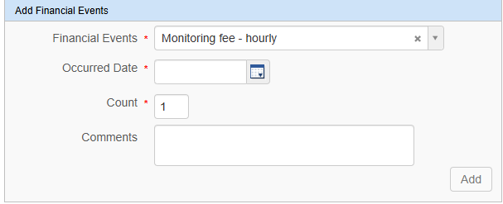
Financial Events
For monitoring visits, the OCR Invoicing would like study teams to indicate the number of hours spent as the count for that specific occurrence date.
For instance, 6 hours spent on October 1 should be indicated in the count as 6. Place any comments needed.

Slide 75
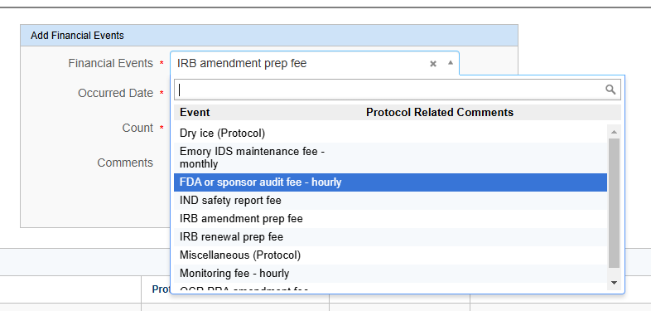
Financial Events - Fees
For OnCore 2.0, study teams will have to track specific administrative fees that OCR Invoicing no longer automatically invoices for but would require your tracking for an invoice to be paid.
Study teams must check this often to ensure they have tracked everything per the contract (CTA).

Slide 76
Financial Events - Fees
For OnCore 2.0, study teams must track specific administrative fees if listed in the Financial Events tab.
Study teams will NOW be responsible for tracking the financial events listed below.
WIRB amendment prep
WIRB renewal prep
IRB amendment
IRB renewal
IDS Pharmacy Maintenance
OCR amendment fee

Slide 77
Financial Events - Auto-Invoiced Fees
OCR Invoicing will auto-invoice for the following administrative fees for the study teams.
Administrative Start-up Costs (inclusive of initial IRB, initial pharmacy, radiology process, and user authorization fees)
Must receive Emory’s eNOA.
Administrative Study Close-out Costs (inclusive of record retention)
Must receive close-out notification from Sponsor.

Slide 78
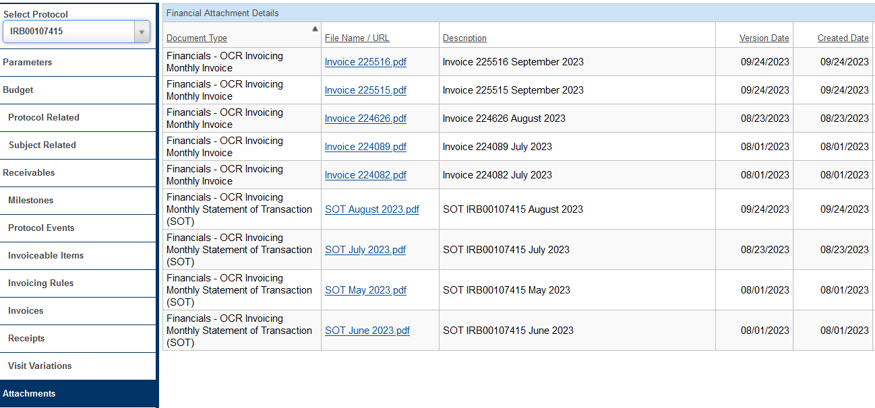
Financial Events – Attachments
Track visits information will flow to the Financials Console so the OCR Invoicing team can create Sponsor invoices.
Statements of Transactions (SOTs)
Invoices
Remittances

Slide 79
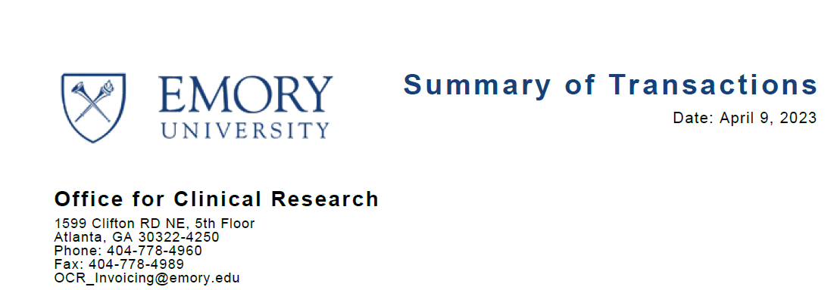
Financial Events – Attachments
Summary of Transactions
Payments received
Invoiceable
Non-Invoiceable
Unapplied
Study Expenses/Subject Reimbursement
Complete the Emory Research Participant Payment Forms on the OCR website.
Outstanding Unpaid Invoices

Slide 80
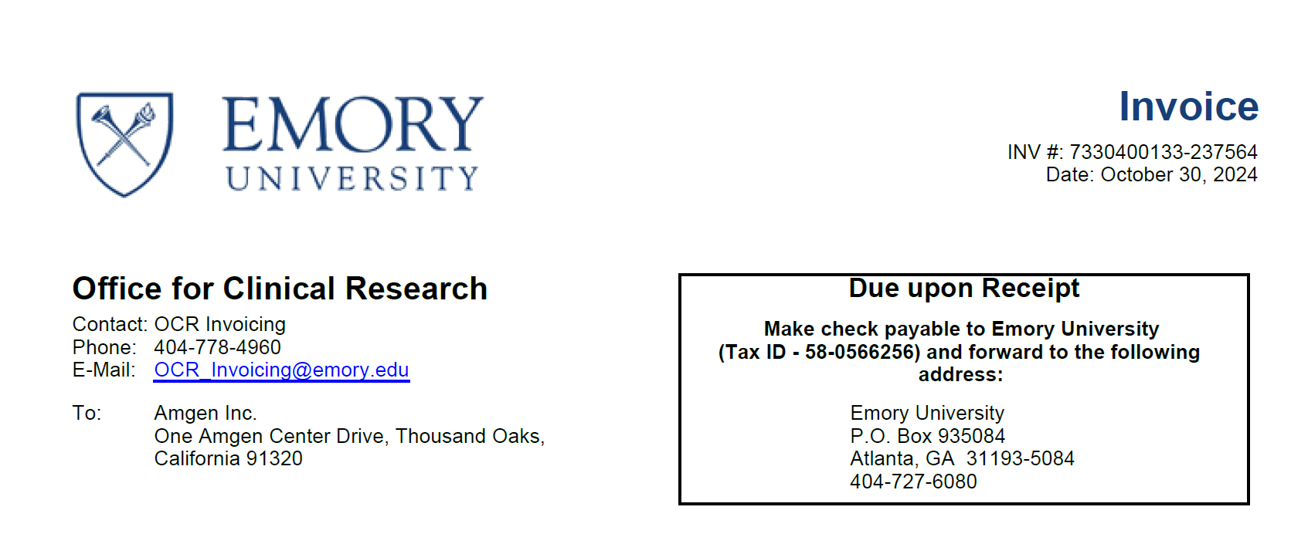
Financial Events – Attachments
Invoices
Sponsor
WIRB
Grady
Most Sponsors pay every 30 days, and we reconcile every 30 days. However, some invoices are due upon receipt, especially for Startup and Closeout. All checks and wires are sent to the Emory Finance Department. RGC will ensure the funds are credited to the account.

Slide 81
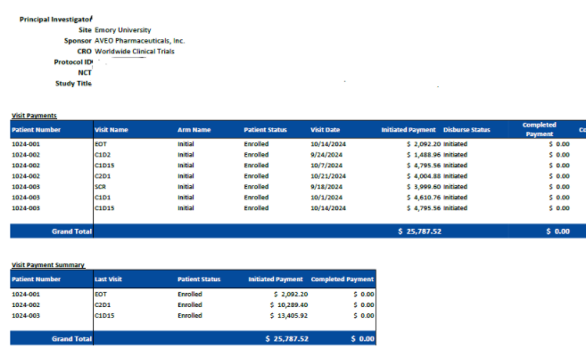
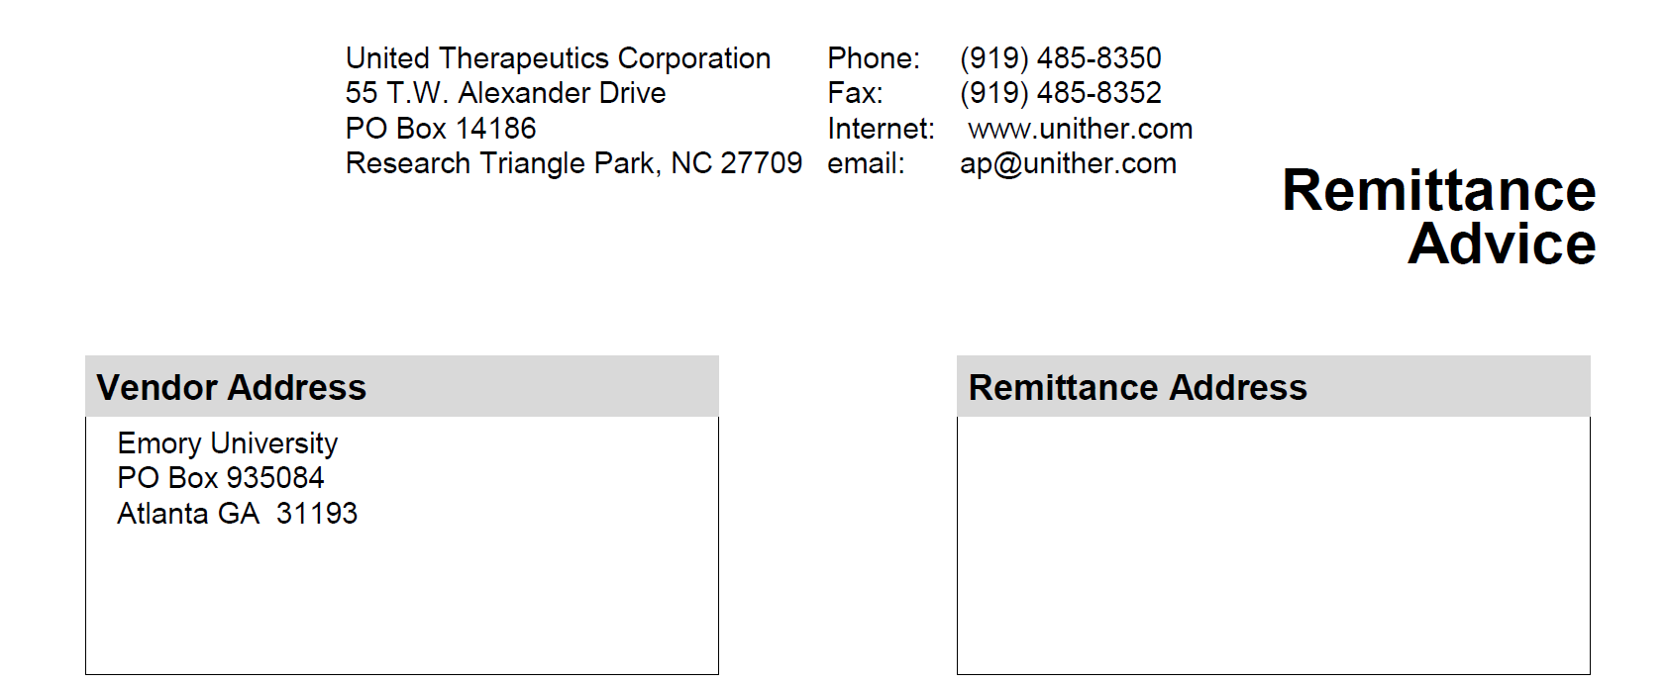
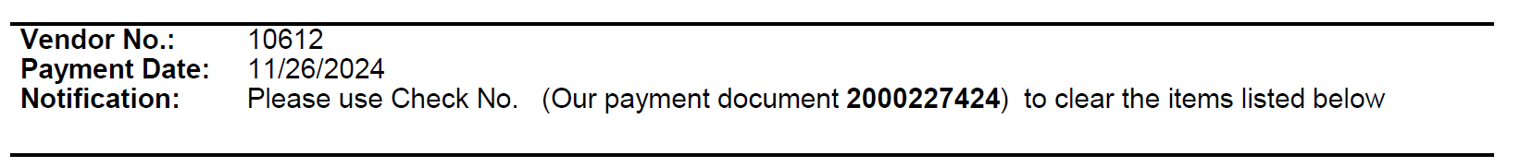
Financial Events – Attachments
Remittances
Sometimes, they are sent with details; sometimes, they are not. OCR Invoicing relies heavily on the tracked visit information to aid in discovery.
With details
Without details

Slide 82
Again … Subject Documentation is Important
Site (Emory)
Sponsor
Document the following: (OnCore, Epic)
  Subject Visit
    Track visits for Invoicing
  Subject SAEs
  Subject Deviations
Document the following: (OnCore, Epic)
  Subject Visit
    Track visits for Payment
  Subject SAEs
  Subject Deviations
Transparency
Compliance

Slide 83
Closeout
Closeout refers to the process of formally concluding a clinical research study within OnCore. It involves documenting that all study activities, data collection, and regulatory compliance are complete, and the study is ready to be closed with the IRB and Sponsor, marking the end of the trial lifecycle within the OnCore platform.

Slide 84
Study Statuses in OnCore

Slide 85
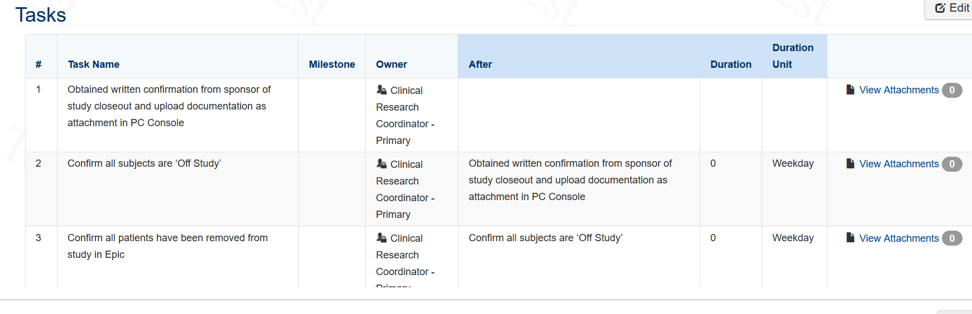
Task Lists
OnCore 570: Task Lists Overview
Study Teams will only need to copy the Task List template for each study once. You will copy the Closeout Task List template.

Slide 86
Closeout Letter & Documentation
Upload documentation in the PC Console.
Ensure all subjects are Off-Study in OnCore.
Ensure all subjects were moved Off-Study in Epic.
A notification must be sent to OCR_Invoicing@Emory.edu to begin the closeout process of financials.
  OCR Invoicing will notify RAS with a final SOT after all payments have been reconciled and confirmed. This final SOT will assist RAS and RGC with closing out the grant account in Compass.

Slide 87
Reports Console
Reports Console is a dedicated section within OnCore where study teams can access a variety of pre-built and customizable reports that pull data from different aspects of a clinical trial, allowing them to analyze and visualize information related to study participants, protocol progress, adverse events, and other key metrics, all within a single interface; essentially, it's the hub for generating and viewing data summaries from your clinical trial data stored in OnCore.

Slide 88
Reports
RPE Discrepant Subjects Report
  Administrative > RPE Discrepant Subjects
Subject Visit Tracking Report
  Subjects > Subject Visit Tracking
Invoice Items Report
  Financials > Invoiceable Items
Any custom reports needed will have to be developed by the OnCore Research Informatics team.

Slide 89
Amendments
Amendments occur as the protocol, staff, or activities change. This will require a modification submission to the IRB, OCR/WISC, etc.
If there are changes that will affect the flow of the protocol or financials, you must submit a new OCR Clinical Research eForm for either one of the changes:
  Coverage Analysis Only
  Coverage Analysis and Budget
  Budget Only - PreAward
  Budget Only - Invoicing

Slide 90
Task Lists
OnCore 570: Task Lists Overview
Study Teams will only need to copy the Task List template for each study once. You will copy the Amendment Task List template.

Slide 91

Module 3 Quick Tips
Be sure both the EDC and OnCore match for OCR Invoicing before submitting an invoice to the Sponsor for payment.
Document monitoring visits and fees for payment per the contract (CTA).
Upload close-out letters and notify OCR Invoicing at OCR_Invoicing@Emory.edu.
Review reports to verify information that has been tracked, submitted invoices, and payment status.
Submit OCR CR eForm for Amendments, especially if it affects the financials.
For any Amendments, copy the OnCore Amendment Task Lists and complete all required steps.

Slide 92
MODULE 4

Slide 93

Final Steps
OnCore 2.0, Simulation Check-Off in OnCore.
  Everyone must complete this step (Superusers, Users, and New Users).
New users can request OnCore access by contacting the OnCore Research Informatics team via Service Now or contacting OCR@Emory.edu until 1/21/25.
Training completion will be verified in OnCore for new access.

Slide 94

THANK YOU!
Review OnCore Tip Sheets and Workflows.

