Slide 1

Research Matters
Office for Clinical Research
February 18, 2021

Slide 2
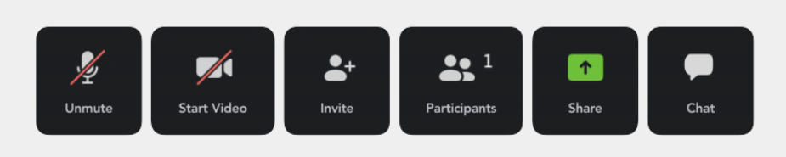
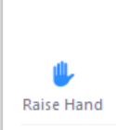
ZOOM Icons

Slide 3
Agenda
11:30 am – 11:35 am Welcome & General Announcements John Doan, MD
Research Services Consultant
Emory University, Office for Clinical Research – Education & Outreach
11:35 am – 12:05 pm COVID-19: The Need for Clinical Trials
Includes Q&A Neal W. Dickert, MD, PhD
Associate Professor
Emory University, SOM: Cardiology
12:10 pm – 12:40 pm Tackling COVID-19
Includes Q&A Marybeth Sexton, MD
Assistant Professor
Emory University, SOM: Infectious Disease
12:45 pm – 1:00 pm Vaccination: COVID-19
Includes Q&A Sam Shartar, MSN, RN, CEN, FAAN
Director of Operations and Senior Administrator
Emory University: Critical Event Preparedness and Response (CEPAR)
1:00 pm Closing Remarks John Doan, MD
Research Services Consultant
Emory University, Office for Clinical Research – Education & Outreach

Slide 4
Objectives
Reasons for further research and clinical trials
Strategy for fighting the COVID-19 pandemic
Vaccination Updates from CEPAR

Slide 5
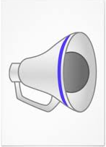
Announcements
General Announcements

Slide 6

February 2021

Slide 7

OCR News

Slide 8
Human Subjects Research Related
External monitors and auditors
Human Subjects Research Related | Emory University | Atlanta GA
https://www.emory.edu/forward/resources/policies-guidelines-protocols/visitor-policy/human-subjects-research-related.html
On the Emory Forward website
Scroll down to Research Study-Monitor and Support section
Not the vendor section
Link entitled “application.”

Slide 9
COVID-19 Vaccine Update & Information
Emory Forward
COVID-19 Information for the Emory Community | Emory University | Atlanta GA
https://www.emory.edu/forward/

Slide 10
OCR News
Job Openings at OCR
Invoicing: Sr. CRFM
CT.gov: Research Service Consultant
CRSS: Clinical Research Navigator
https://www.hr.emory.edu/careers/

Slide 11

Continuing Education Credits
Continuing education credits will be provided in December for all Research Matters educational seminars.

Slide 12
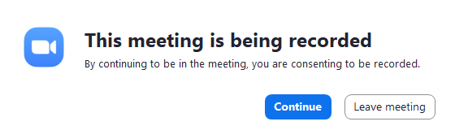
Remember!!!

Slide 13

Emory’s Physicians

Slide 14

COVID-19 Vaccine and the Black Community
A Tyler Perry Special

Slide 15
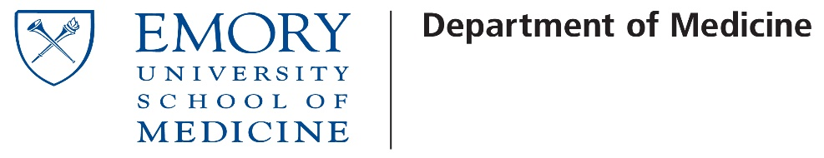

COVID-19: The Need for Clinical Trials
Neal Dickert, MD, PhD
Division of Cardiology and Georgia CTSA Recruitment Center

Slide 16
Disclosures
No commercial interests
Research Support
NIH (NINDS, NICHD, NCATS, and NHLBI)
PCORI
AHRQ
The Greenwall Foundation
DSMB service for clinical trials funded by NHLBI and PCORI
I am a cardiologist and ethicist (not a coronavirus expert…)

Slide 17
Background- The obvious
COVID-19 came on suddenly
We had never seen it before
We had no vaccine and had no drugs…
Three key tasks from a medical prevention/treatment perspective
Develop therapeutic and preventive approaches
Test them quickly and definitively
Disseminate and implement them
All happening in the context of a public health crisis and political environment like we have never seen

Slide 18
Background
Use of unproven therapies is bad
Potential for harm
Lack of benefit
Resource diversion and consumption
Clinical trials are carefully reviewed and monitored (the outside world is not…)
Many promising therapies do not pan out (upper estimate of 13.8%)*
Clinical trials offer a safe and efficient way to learn what works and what does not
Not a tension between ethics and science; the tension is between competing ethical considerations (social value of greater knowledge vs desire to benefit an individual)
* Wong CH et al. Biostatitstics 2019; 20(2).

Slide 19
Outline- focus on ethical imperative for clinical trials
The limits and challenges of observational data
Determining adequacy in trials of novel agents
Comparative designs versus placebo controls
Key elements of ethical clinical trials

Slide 20
The Limits of observational data…
Hydroxychloroquine
Early observational reports suggested overwhelming effect
RCTs were rapidly designed and implemented
FDA issues EUA for HCQ 4/27/2020, prior to any significant RCT data
Drug widely promoted and used
Series of negative RCTs rapidly executed (initiated prior to EUA)
ORCHID enrolled 497 patients between April 2 and June 19, 2020 at 34 hospitals*
Observational data continued
13.5% vs 26.4% in HFH series with significant biases*
EUA revoked 6/15/2020
*Self W et al. JAMA. 2020; Arshad S J Intl Infections Disease. 2020

Slide 21
The Limits of observational data…
Similar issues/tensions with other pre-existing therapies
Convalescent plasma
Ivermectin
Vitamin D
Key Lessons
High-quality RCT data allow for informed decisions
Avoided potential toxicities, resource diversion, etc.
Answers can be generated quickly and accurately
Could have easily been derailed
Unwillingness to randomize
Refusal by participants
Tensions do exist between societal need for robust data and individual clinician/patient orientation

Slide 22
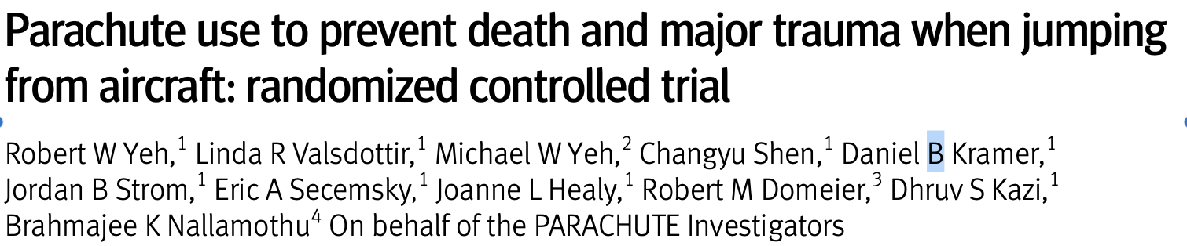

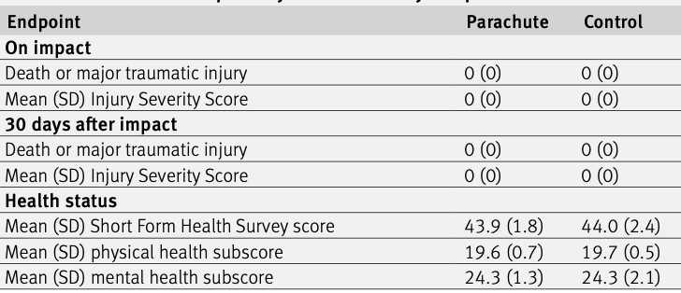
Maybe not everything needs an RCT…

Slide 23
Trials for Novel Agents Face Different Challenges
Observational data are unavailable if the agent is not available for use
Challenge with novel agents are more about the amount of data/experience needed:
To demonstrate efficacy
To demonstrate safety
Remdesivir/ACTT-1*
Stopped early based on hitting primary outcome (time to recovery) but mortality signal was not demonstrated
Based strongly on the view that it was no longer ethical to withhold drug from patients in placebo group
Vaccine trials
Pressure on FDA to authorize early, prior to ensuring 2-months of safety data in Phase III participants
Safety data determined to be crucial
The magnitude of COVID made these issues more acute
*Beigel JS. NEJM. 2020

Slide 24
A Different Stage
Existing therapies complicates conduct of new trials
Two vaccines with EUAs and good data
Therapeutic options
Outpatient- Neutralizing monoclonal antibodies (EUA)
Inpatient- Glucocorticoids and Remdesivir
Need for trials remains substantial but new complexities
Potential resistance by patients (Take what we know works)
Questions about when placebo is ethical
Comparative trials introduce far larger sample sizes and lengthen timelines till completion substantially.
When to offer vaccine to placebo arm of vaccine trials

Slide 25
What makes Clinical trials for COVID-19 ethical
Social or scientific value
Scientific validity
Fair subject selection
Favorable risk-benefit ratio
Independent review
Informed consent
Respect for potential and enrolled subjects
Emanuel EJ, Wendler, and Grady C. JAMA. 2000

Slide 26
What makes Clinical trials for COVID-19 ethical
Social or scientific value
Scientific validity
Fair subject selection
Favorable risk-benefit ratio
Independent review
Informed consent
Respect for potential and enrolled subjects
Emanuel EJ, Wendler, and Grady C. JAMA. 2000
Ethical Concepts!

Slide 27
What makes Clinical trials for COVID-19 ethical
Social or scientific value
Scientific validity
Fair subject selection
Favorable risk-benefit ratio
Independent review
Informed consent
Respect for potential and enrolled subjects
Emanuel EJ, Wendler, and Grady C. JAMA. 2000
5th on the list…

Slide 28
What makes Clinical trials for COVID-19 ethical
Social or scientific value
Scientific validity
Fair subject selection
Favorable risk-benefit ratio
Independent review
Informed consent
Respect for potential and enrolled subjects
Emanuel EJ, Wendler, and Grady C. JAMA. 2000
Critical issues in discussions about RCTs for COVID-19

Slide 29
Fair subject selection
Centered around enrollment of traditionally under-represented populations in trials
Under-represented minorities
Elderly
Significant attention in vaccine trials
Implications for access, science, and downstream uptake
COVE Phase III Trial*
25% >65; 20% Hispanic; 10% Black or African American
Slowed to increase minority enrollment
Ethical need to include populations disproportionately affected
Ethical concerns related to mistrust and hesitancy
*Baden LR et. al. NEJM. 2021

Slide 30
Fair subject selection
Minority enrollment in COVID trials has been highly variable by site
Drivers of under-enrollment are incompletely understood
Data suggest that willingness to enroll may not be the primary issue
Langford AT et al. Cancer. 2014; Wendler D et al. PL:OS Med. 2006; Speight CD et al. AJOB Emp Bioethics. In press.
There are likely large discrepancies in being asked to enroll

Slide 31
Favorable risk-benefit ratio
Common standard = Clinical Equipoise
“Genuine uncertainty within the expert medical community--not necessarily on the part of the individual investigator--about the preferred treatment.” Freedman B. NEJM. 1987
Simple concept; TOUGH to operationalize
Can be hard to know when to start and stop
Certainty is not binary
In the context of COVID, the stakes have been high
The role and impact of DSMBs has been elevated

Slide 32
Conclusion
Clinical trials are the foundation of what we know about what works and what doesn’t
Safe, efficient, and the consequences of not doing them (or of doing them poorly) can be disastrous
They are very much needed for continued progress in the fight against COVID
Challenges are shifting as our armamentarium grows
Real need for dialogue about the essential nature of trials in development of knowledge
Need to understand barriers to participation and inclusion

Slide 33
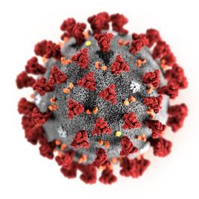
Tackling COVID-19
Marybeth Sexton, MD, MSc
Assistant Professor of Infectious Diseases,
Emory University School of Medicine
Epidemiologist, The Emory Clinic

Slide 34
Outline
COVID trends
What we’ve learned:
Disease presentation
“Long-haulers”
Treatments and ongoing research
Keeping yourself safe
Masking
Distancing
Hand hygiene
What’s new:
Vaccines
Variants
Disparities

Slide 35
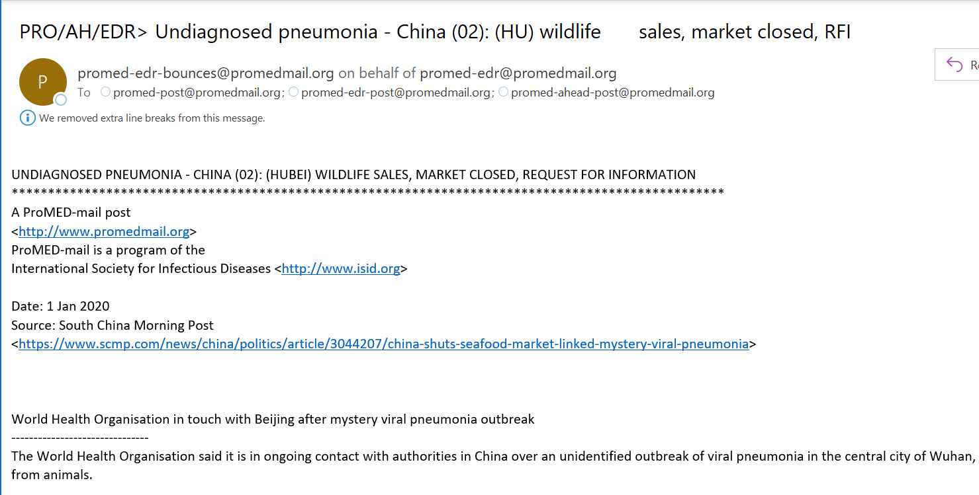

Slide 36
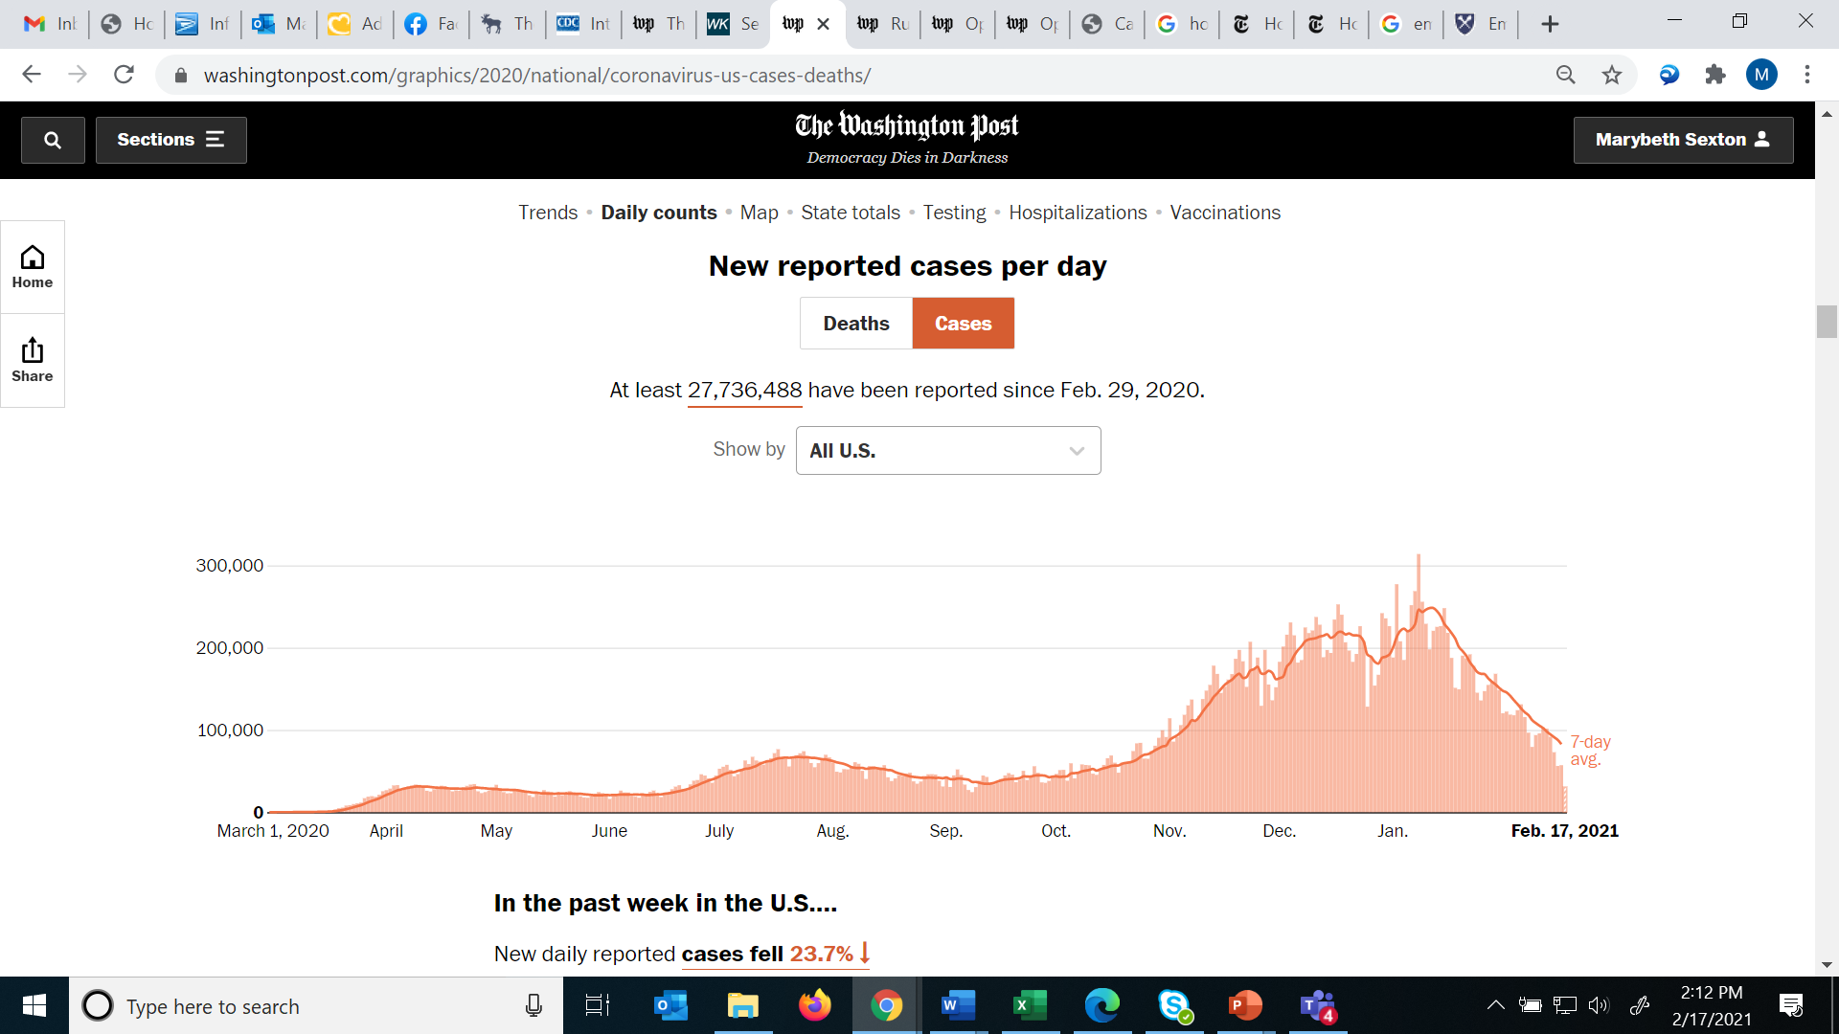

Slide 37
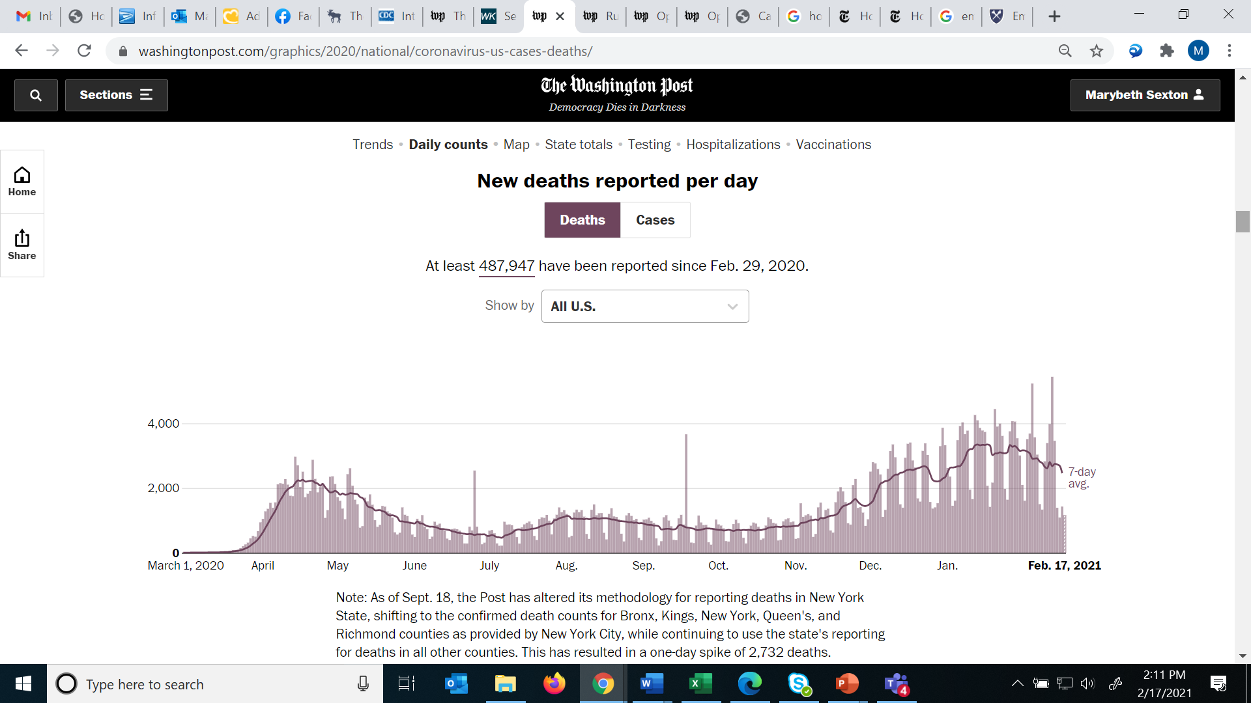

Slide 38
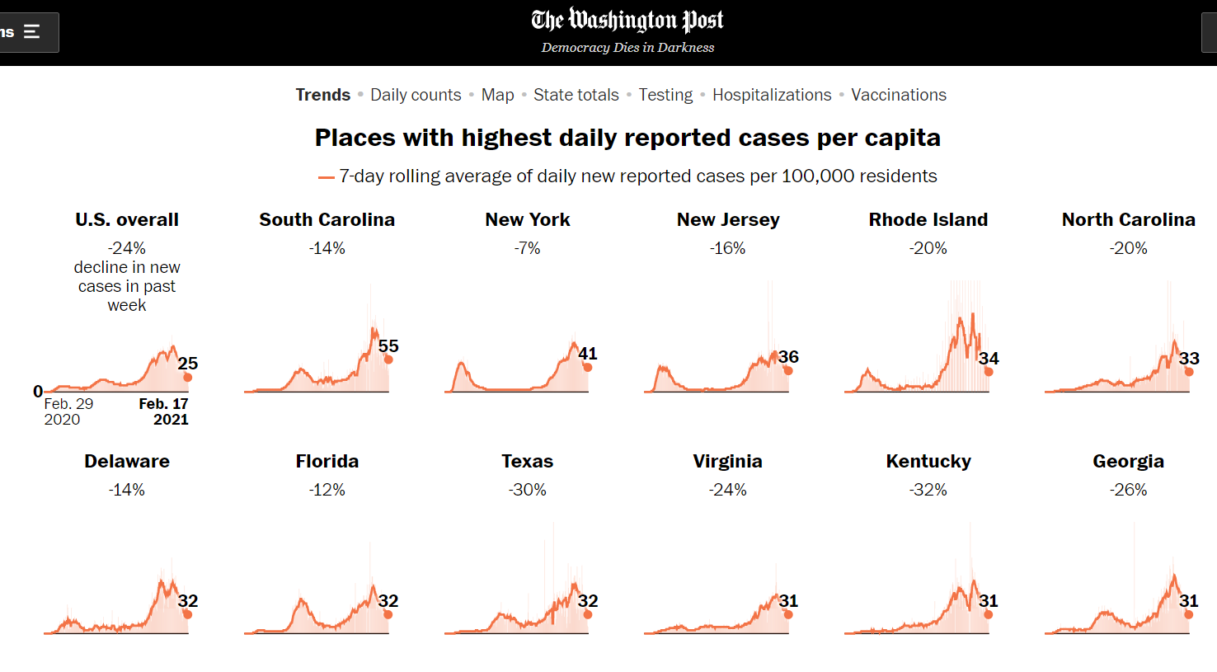

Slide 39
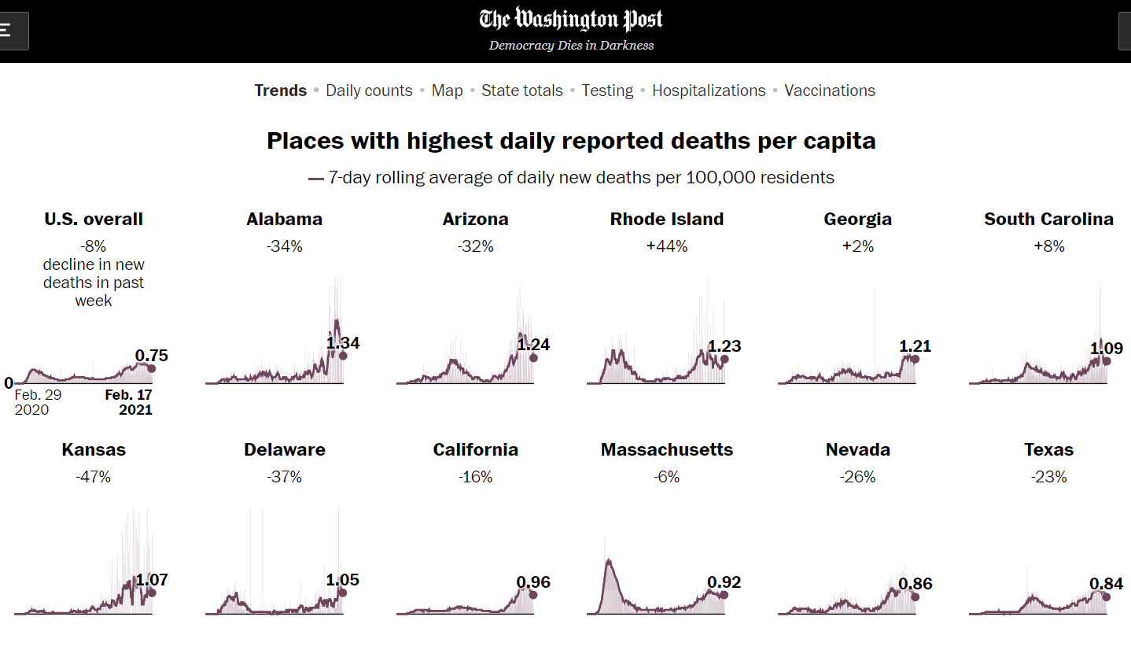

Slide 40
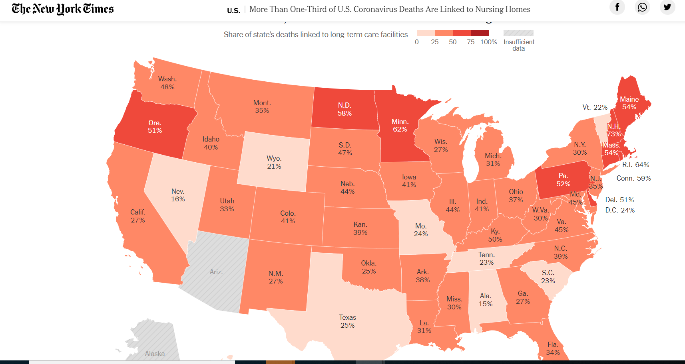
Nursing Home Deaths
https://www.nytimes.com/interactive/2020/us/coronavirus-nursing-homes.html
Notes:
https://www.nytimes.com/interactive/2020/us/coronavirus-nursing-homes.html

Slide 41
COVID Case and Death Rate Trends Over Time
https://www.washingtonpost.com/graphics/2020/national/coronavirus-us-cases-deaths/?itid=sn_coronavirus_1/

Slide 42
What We’ve Learned

Slide 43
Very Varied Presentations
A relatively large number of patients are asymptomatic (CDC estimate of 40%)
Asymptomatic versus pre-symptomatic debate
Symptoms can range from mild to severe (>80% mild in a large cohort)
Symptom list has expanded over time:
Fever/chills
Cough, trouble breathing, congestion, sore throat
Fatigue, muscle aches, headache
Nausea/vomiting/diarrhea
Loss of taste or smell
Notes:
https://www.cdc.gov/coronavirus/2019-ncov/symptoms-testing/symptoms.html
https://www.cdc.gov/coronavirus/2019-ncov/hcp/clinical-guidance-management-patients.html
https://www.cdc.gov/coronavirus/2019-ncov/hcp/clinical-tips-for-healthcare-providers.html
https://www.cdc.gov/coronavirus/2019-ncov/hcp/planning-scenarios.html
https://www.medscape.com/viewarticle/938195#:

Slide 44
Outcomes
In the first 4 months of the pandemic in the U.S.:
~14% hospitalized, 2% required ICU admission
If patients decompensate, usually in the 2nd week of illness
Mortality rates trending between 1.5-2% overall
Likely overestimate given asymptomatic cases may not be included
Rates differ significantly by age group
Some patients are experiencing prolonged symptoms
Estimate of ~10%
Can have problems for weeks-months after initial infection
Notes:
https://www.cdc.gov/coronavirus/2019-ncov/hcp/clinical-guidance-management-patients.html
https://jamanetwork.com/journals/jama/fullarticle/2771111

Slide 45
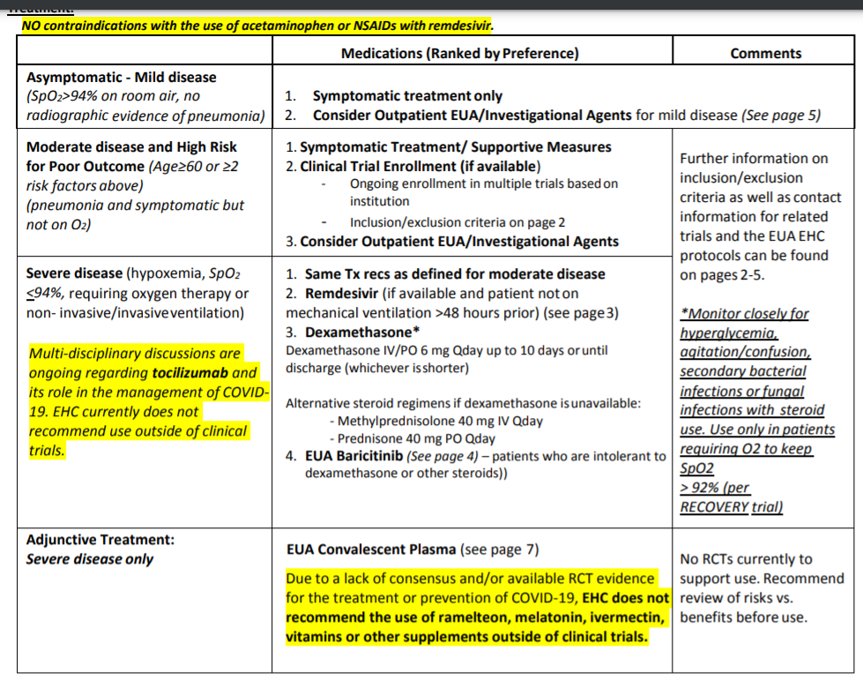
Treatment Options for Hospitalized Patients: EHC Inpatient Guidelines

Slide 46
Treatment Options for Outpatients
Monoclonal antibodies:
Bamlanivimab (Eli Lilly)
Casirivimab/imdevimab (Regeneron)
Both have EUA approvals for outpatient use in high-risk patients
Decreased risk of needing an ED visit or inpatient admission in small studies:
1.6% - 3% of patients receiving mAb
6.3% - 9% of patients receiving placebo
Lilly: https://www.fda.gov/media/143603/download
Regeneron: https://www.fda.gov/media/143892/download

Slide 47
Protecting Yourself Against COVID-19

Slide 48
COVID Transmission
Recent headlines about “airborne transmission” don’t change much about how to protect ourselves
Key definitions:
Aerosols – small particles that can travel some distance and remain suspended in the air
Droplets – larger particles that usually fall to the ground quickly within 6 feet
People usually produce BOTH when they breathe, speak, cough, sing, etc.
The question with respiratory illnesses is which type contributes most to spread
Droplet versus aerosol/airborne spread in COVID:
Both are possible, depending on the circumstances
In general, COVID appears less infectious than other viruses we know are mainly “airborne:”
One person with measles will infect 12-18 other people, and >90% of people in the same house
One person with COVID will infect 2-3 other people, and 20-50% of people in the same house
COVID may briefly behave as airborne in the right situation:
Certain hospital procedures (why we wear different protective equipment)
OR if you get someone highly contagious in a crowded indoor space with poor ventilation, no masks

Slide 49
What Does This Mean?
We all should avoid the types of settings and situations where airborne spread is possible:
Outside > inside
Fewer people > large crowds
Good air flow (open windows, larger rooms, etc) > poor ventilation
Distancing > face-to-face contact
Masks on > masks off
BUT – the same procedures of following the “3 W’s” protect you from both aerosols and droplets

Slide 50

COVID Transmission at Work: Where is The Risk?
Image courtesy of https://businessmirror.com.ph/2018/03/19/risk-assessment-penetration-tests-ethical-hacking/
Notes:
https://businessmirror.com.ph/2018/03/19/risk-assessment-penetration-tests-ethical-hacking/

Slide 51
What We’ve Learned in Healthcare
We all initially worried about our risk from patients
However, we’ve seen only a very small number cases that appear to be patient to healthcare worker (HCW) transmission
The overwhelming majority of infections we think happened at work are HCW to HCW transmission
Carpooling without masks
Masks off in break rooms, work spaces, and nurses stations
Large groups gathering to eat together
Behavior outside of work appears to be the biggest risk of all:
Infections from family members
Visiting restaurants, bars, parties or other large gatherings

Slide 52
So, What Else Can You Do To Protect Yourself?
If you share an office space:
Try to space out desks and improve ventilation (e.g. open doors and windows) as much as possible
Keep your mask on even at your desk if another person is present
When you take breaks:
Do not take your mask off to have coffee, a snack, etc in a group
When you eat lunch or other meals at work:
Similarly, try to avoid eating and drinking around other people who may also have their masks off
Look for a place to eat alone or space out as much as possible
When you’re outside of work:
Don’t let your guard down
Continue masking in public
Avoid large gatherings especially if indoors

Slide 53
The “3 Ws” Guidance
WEAR a mask
1
WATCH your distance
2
WASH your hands
3

Slide 54
Why Have Mask Recommendations Changed Over the Last Year?
Early on:
Very few cases in the US
Spread appeared to be from symptomatic patients
Serious supply chain concerns
No good studies on mask wearing in the community
Now we know:
We have a true global pandemic
There is significant asymptomatic spread
Supply chain can support community use, especially of cloth masks
Initial data suggest masks are highly effective in the community

Slide 55
Mask Wearing: Does it Really Work?
Short answer = absolutely
Protects other people – you won’t put either droplets or aerosols out into the environment if they are blocked by a mask
Protects you, too – increasing evidence for this, especially with a well-fitting mask
Studies and cases:
Amount of coronavirus detected in the surrounding air dropped from ~100,000 viruses to ~0 when infected people put on masks
Study from SARS in 2003 – “frequent mask wearers” were significantly less likely to have gotten infected
Recent review of multiple studies → wearing any mask significantly decreased the risk of getting COVID
Case rates found to be lower in locations with mask requirements → estimate of >200,000 infections prevented through May 2020
Missouri hair salon example:
2 hair stylists worked while contagious but wore masks
Cut 139 people’s hair
No one became symptomatic; the 67 people who got tested were all negative
Notes:
https://wwwnc.cdc.gov/eid/article/10/4/03-0628_article
https://www.preprints.org/manuscript/202004.0203/v1
https://www.nature.com/articles/s41591-020-0843-2
https://jamanetwork.com/journals/jama/fullarticle/2768396
Chu et al. Physical distancing, face masks, and eye protection to prevent person-to-person transmission of SARS-CoV-2 and COVID-19: a systematic review and meta-analysis. Lancet 2020.
W Lyu, GL Wehby, Community use of face masks and covid-19: Evidence from a natural experiment of state mandates in the us: Study examines impact on covid-19 growth rates associated with state government mandates requiring face mask use in public. Heal. Aff,10–1377 (2020).
https://www.cdc.gov/mmwr/volumes/69/wr/mm6928e2.htm

Slide 56
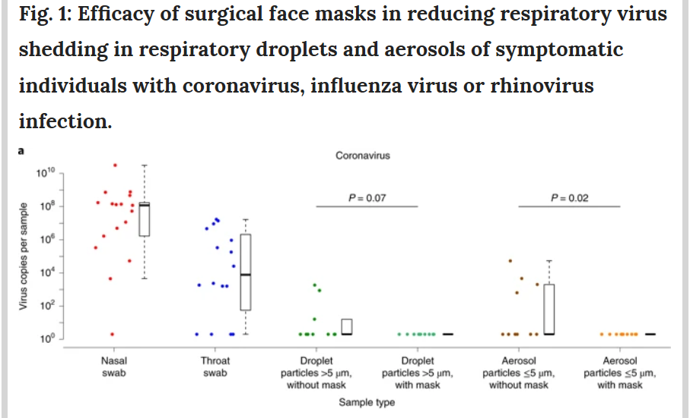
Experimental Evidence
https://www.nature.com/articles/s41591-020-0843-2

Slide 57
The Starbucks Case: An Illustrative Example
A woman with asymptomatic COVID infection went to a Starbucks in South Korea on August 8th and had her mask off while eating and drinking
She was sitting right underneath a blowing air conditioner vent that circulated air throughout the small café
There were 27 other customers infected (ultimately led to 56 total infections)
None of the 4 employees were infected; they all wore face masks at all times
Notes:
https://www.bloomberg.com/news/articles/2020-08-25/this-starbucks-in-south-korea-became-a-beacon-for-mask-wearing
https://www.businessinsider.com/56-got-coronavirus-south-korea-starbucks-mask-wearers-did-not-2020-8

Slide 58
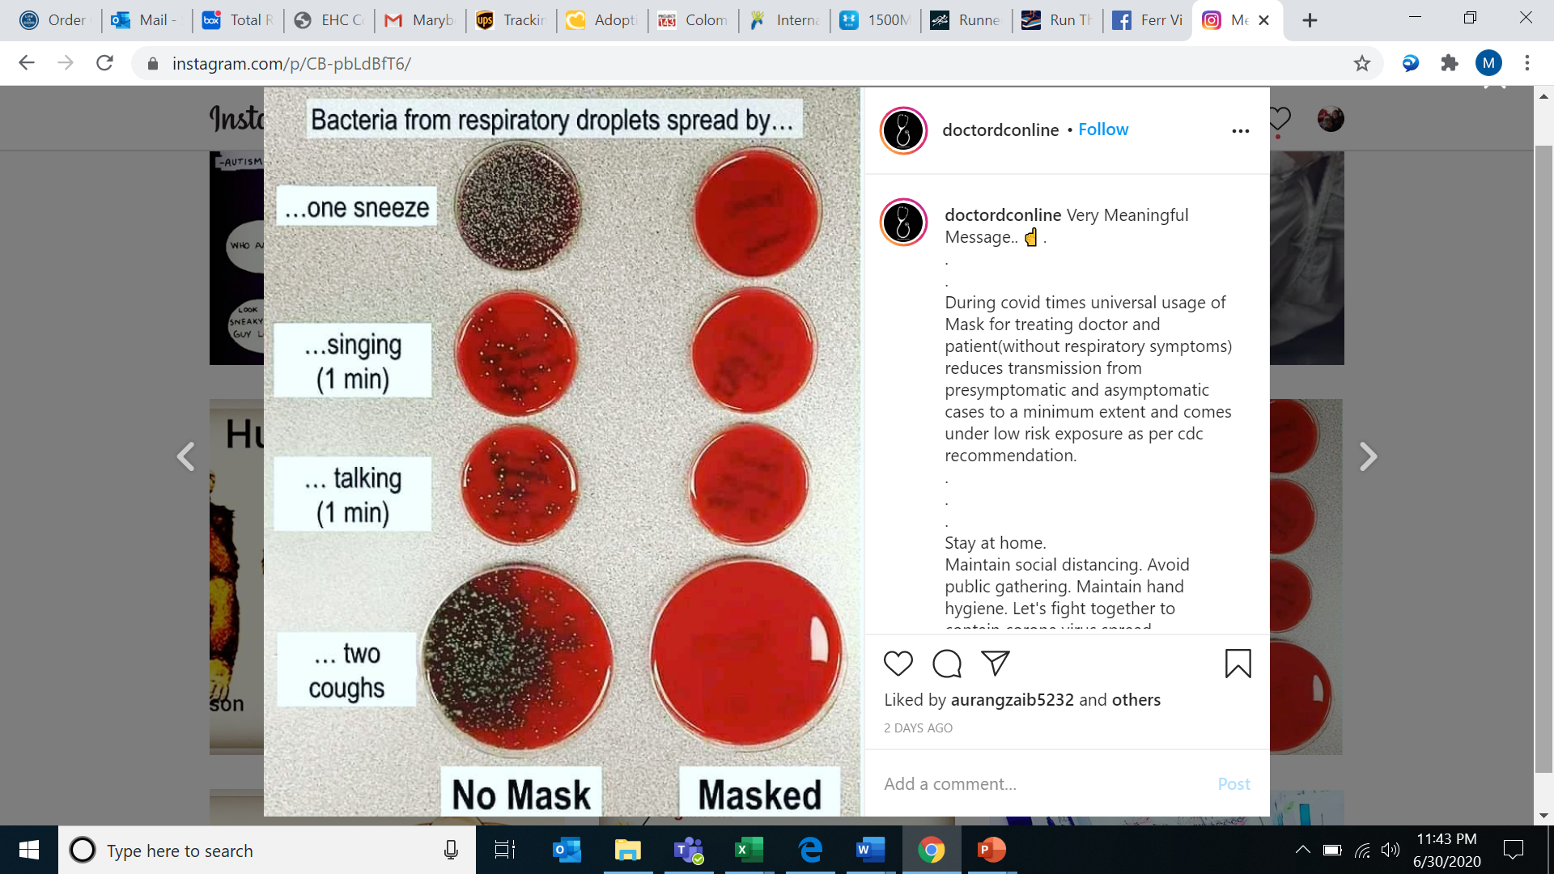
Mask Demonstration
https://www.instagram.com/doctordconline/?hl=en

Slide 59
Do Masks Have Health Risks?
Masks are not recommended in:
Children <2
Anyone with a decreased level of consciousness
Some people with severe underlying lung disease
But otherwise, masks DO NOT:
Decrease oxygen
Increase carbon dioxide
Dampen your immune response
Make you sicker/raise the viral load

Slide 60
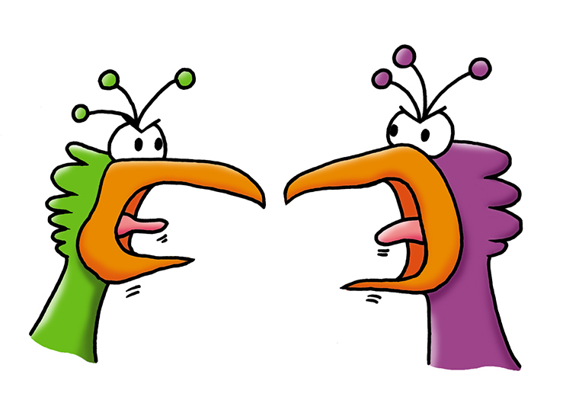
COVID Masking: The Ongoing Debate
Wear one!
Wear two!
Image courtesy of http://clipart-library.com/clipart/pi7rLKAAT.htm

Slide 61
Main Take-Home Points
Masks work to prevent COVID transmission
Masks should be high-quality and well-fitting
You should take any steps you need to for improved mask fit:
Could include adjustments to a surgical/procedure mask:
Ear savers
Ear loop knotting
Folding/tucking fabric at the edges
Could include wearing a cloth mask over a procedure mask
Do what works best for you:
If these modifications worsen fit or make you touch your face/mask frequently, focus on one high-quality mask
Don’t wear a cloth mask alone for a patient/research subject encounters
https://www.cdc.gov/coronavirus/2019-ncov/prevent-getting-sick/cloth-face-cover-guidance.html

Slide 62
Why is Distancing Important if You’re Masked?
None of these interventions works perfectly 100% of the time
The more of them you combine, the closer to 100% you get
Distancing helps in several ways:
If any particles escape someone else’s mask, they may not make it to you
If someone unexpectedly takes off their mask, isn’t wearing their mask properly, or doesn’t have on an appropriate mask, being farther away decreases your risk of infection

Slide 63
Hand Washing Importance
The more we learn about COVID, the more it appears to be almost entirely a respiratory infection
However, it’s still possible that you could touch a surface that droplets or aerosols containing COVID have landed on, and then infect yourself by touching your face
There are also other viruses (flu, RSV, common cold) that have more of a surface transmission possibility, and you don’t want to get those either!
Therefore, you should always wash your hands:
Before eating or drinking
Before touching your face
Before you put on your mask and after you take it off

Slide 64
The Latest COVID-19 News

Slide 65
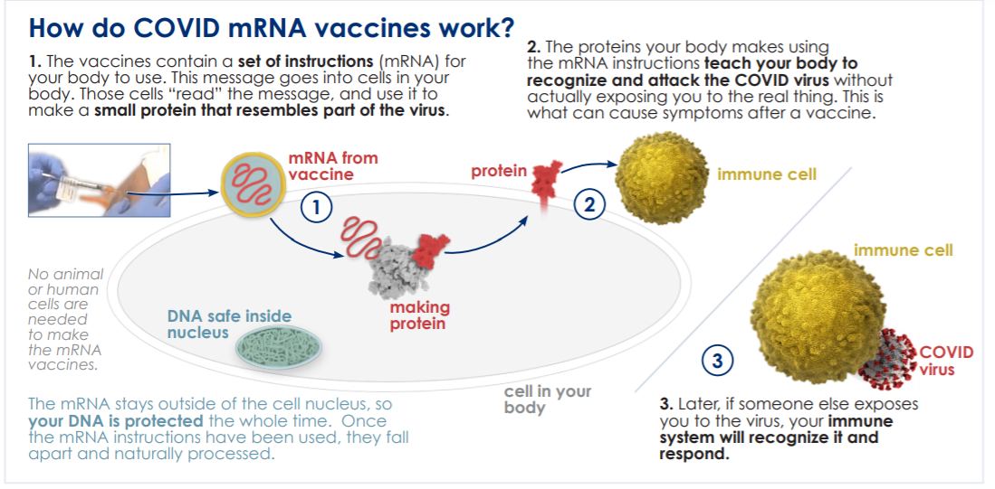
Two Vaccines with EUAs
mRNA vaccines – Pfizer/BioNTech and Moderna
Image courtesy of Michael Konomos, medical illustration

Slide 66
Vaccine Development: How was this so fast?
Built on decades of mRNA vaccine research for vaccines targeted against both infectious pathogens and malignant cells
COVID genome was publicly-available in January 2020
Researchers started work before we’d ever seen a case in the U.S.
No need to grow the virus in a lab
International collaborative effort with many volunteers for clinical trials
For Pfizer: 42% of global/30% of U.S. participants from racially and ethnically diverse backgrounds
For Moderna: 37% of study participants from communities of color
Aggressive spread of COVID allowed trials to reach case numbers needed to detect a difference quickly
U.S. government funded manufacturing prior to EUA approval
https://www.modernatx.com/covid19vaccine-eua/eua-fact-sheet-providers.pdf
https://www.fda.gov/media/144413/download

Slide 67
Safety
Almost 40,000 people received the vaccines in clinical trials
Currently vaccinating >1 million people/day in the United States
No serious safety concerns reported in the trials
Patients had 2 month follow-up post-dose #2 for inclusion in data reporting
Ongoing safety monitoring continues:
Emory monitoring internally
VAERS reporting
V-safe reporting

Slide 68
Immunocompromised Patients
Other than HIV patients, have not been well-represented in clinical trials
However, main concern is about efficacy, NOT safety
Possible that immune response to vaccine may not be as strong
Nothing about mRNA technology or current experience to suggest this should be dangerous in someone immunocompromised
COVID is dangerous in this patient population → vaccination strongly recommended
https://www.cdc.gov/vaccines/covid-19/info-by-product/clinical-considerations.html

Slide 69
Pregnant and Breastfeeding Women
Not included in initial clinical trials
However, new studies are ongoing and 15,000+ pregnant women have registered with CDC’s V-safe database
Similarly, no reason to expect there to be a safety issue, and we know COVID is dangerous in pregnancy
If pregnant women develop a fever post-vaccination, they should immediately take Tylenol
Benefits likely > theoretical risk, especially in those at high exposure risk
Women should talk to their doctor with questions, but not required to in order to proceed
https://www.cdc.gov/vaccines/covid-19/info-by-product/clinical-considerations.html

Slide 70
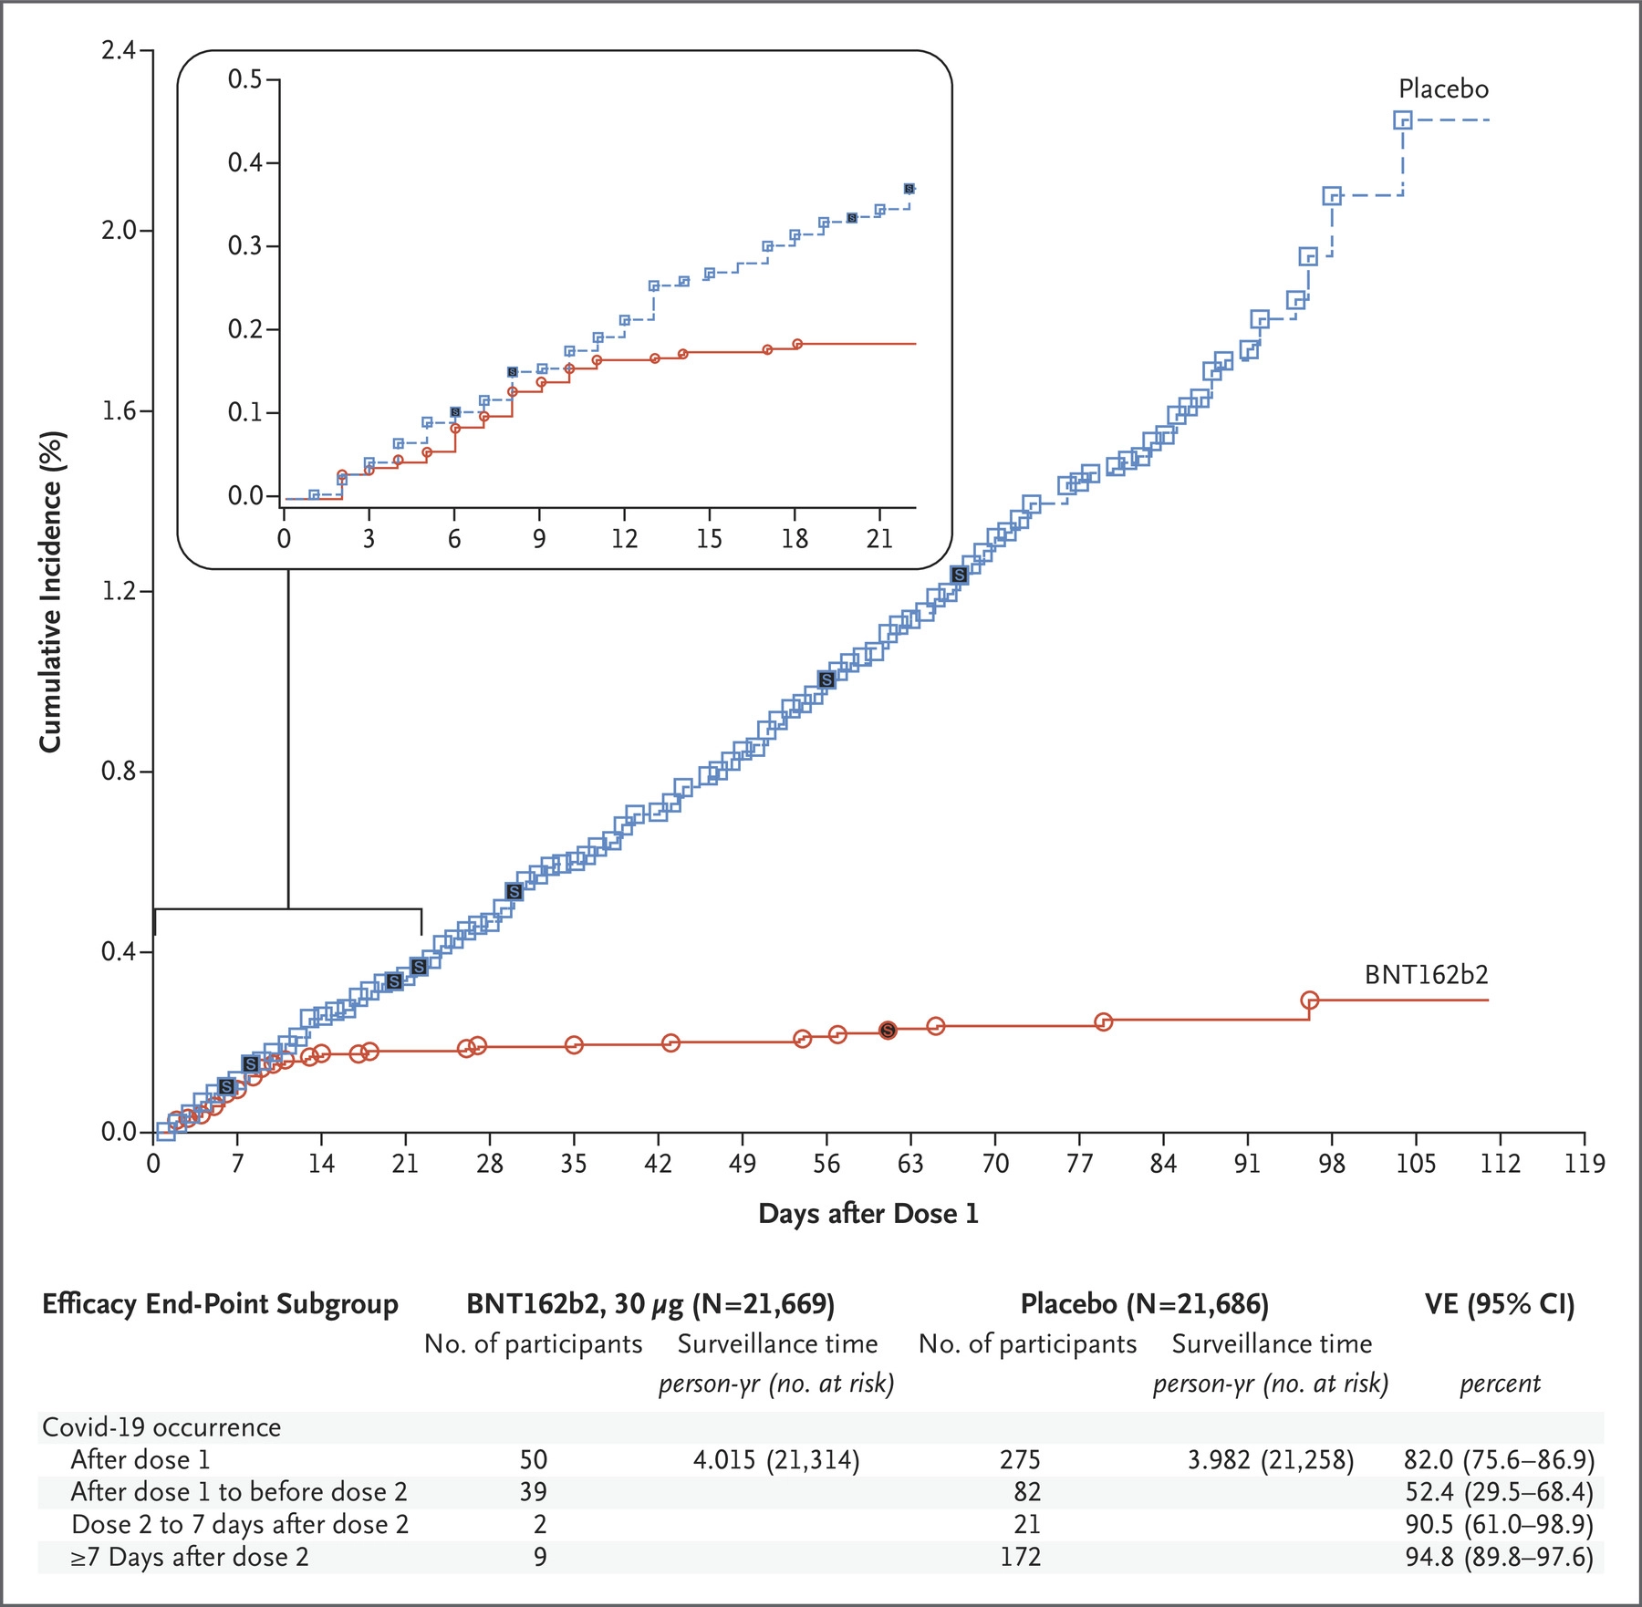
How well do the vaccines work?
Both had ~95% efficacy in preventing symptomatic COVID infections, and almost 100% efficacy in preventing severe disease
Pfizer data:
Curves diverged 12 days after dose #1 (52% efficacy)
Efficacy over 90% by 7 days after dose #2
https://www.nejm.org/doi/full/10.1056/NEJMoa2034577

Slide 71
Side Effects
Can see a range from no symptoms to complaints like arm pain at the injection site, fatigue, body aches, headache, fever/chills
When people do have symptoms, they indicate an immune response to the vaccine
A lack of symptoms does not mean the vaccine did not work
None of these symptoms are dangerous, just uncomfortable
85-90% either have no symptoms, or have mild-moderate symptoms that don’t interfere with daily activities
Still need dose #2 even with side effects to dose #1
Side effects are more common with dose #2 because your immune system is “primed”
https://www.cdc.gov/vaccines/covid-19/info-by-product/clinical-considerations.html

Slide 72
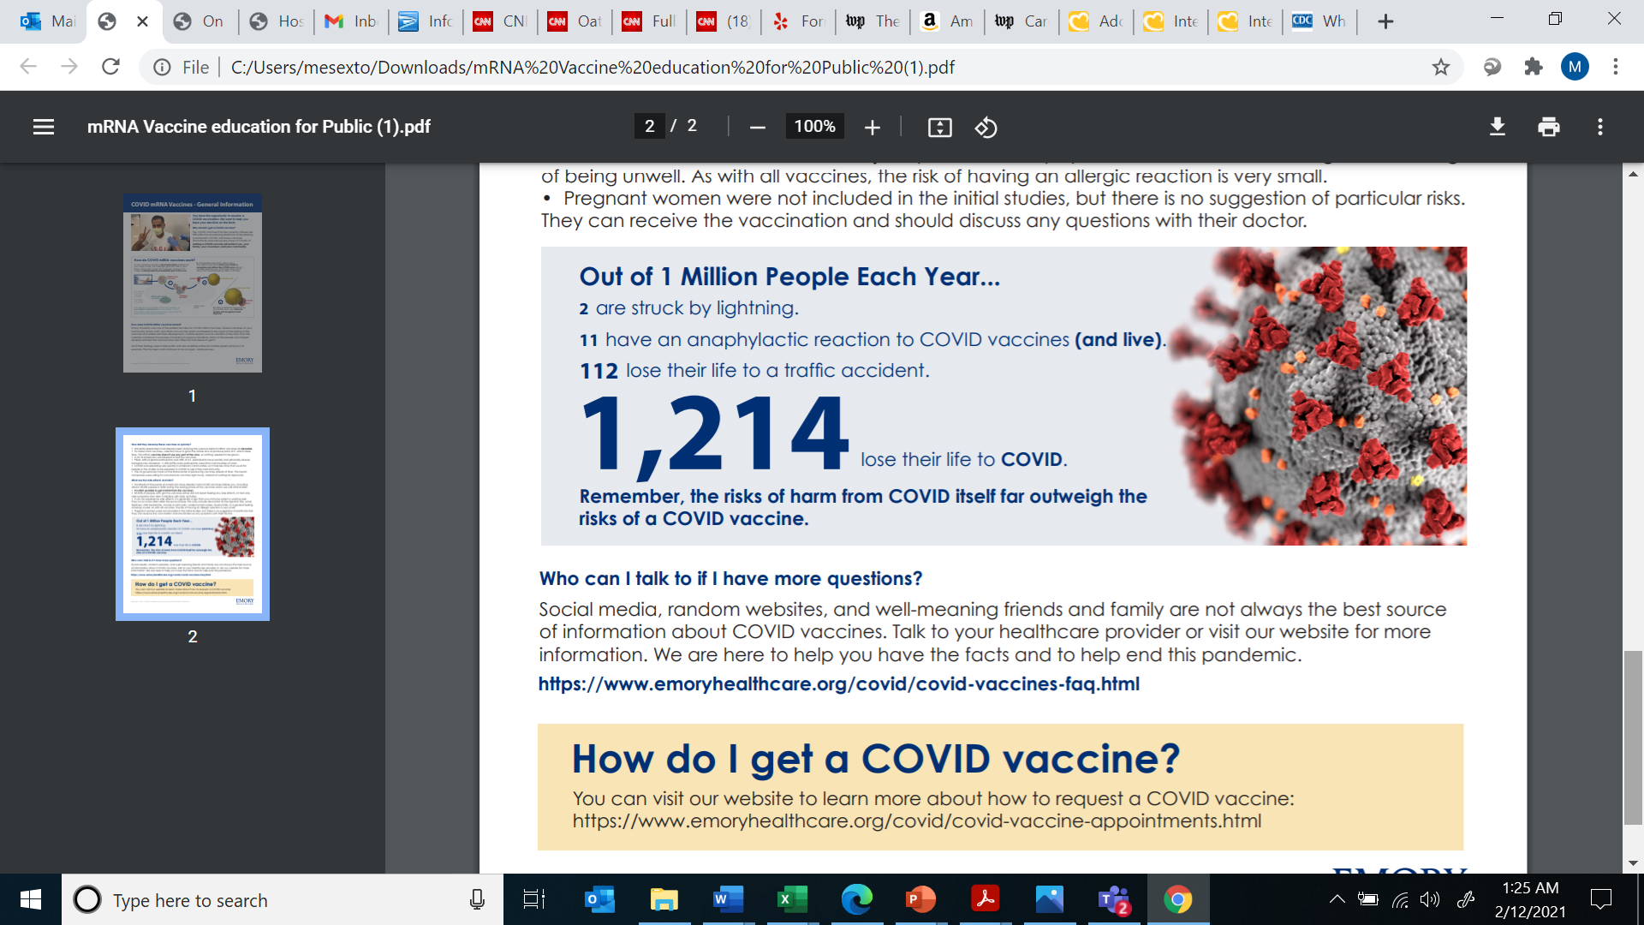
Allergic Reactions
Very rare
People recommended to avoid mRNA vaccines with any history of allergy to the ingredients, or polysorbate
Suspicion re: PEG component as the trigger
Monitoring for 30 minutes post-vaccine with h/o anaphylaxis to something else
Discussion with MD recommended pre-vaccine if prior reaction was to a vaccine or injectable medication
Image courtesy of Michael Konomos, medical illustration
https://www.cdc.gov/vaccines/covid-19/info-by-product/clinical-considerations.html

Slide 73
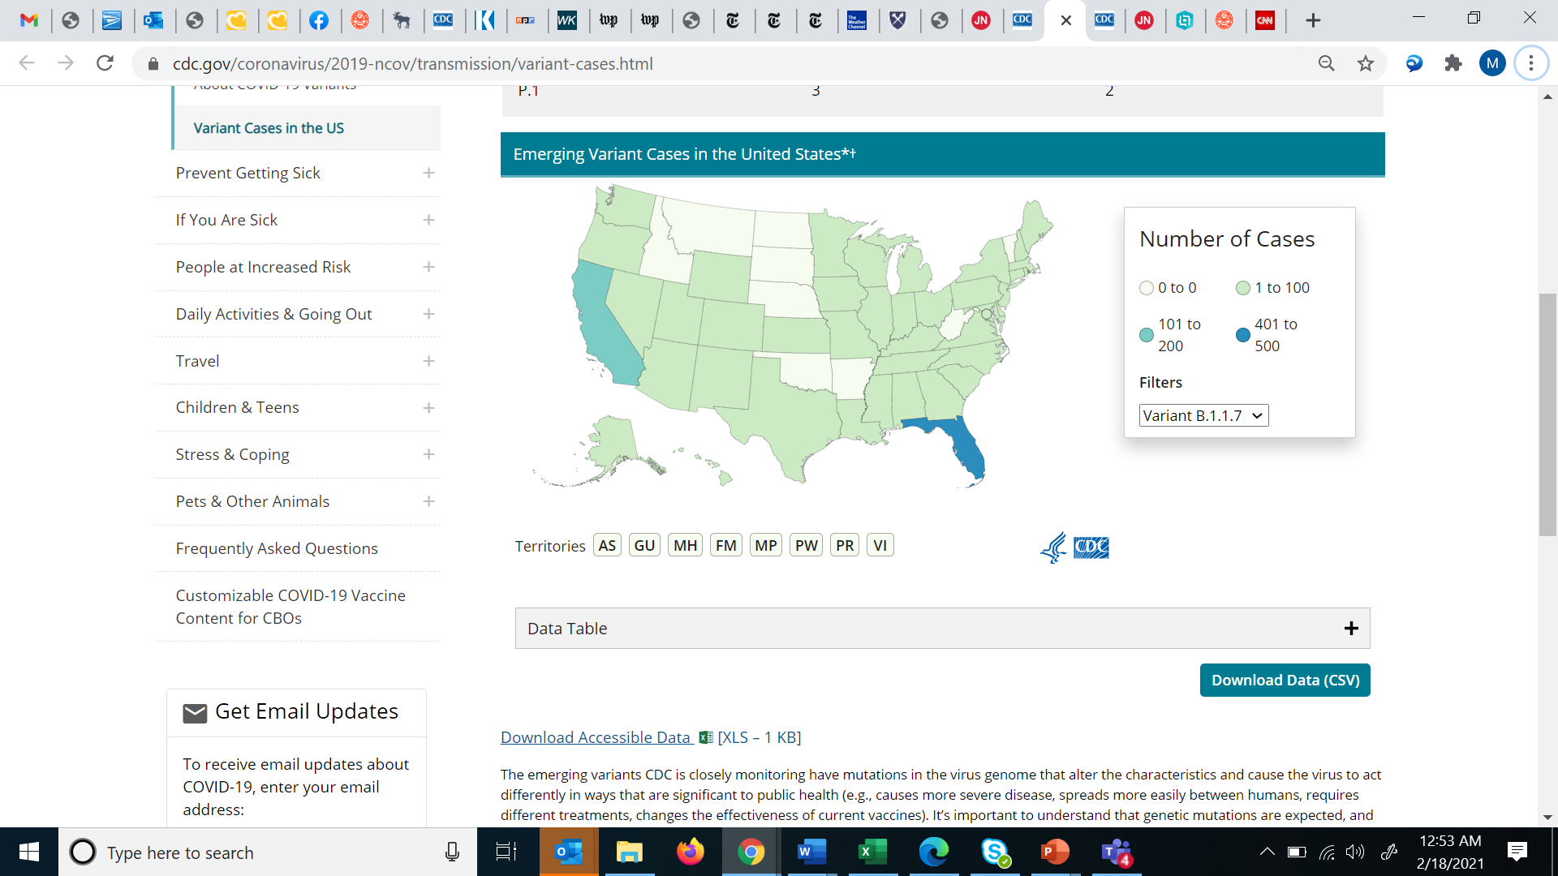
COVID Variants
UK Variant
All viruses mutate
We worry about new variants/strains that spread more easily and/or are more lethal
3 current variants of concern:
UK variant: more contagious, appears more lethal
South African variant: more contagious, potential cause of reinfections
Brazilian variant: more contagious, also may be able to reinfect patients
https://www.cdc.gov/coronavirus/2019-ncov/transmission/variant-cases.html
Notes:
https://www.cdc.gov/coronavirus/2019-ncov/transmission/variant.html

Slide 74
Variants and Vaccine Efficacy
Current vaccines appear to have activity against all known variants
Potential for decreased efficacy against the South African variant
Vaccination is the best defense against the variants
mRNA vaccine technology does allow for easy modification in the future, in the event a variant is identified where the vaccine has poor coverage

Slide 75
What to do after vaccination
Continue to wear a mask in public at all times
Unknowns = potential for asymptomatic infection and/or oropharyngeal shedding
Continue to stay home from work and get tested if you develop COVID-19 symptoms
Vaccine is not 100% effective
There is also some minimal circulation of other viruses
New CDC guidance = if you are >2 weeks but <3 months from dose #2, you don’t need to quarantine following an exposure

Slide 76
Possible Upcoming Vaccines
Johnson and Johnson:
Single-dose vaccine under review for EUA
Efficacy up to 72% (lower in counties with high South African variant prevalence)
DNA instructions for making the spike protein enclosed in an adenovirus vector
More stable at refrigerator temperatures
AstraZeneca
Also an adenovirus vector vaccine containing DNA instructions for the spike protein
Two-doses; delaying the second dose up to 12 weeks may actually improve immune response
Concern re: efficacy against the South African variant
Novavax
Two-dose protein-based vaccine using spike proteins
Also stable at refrigerator temperatures
More complicated manufacturing process → clinical trials taking longer
Notes:
https://www.nytimes.com/interactive/2020/health/johnson-johnson-covid-19-vaccine.html
https://www.prevention.com/health/a35118263/astrazeneca-vs-pfizer-vs-moderna-covid-19-vaccine/
https://www.nytimes.com/interactive/2020/health/novavax-covid-19-vaccine.html

Slide 77
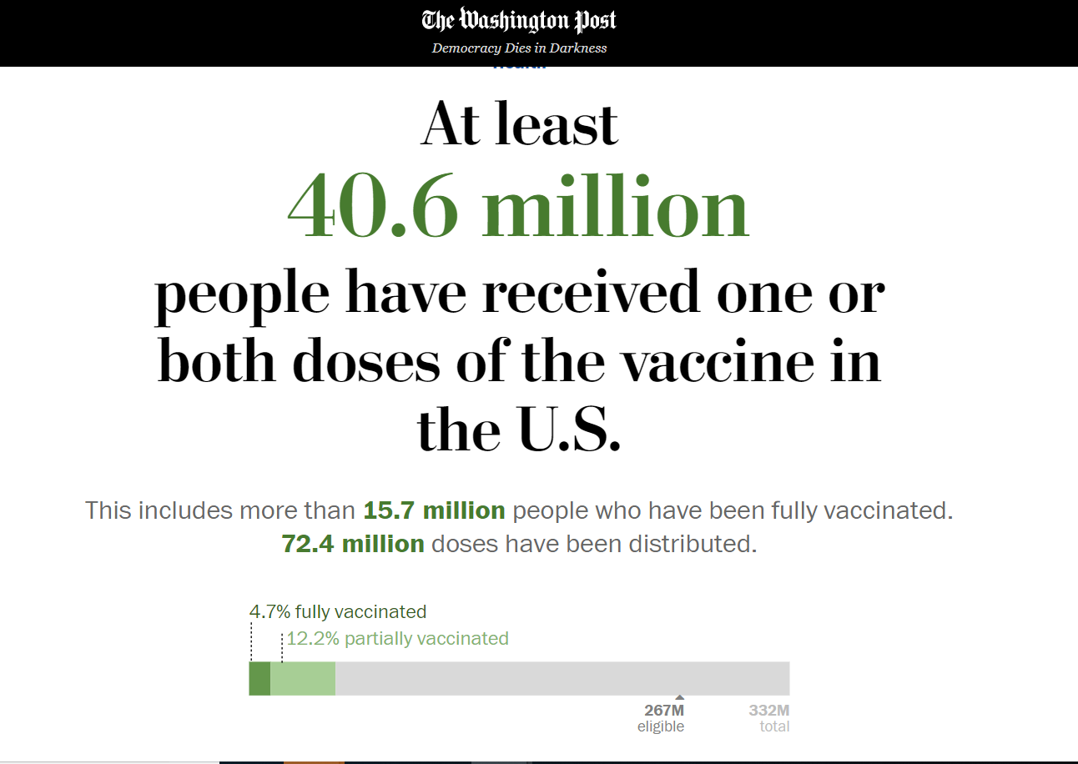

Slide 78
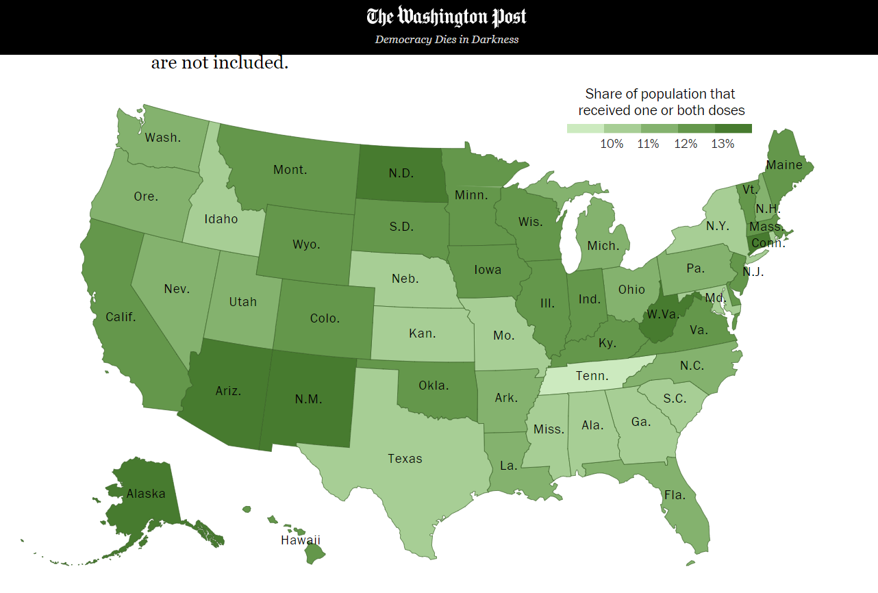

Slide 79
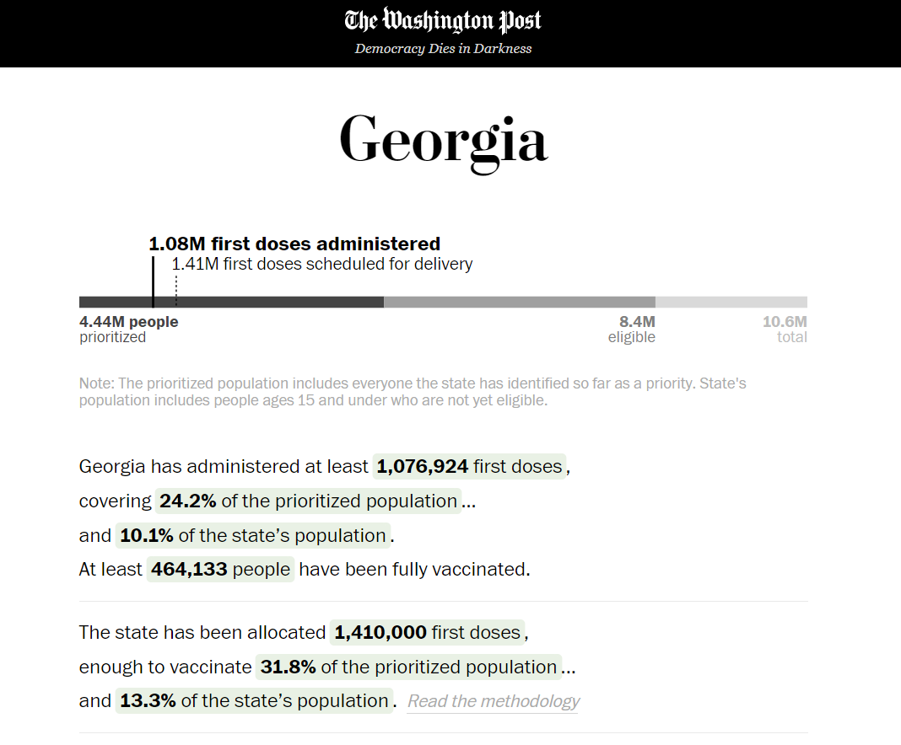

Slide 80
COVID-19 and Racial Disparities
Significant disparities with respect to COVID-19 infection rates and associated mortality:
Unfortunately, these same disparities are being seen with initial vaccination numbers
 | Hospitalization Rate (per 10,000) | Death Rate (per 10,000)
White patients | 7.4 | 2.3
Asian patients | 15.9 | 4.3
Black patients | 24.6 | 5.6
Hispanic patients | 30.4 | 5.6
https://jamanetwork.com/journals/jama/fullarticle/2775687
https://www.cdc.gov/coronavirus/2019-ncov/community/health-equity/racial-ethnic-disparities/increased-risk-exposure.html
Notes:
https://jamanetwork.com/journals/jama/fullarticle/2775687
https://www.cdc.gov/coronavirus/2019-ncov/community/health-equity/racial-ethnic-disparities/increased-risk-exposure.html

Slide 81
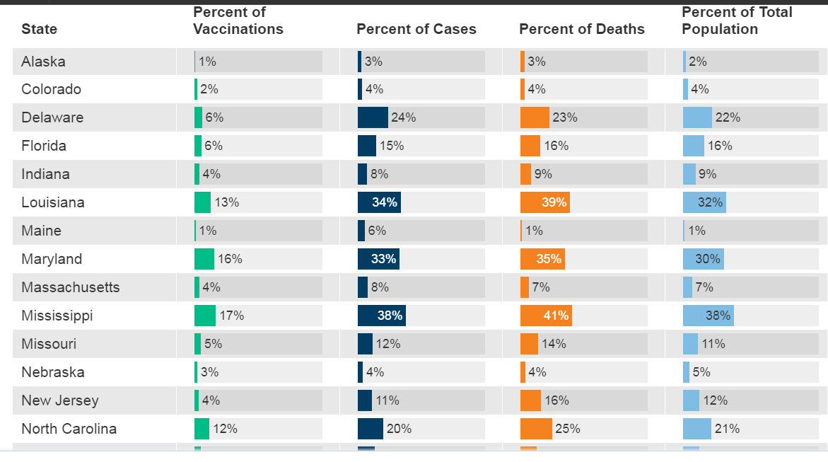
https://www.kff.org/coronavirus-covid-19/issue-brief/latest-data-covid-19-vaccinations-cases-deaths-race-ethnicity/
Notes:
https://www.kff.org/coronavirus-covid-19/issue-brief/latest-data-covid-19-vaccinations-cases-deaths-race-ethnicity/

Slide 82
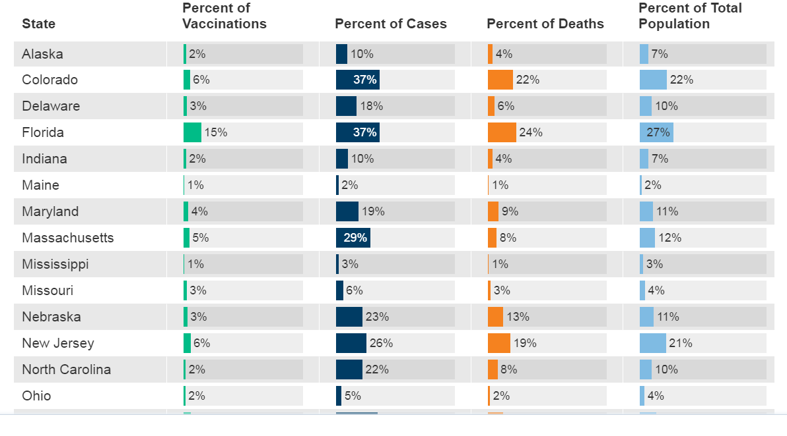
https://www.kff.org/coronavirus-covid-19/issue-brief/latest-data-covid-19-vaccinations-cases-deaths-race-ethnicity/
Notes:
hispanic

Slide 83
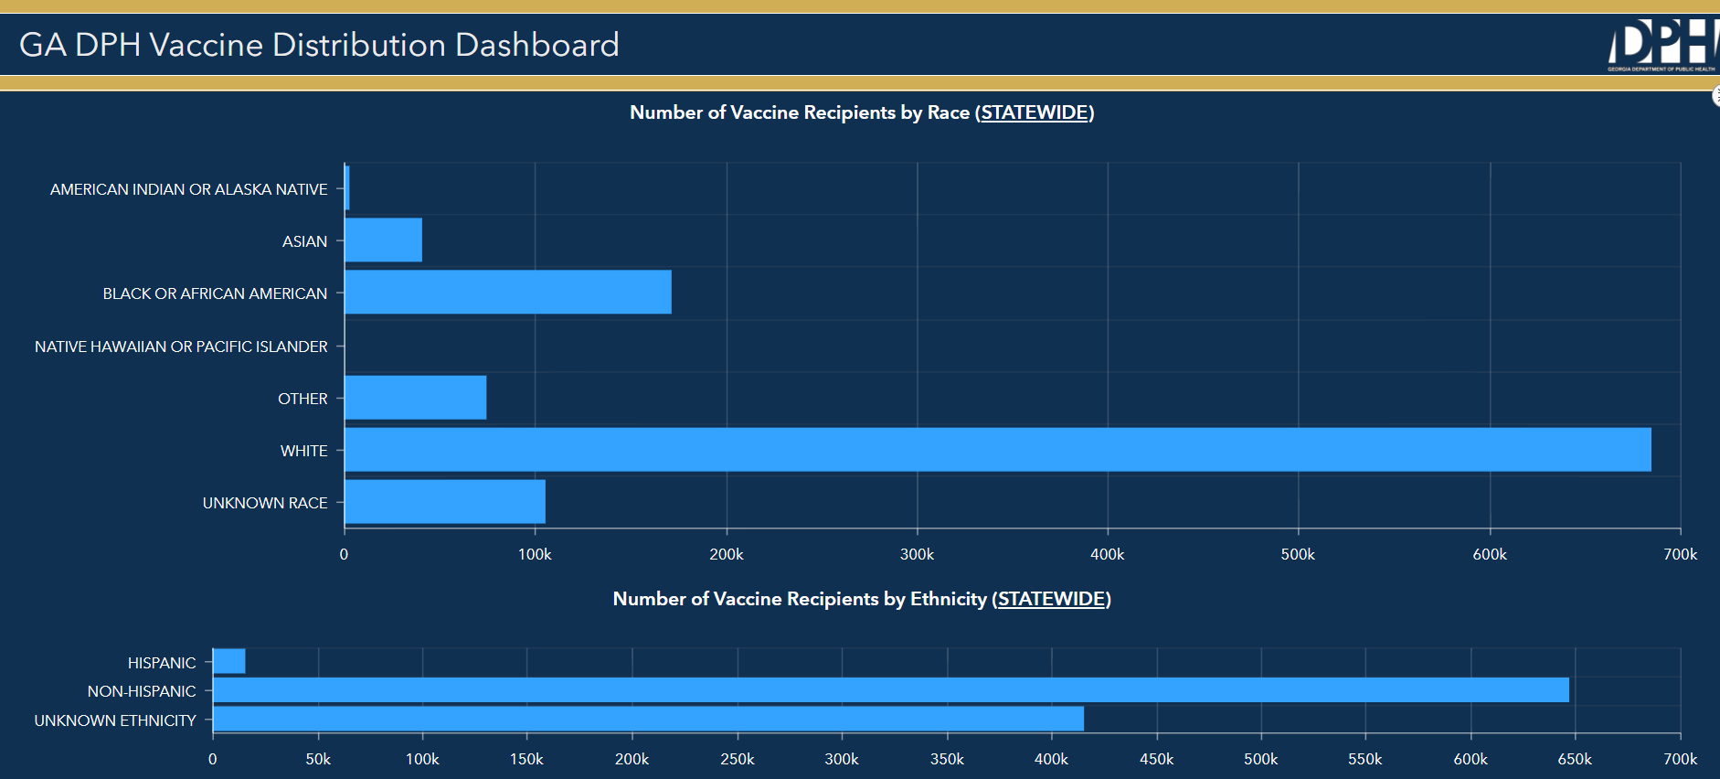
https://experience.arcgis.com/experience/3d8eea39f5c1443db1743a4cb8948a9c/
Notes:
https://experience.arcgis.com/experience/3d8eea39f5c1443db1743a4cb8948a9c/

Slide 84
Additional References
https://www.cdc.gov/coronavirus/2019-ncov/symptoms-testing/symptoms.html
https://www.cdc.gov/coronavirus/2019-ncov/hcp/clinical-guidance-management-patients.html
https://www.cdc.gov/coronavirus/2019-ncov/hcp/clinical-tips-for-healthcare-providers.html
https://www.cdc.gov/coronavirus/2019-ncov/hcp/planning-scenarios.html
https://www.medscape.com/viewarticle/938195#:
https://jamanetwork.com/journals/jama/fullarticle/2771111
http://haicontroversies.blogspot.com/2020/07/a-tiresome-spat.html
http://haicontroversies.blogspot.com/2020/04/airborne-vs-droplet-turbulent-gas.html
https://wwwnc.cdc.gov/eid/article/10/4/03-0628_article
https://www.preprints.org/manuscript/202004.0203/v1
https://www.nature.com/articles/s41591-020-0843-2
https://jamanetwork.com/journals/jama/fullarticle/2768396
Chu et al. Physical distancing, face masks, and eye protection to prevent person-to-person transmission of SARS-CoV-2 and COVID-19: a systematic review and meta-analysis. Lancet 2020.
W Lyu, GL Wehby, Community use of face masks and covid-19: Evidence from a natural experiment of state mandates in the us: Study examines impact on covid-19 growth rates associated with state government mandates requiring face mask use in public. Heal. Aff,10–1377 (2020).
https://www.cdc.gov/mmwr/volumes/69/wr/mm6928e2.htm
https://www.bloomberg.com/news/articles/2020-08-25/this-starbucks-in-south-korea-became-a-beacon-for-mask-wearing
https://www.businessinsider.com/56-got-coronavirus-south-korea-starbucks-mask-wearers-did-not-2020-8
https://www.nytimes.com/interactive/2020/health/johnson-johnson-covid-19-vaccine.html
https://www.prevention.com/health/a35118263/astrazeneca-vs-pfizer-vs-moderna-covid-19-vaccine/
https://www.nytimes.com/interactive/2020/health/novavax-covid-19-vaccine.html

Slide 85
Vaccination COVID-19
Research Matters Educational Event
February 18, 2021
Mr. Sam Shartar, MSN, RN, CEN, FAAN, PCEM
Office of Critical Event Preparedness and Response (CEPAR)

Slide 86

COVID-19 Vaccine
Emory is taking an enterprise approach to vaccine delivery which included Emory Healthcare employees, Emory Healthcare patients, and Emory University students, faculty, and staff.
Two EUA approved vaccines with a third pending approval.
Vaccine distribution must be aligned with Georgia’s phased distribution model, administered by the Department of Health.
Currently vaccinating eligible persons who are included in Tier 1A plus those who are 65 or older, and their care givers.
Vaccine supply is constrained.

Slide 87
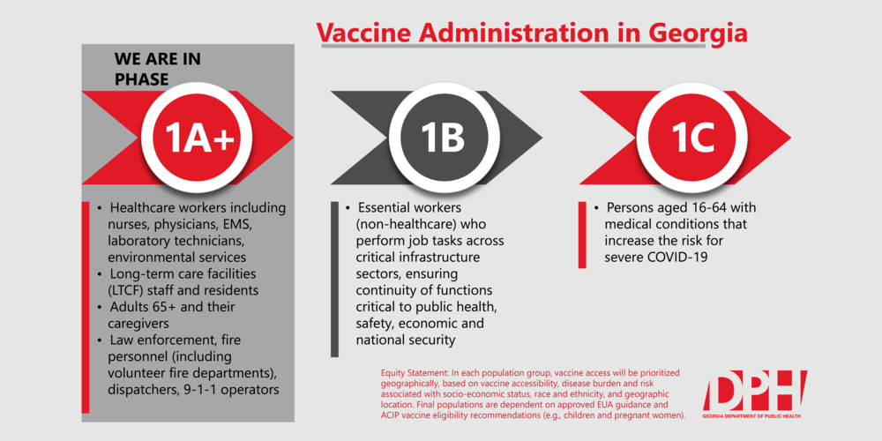
Vaccine Administration Tiers

Slide 88
Communications
Emory Forward COVID-19 Vaccine webpage
Bi-weekly updates
Vaccine FAQs
Town hall meetings
E-mails

Slide 89
Vaccine Planning
Validating and loading lists of eligible faculty, staff, and students into the H.O.M.E system.
Identifying Emory University personnel who are performing essential functions as we plan for Tier 1B.
Vaccine site at ECCH
Planning for Tier 1C
Planning for broad distribution

Slide 90
Current Vaccine Data
Global:
176 million doses administered worldwide.
U.S.
54 million doses/1.64 million doses per day
Georgia: 1,445,835 doses administered/9.7% first dose , 3.6 fully vaccinated
Emory University :
7,025 eligible university employees/62.5% first dose received.
1,866 eligible physicians(faculty)/87% first dose received.

Slide 91
Questions?

Slide 92

Black History Month Events
https://news.emory.edu/stories/2021/02/er_black_history_month/campus.html
Black Men in White Coats | Emory School of Medicine
Panel Discussion – February 24, 2021 at 12:00-1:30 p.m.
Registration is required.
https://med.emory.edu/about/diversity/bhm.html

Slide 93
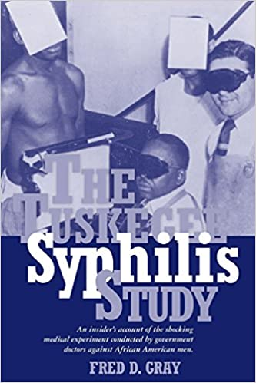


Thank you!
Three winners will receive:

Slide 94
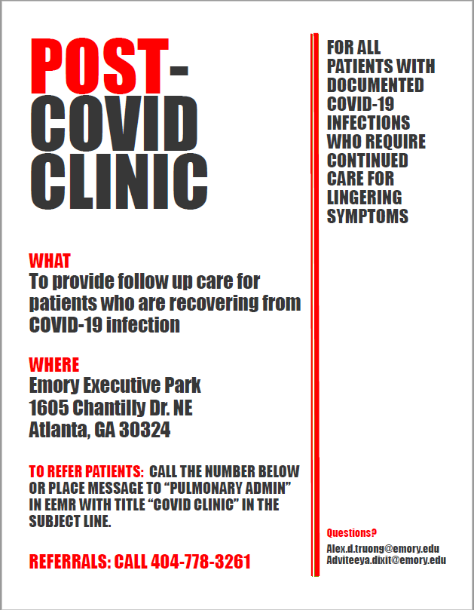

Slide 95
Closing Remarks
PowerPoint Presentations and this event recording will be available on OCR’s website at http://www.ocr.emory.edu/training/research%20matters.html
Our next Research Matters educational seminar will be June 17, 2021.
See you next time!

