Slide 1

Research Matters
Office for Clinical Research
June 18, 2020

Slide 2



Important Items
Electronic Devices
Restrooms Lunch Boxes

Slide 3
Agenda
11:30 am – 11:35 am Welcome & General Announcements
John Doan, MD
Research Services Consultant
Emory University, Office for Clinical Research – Education
11:35 am – 12:15 pm Adaptive COVID-19 Treatment Trial (ACTT)
Includes Q&A Aneesh Mehta, MD
Professor
Emory University, SOM: Infectious Diseases
Hollie Macenczak, RN
Clinical Research Nurse
Emory University, SOM: Infectious Diseases
12:15 pm – 012:45 pm Rapid Response Team: Process
Includes Q&A Sherry D. Coleman, DNP, RN, CHRC, CHC
Associate Executive Director
Emory University, Office for Clinical Research
12:45 pm – 1:00 pm Stress Management Considerations During COVID-19
Includes Q&A Gordon Tuttle, PhD
Manager of Clinical Training/Physician Services
Emory University, Human Resources
1:00 pm Closing Remarks
John Doan, MD
Research Services Consultant
Emory University, Office for Clinical Research – Education

Slide 4
Objectives
To discuss ACTT, from a Principle Investigator and Clinical Research Nurse perspective
To discuss the process of the Rapid Response Team
To hear about ways to cope with the COVID-19 pandemic

Slide 5

Announcements
General Announcements

Slide 6


June is Cancer Survivor Month

Slide 7
OCR News
OCR Submission Form Update
Job Opening at OCR

Slide 8

Continuing Education Credits
Continuing education credits will be provided in December for all Research Matters educational seminars.
You will be provided a link to complete the seminar’s evaluation.

Slide 9
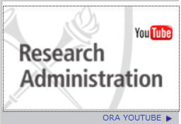
Remember!!!
Today’s Research Matters recording will be available on OCR’s website as well as ORA’s You Tube.
www.ocr.emory.edu
www.or.emory.edu
Note: For recording purposes
Please click on the “raise your hand” button.

Slide 10



Update on Adaptive COVID-19 Trial of Therapeutics (ACTT) studies
Aneesh Mehta
On behalf of the
Emory ACTT team

Slide 11
Disclosures
No pertinent financial disclosures
I have received research funding from the NIH related to COVID-19, specifically for the ACTT trial
I have previously received research funding from Merck, Oxford Immunotec, and Genentech, but not related to COVID-19 or data presented today
I have previously served on advisory boards for Merck and Oxford Immunotec, but not related to COVID-19 or data presented today

Slide 12
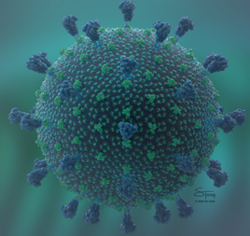

COVID-19 Timeline
31 December 2019: WHO China Country Office was informed of cases of pneumonia of unknown etiology detected in Wuhan City, China.
07 January 2020: Chinese authorities identified a novel coronavirus as the probable causative agent.
  That week, the Emory Serious Communicable Disease Program, along with NETEC, started preparedness for patients
20 January 2020: First confirmed case in US (Washington)
02 March 2020: First confirmed case in Georgia
04 March 2020: First confirmed case at Emory
There were cases and transmission prior these dates

Slide 13
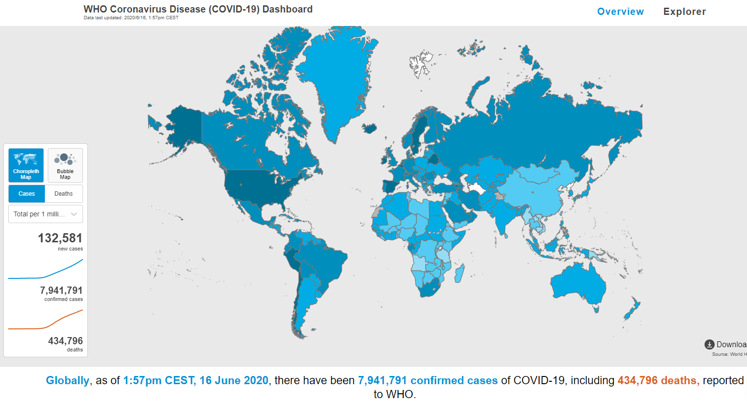

https://covid19.who.int/

Slide 14
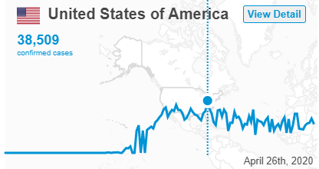
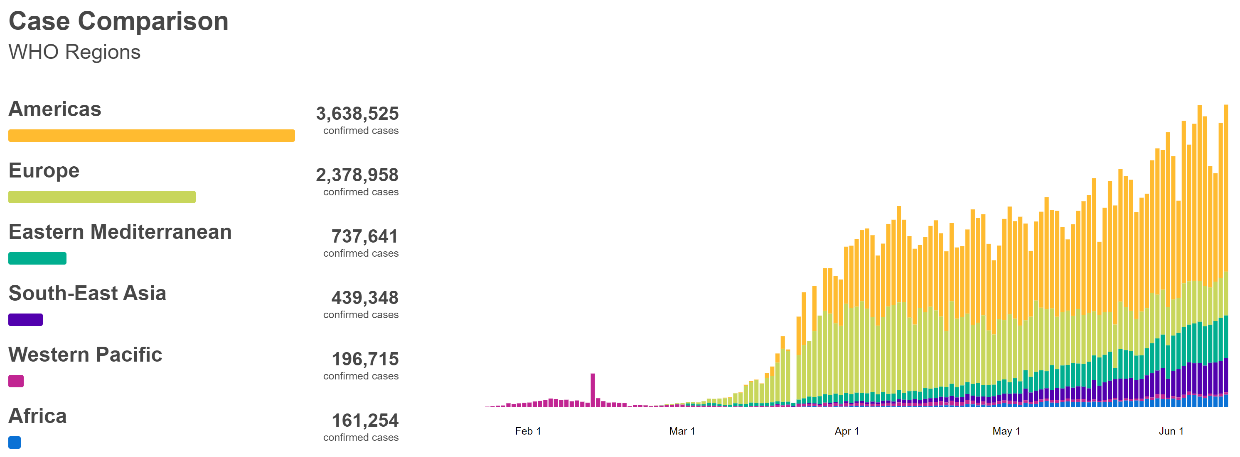
https://covid19.who.int/

Slide 15
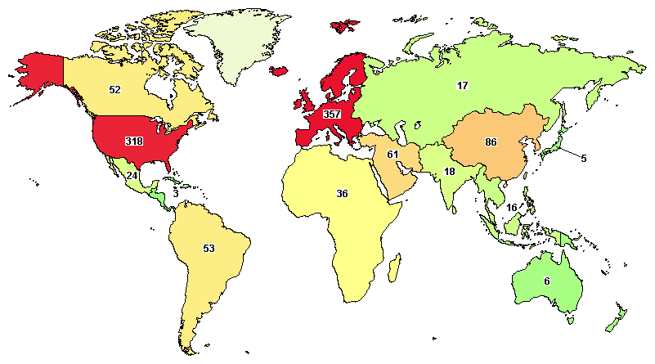

Therapeutics for COVID-19
There are not approved therapeutics for any coronavirus
  Chloroquine/hydroxychloroquine use emergency use authorization (EUA) granted on March 28; terminated June 14
  Remdesivir EUA on May 1
Over 1200 clinical trials for COVID-19 listed on clinicaltrials.gov
  > 600 actively recruiting
  > 475 to be started
  > 300 in US

Slide 16
NIH Adaptive COVID-19 Trial of Therapeutics
In late January, the NIH convened a group of scientists and clinicians to design studies to evaluate putative therapeutics for SARS-CoV2
Adaptive, randomized, double-blind, multicenter trial to evaluate novel therapeutic agents in hospitalized patients with COVID-19
  ACTT = Adaptive COVID-19 Trial of Therapeutics
NIH approaches NETEC and VTEUs in February to be launch partners of study – Emory is one of the lead sites in both networks
  NETEC = National Ebola Emerging Special Pathogens Treatment and Education Center (Bruce Ribner – PI)
  VTEU = NIAID Vaccine and Therapeutics Evaluation Units (Nadine Rouphael – PI)
Based on available data in early Feb, Remdesivir was selected as the first agent to test

Slide 17
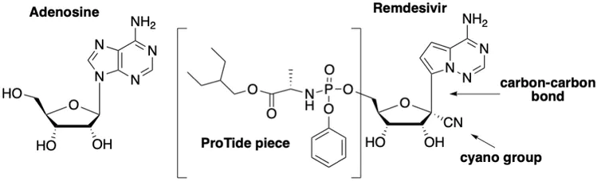
Remdesivir
Nucleoside analog of adenosine that interferes with viral RNA-dependent RNA polymerase
  2009: Developed for Hepatitis-C – not effective
  2015: Resurrected as a possible treatment for Ebola
    Outbreak stopped before it could be tested
  2017: Data emerged that it was effective against SARS and MERS
  2019: Tested in large adaptive clinical trial in Ebola outbreak in the DRC
    Inferior to two other drugs
  2020: Laboratory testing against SARS-CoV-2 indicated good activity
Available as IV medication only
Credit: Katherine Seley-Radtke, CC BY-SA

Slide 18
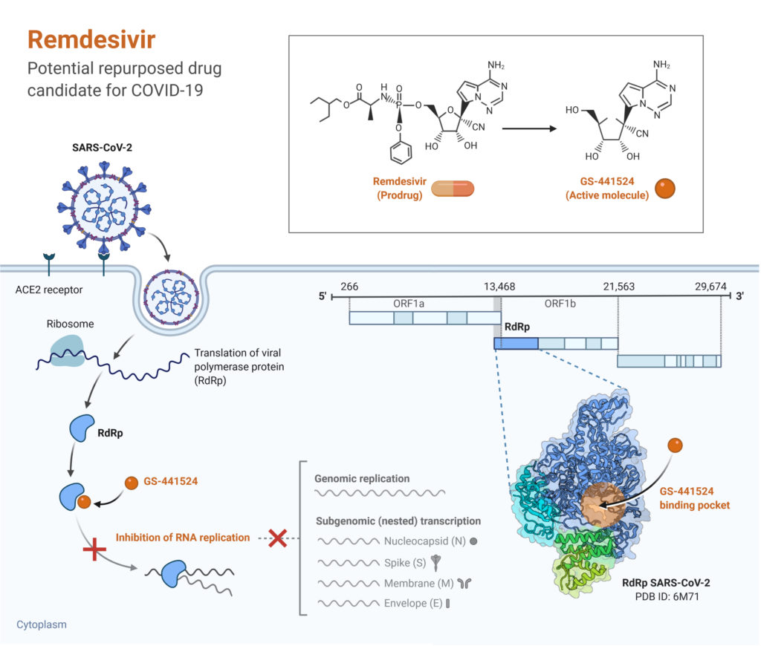
Remdesivir
Figure: Remdesivir- Potential Repurposed Drug Candidate for COVID-19. Image created with biorender.com
https://microbenotes.com/remdesivir/

Slide 19
NIH ACTT-1
ACTT-1: Standard of Care + Remdesivir versus standard of care + placebo
NIH approaches NETEC and VTEUs in February to be launch partners of study – Emory is one of the lead sites in both networks
  Initial goal of 440 patients in 3-4 months
  Nebraska enrolls first patient on February 25; 68 sites, 47 in the US
  Enrolled 1063 patients in 2 months

Slide 20

NIH ACTT-1 at Emory
Investigators
Aneesh Mehta
Colleen Kraft
Marshall Lyon
Bruce Ribner
Jay Varkey
Marybeth Sexton
Coordinator
Jennifer Truell

Slide 21
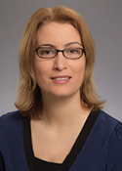




NIH ACTT-1 at Emory with Emory VTEU
Aneesh Mehta (PI)
Nadine Rouphael (Co-PI)
Ghina Alaaeddine (Project Lead)
Jennifer Truell (Regulatory)
Lisa Harewood (Regulatory) Brandi Johnson (Lab Lead)
Investigators
Aneesh Mehta
Nadine Rouphael
Colleen Kraft
Marshall Lyon
Bruce Ribner
Coordinators
Youssef Saklawi
Ghina Alaaeddine
Nina McNair
Cindy Lubbers
Meg Taylor
Caroline Ciric
Investigators
Jessica Traenkner
Nadine Rouphael
Zanthia Wiley
Aneesh Mehta
Coordinators
Laurel R. Bristow Kieffer Hellmeister
Hollie Macenczak
Investigators
Ron Trible
Nadine Rouphael
Coordinators
Ariel Kay
Ghina Alaaeddine
Investigators
Carlos Del Rio
Valeria Cantos
Colleen Kelley
Paulina Rebolledo Sheena Kandiah
Annette Esper
Coordinators
John Gharbin
Rotrease Regan
Catherine Abrams
VTEU Data Team

Slide 22
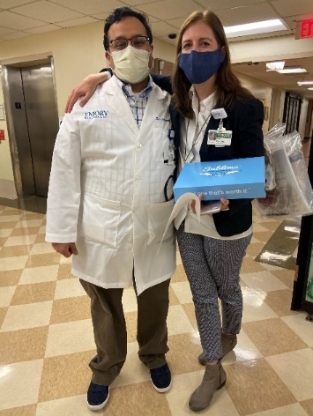
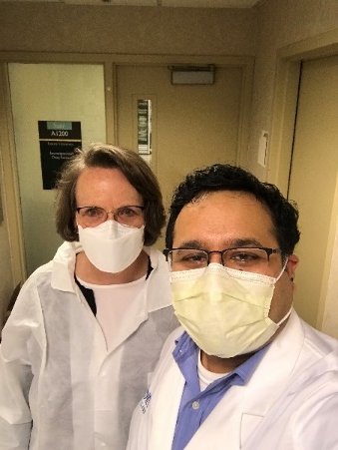
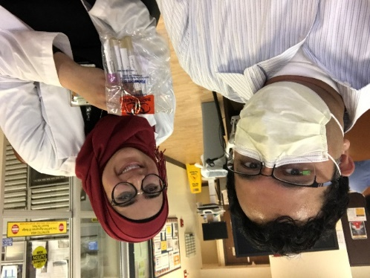
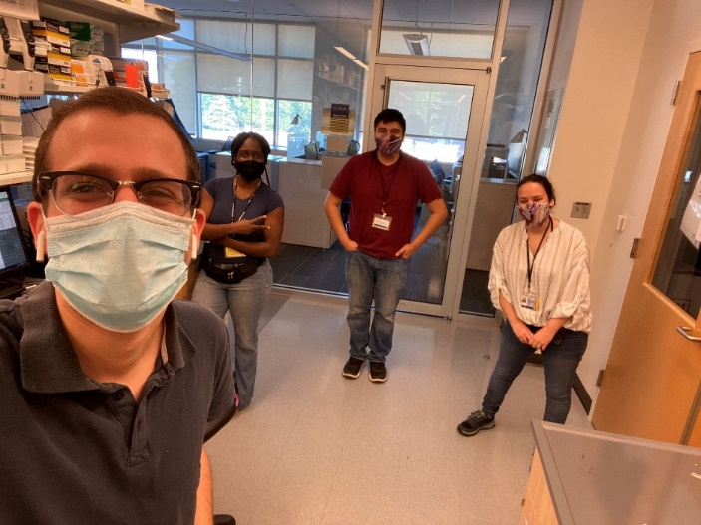
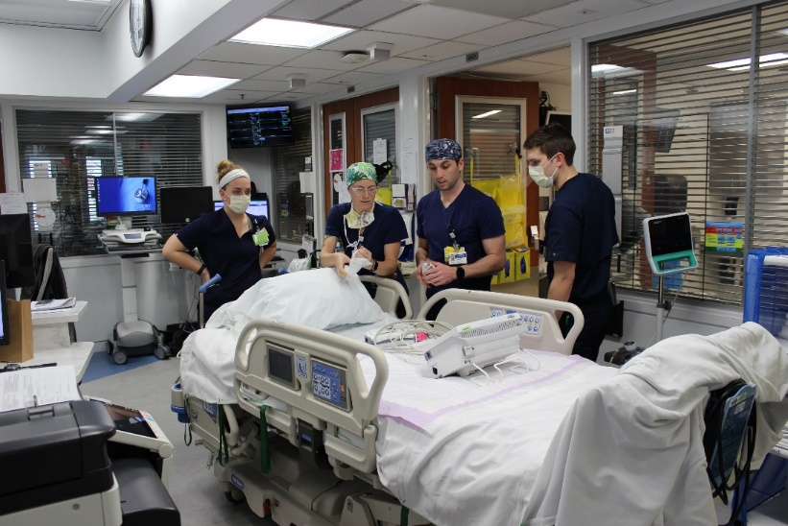
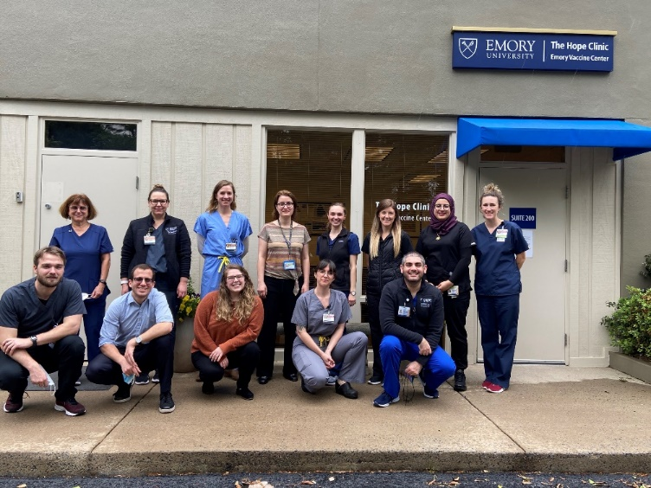
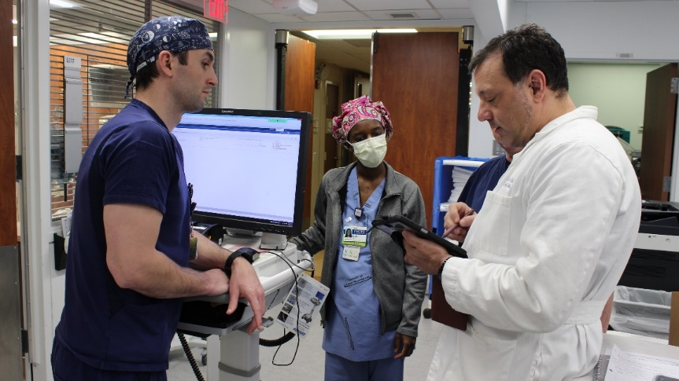
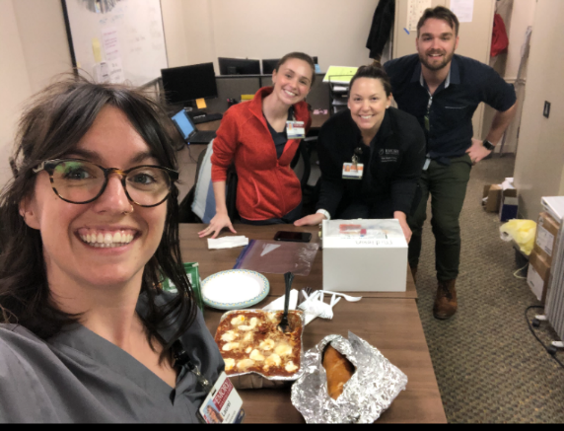
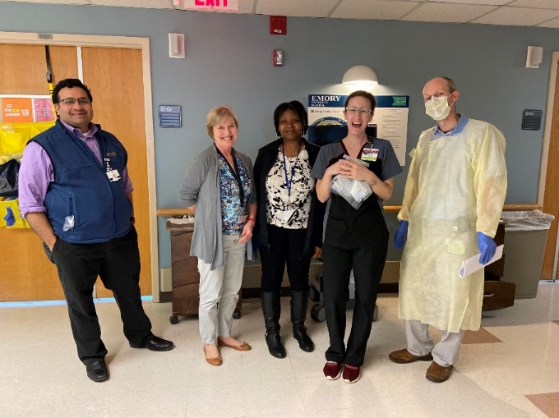
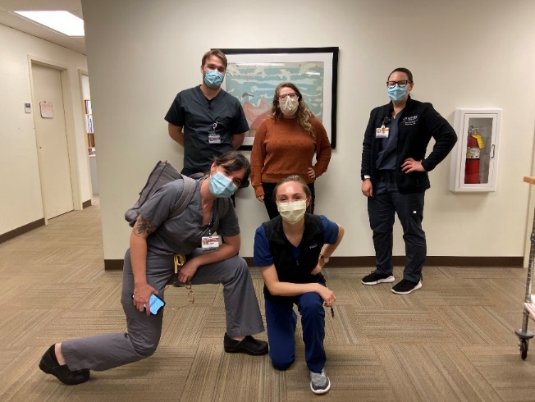
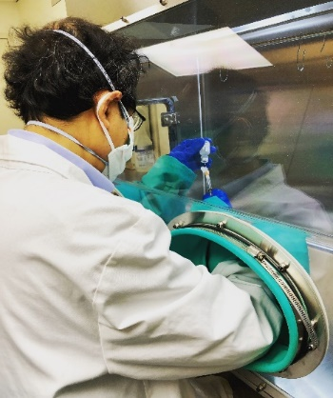
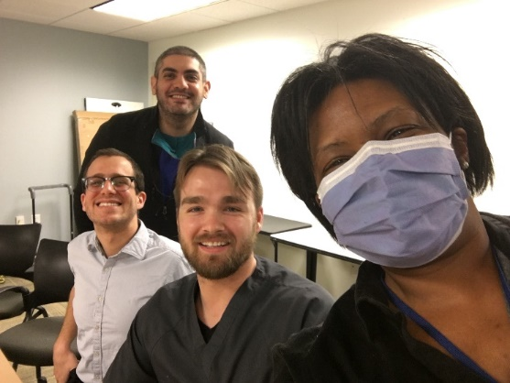
The Amazing Team

Slide 23
NIH ACTT-1
ACTT-1: Standard of Care + Remdesivir versus standard of care + placebo
NIH approaches NETEC and VTEUs in February to be launch partners of study – Emory is one of the lead sites in both networks
  Initial goal of 440 patients in 3-4 months
  Nebraska enrolls first patient on February 25; 68 sites, 47 in the US
  Enrolled 1063 patients in 2 months
Emory enrolled 103 patients – more than any other site in the world!
  EUH = 32
  EUHM = 36
  ESJH = 24
  Grady = 11

Slide 24
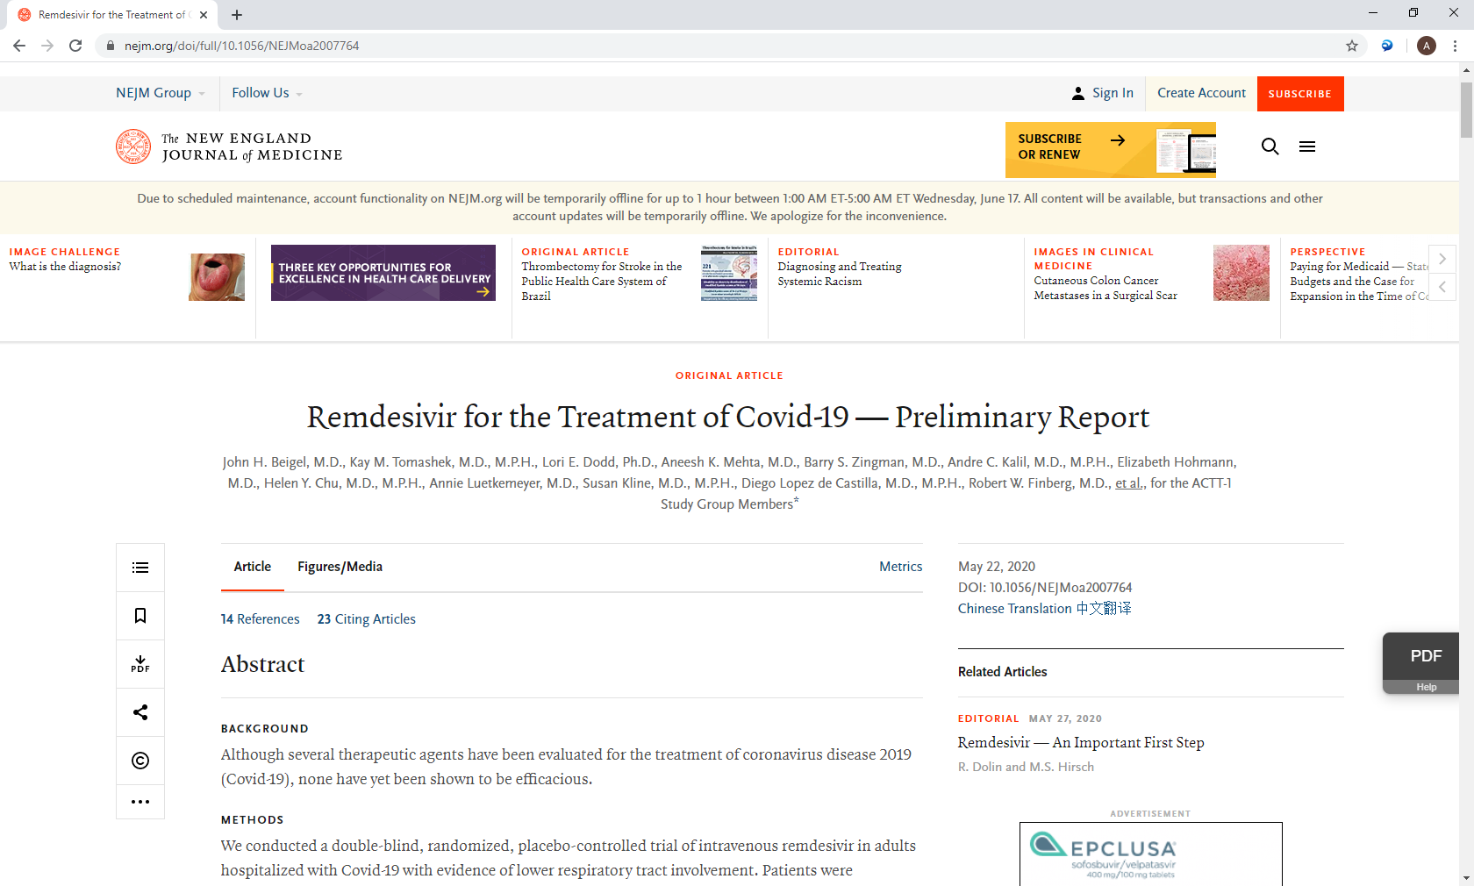
NIH ACTT-1: Preliminary Data
The independent data and safety monitoring board (DSMB) met on April 27 to review data from ~500 recovered patients
  Recovered = being well enough for hospital discharge
Patients on remdesivir had a 31% faster time to recovery than those who received placebo (p<0.001).
  Median time to recovery was 11 days versus 15 days for those who received placebo
Mortality at day 14 was 7.1% with remdesivir versus 11.9% for the placebo group (hazard ratio for death, 0.70; 95% CI, 0.47 to 1.04; not statistically significant).
Definitely not a grand slam or magic bullet, but at least something that helps beyond the amazing care of our clinical teams.
Still analyzing full data set

Slide 25
ACTT-2
Based off of DSMB recommendations on preliminary data, pure placebo arm was removed from ACTT-2
ACTT-2 is evaluating the addition of an immune modulator to remdesivir for of hospitalized patients
  Subjects will be randomized into two arms (1:1):
  remdesivir + baricitinib or remdesivir + placebo
Current Enrollment = 673
  Emory = 64
  EUH = 11 EUHM = 8 ESJH = 28 Grady = 12 Atlanta VAMC = 5

Slide 26
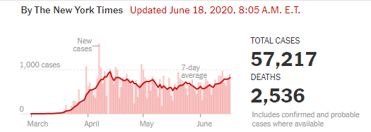
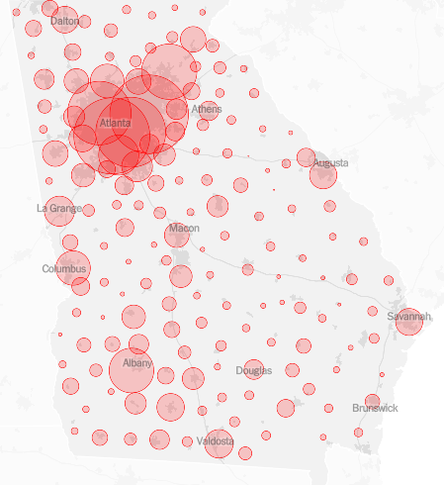
ACTT-2 Limitation
Inclusion Criteria
  Laboratory-confirmed SARS-CoV-2 infection AND Pneumonia OR needing O2 support, mechanical ventilation or ECMO.
Exclusion Criteria
  eGFR < 30 ml/min or receiving hemodialysis or hemofiltration
  Neutropenia (absolute neutrophil count <1000 cells/μL) OR Lymphopenia (absolute lymphocyte count <200 cells/μL)
  Received cytotoxic or biologic treatments within 4 weeks prior to screening.
  Received convalescent plasma or intravenous immunoglobulin for COVID-19.
  History of VTE

Slide 27
Other Active Clinic Trials for COVID at Emory
Immune Modulators
  Regeneron: Sarilumab (IL-6 blocker) vs placebo
  Kinevant: Gimsilumab (anti-GM-CSF antibody) vs placebo
  Winship “RESCUE 19-9”: limited radiation to lungs with COVID pneumonia
  NHLBI: Mesenchymal stem cell transfusion for patients with COVID and Acute Respiratory Distress Syndrome (ARDS)
Monoclonal antibodies
  Eli Lilly: LY3819253 (SARS-CoV-2 monoclonal antibody) vs placebo
  Regeneron: Monoclonal cocktail

Slide 28
The Emory ACTT Team
Catherine Abrams, RN
Ghina Alaaeddine, MD
Evan Anderson, MD
Amer Bechnak, MD
Mary Bower, RN, BSN
Laurel R. Bristow, MSc
Juliet Brown, BS
Valeria D Cantos, MD
Andrew Cheng, BA
Caroline Ciric, BS
Matthew H Collins, MD, PhD
Blair P. Curless, PharmD, PhD
Carlos Del Rio, MD
Rijalda Deovic, MPH
Ana Drobeniuc, MPH
Annette Esper, MD
KaRon Gaston, BS
John Gharbin, MBChB, MPH
Tigisty Girmay, RN, BSN, MSN
Rebecca Feng Gonzalez, PharmD
Lisa Harewood, BA
Kieffer Hellmeister, BS
Christopher Huerta, BS
Valerie Hunter
Laila Hussaini, MPH
Hannah Huston
Rondell Jaggers
Brandi Johnson, BS
Sheetal Kandiah, MD, MPH
Vinit Karmali, MSc
Ariel Kay, MPH
Colleen F. Kelley, MD, MPH
Vinit Karmali
Dean Kleinhenz, MBA
Jennifer Kleinhenz, BS
Colleen S. Kraft, MD, MSc
Cindy Lubbers, RN
G. Marshall Lyon, MD, MSc
Hollie Macenczak, RN, BSN
Michael Mattaliano, PharmD
Michele McCullough, MPH
Nina McNair, BS
Aneesh K. Mehta, MD
Juliet Morales, BS
Phillip M Murray
Tuong-Vy N Ngo PharmD
Amanda Panepento, BA
Esther Sue Park, PharmD
Varun K. Phadke, MD
Ilana Ray Pollack, MSc
Philip Powers, PharmD
Paulina Rebolledo, MD, MSc
Rotrease Regan, RN, MPH, PhD
Susan Rogers, RPh
Christin Root, BS
Nadine G Rouphael, MD
Youssef Saklawi, MD
Nicholas Scanlon, MD
Erin Scherer, PhD, Dphil
Robert Shepard, PharmD
Amy C. Sherman, MD
Stacey Smith, PhD
Tae Stallworth, BS
Megan Taylor, BS
Joseph Torrisi PharmD,
Jessica Traenkner, PA-C
Ronald Trible, MD, PhD
Jennifer Truell, MA, MPH
Jesse Waggoner, MD
Dongli Wang, BS
Michelle Wiles, RN, BSN, MPH
Zanthia Wiley, MD
Juton Winston, BS
Terra Winter, CIP
Felicia Wright, ChPhT
Jianguo Xu, RPh, PhD
Yongxian Xu, MD

Slide 29


Acknowledgements
Emory Investigation Drug Services
  COVID Research Heroes!!!
Nebraska Central IRB
Emory Rapid IRB
Emory OCR and OSP
Nurses
Providers
Respiratory Therapists
Phlebotomy

Slide 30
The role of the Crn/crc during the covid-19 pandemic
Hollie Macenczak RN, BSN

Slide 31
Logistics during ACTT 1 and 2
Sites: EUH, EUHM, ESJ, the Hope Clinic
Coordinating communication between primary hospital team and PIs/research team
Approaching Spanish-speaking patients and translation
Assisting with obtaining informed consent, including communication with LAR
Coordinating sample collections (NP/OP swabs, blood)
Coordinating pick up and distribution of study drug
Nurse education for study product administration
Review of eligibility criteria
Reviewing daily labs

Slide 32
Logistics during ACTT 1 and 2
(continued)
Documentation of study visits
Discharge instructions
Coordinating + conducting follow up appointments (Days 15, 22, 29) post-discharge
Reporting/recording AEs/SAEs appropriately
Preparing for IMV/FDA audit
QM of subject charts
In short, the CRN/CRC plays a vital part in organizing many moving parts in the midst of chaos!

Slide 33
Staying Safe During the Pandemic
Limiting entering patient rooms
Limiting use of PPE
Weighing risk/benefit to complete study procedure
Appropriately don/doff PPE if entering a room
Correctly choose type of PPE needed
Thoroughly cleaning clinic exam rooms for convalescent visits

Slide 34
Work-Life Balance
Creating boundaries through balanced work distribution on the team
Asking for help
Balancing the work week + ensuring time off to disconnect
Managing stress through exercise, good nutrition, and enough sleep
Emotional support for co-workers, patients, and self
Family/personal time/self-care

Slide 35


Rapid Response Team
(RRT)
Research Matters
June 2020
Sherry D. Coleman, DNP, RN, CHC, CHRC
Associate Executive Director, Clinical Trials
Office for Clinical Research
Office for Clinical Research
Transforming Research … Together!

Slide 36
Ebola
Summer 2014
Emory admitted Ebola patients
  Need for emergency testing of experimental treatments
Office for Research Administration (ORA) created a RRT to approve Ebola studies
  RRT was able to complete all processes necessary for study launch within 3 days
Office for Clinical Research
Transforming Research … Together!

Slide 37
Georgia CTSA
Quality & Efficiency Program
Specific Aim 3: Apply systematic approach to maximize efficiency across the spectrum of clinical research operations, and to promote and disseminate innovative efficiency methods across the collaborating institutions
3c: Execute novel implementation of Rapid Response Team processes to expedite approval and enrollment in high value network clinical trials
Office for Clinical Research
Transforming Research … Together!

Slide 38
Qualifying Criteria for RRT
High Priority; Requiring emergency approval for survival
Public Health Emergency
Bioterrorist Attack
Significant outbreak of a Infectious Disease
Other significant or catastrophic event
Requested by:
NIH or other Federal Funded Network Study
Centers for Disease Control and Prevention (CDC)
IND or IDE
Office for Clinical Research
Transforming Research … Together!

Slide 39
RRT Submission Process
Review to see if protocol meets Qualifying Criteria
Complete the RRT Submission Form
Upload the following documents with RRT Submission Form
  Protocol
  Informed consent
  Investigational Brochure
  Clinical Trial Agreement (CTA)
  Sponsor Budget
  IND/IDE Approval Letter
  IND/IDE Exemption Letter
  OCR Submission Form (new)
Submit form to the myresearchnavigator@listserv.cc.emory.edu
Office for Clinical Research
Transforming Research … Together!

Slide 40
What happens after RRT Submission Form is completed?
Submission reviewed
If study approved:
  Facilitator deploys the RRT
    Deployment notification email sent to RRT and study team
      Attached all required documents to complete review
      Point of Contact (POC) list includes:
      (Dept Admin, RAS, OTT/OSP, OCR, IRB, EHSO, EHC – Nsg, Lab, RAD, IDS, ORC)
    Works to streamline and facilitate the approval process to completion and expedite the study approval within 7 calendar days
      Late evenings, early mornings and weekends
If study not approved:
  Email and/or phone call to study team to discuss rationale
Office for Clinical Research
Transforming Research … Together!

Slide 41
COVID-19 Metrics
(as of June 12,2020)
# of Completed studies (15)
  #Pending studies (4)
Metrics (calendar days)mean/median
  Time RRT to Time to enrollment (11/8)
  RAS (1/1)
  OCR (3/2)
  IRB (4/1)
  OTT/OSP (11/9)
Office for Clinical Research
Transforming Research … Together!

Slide 42
Hope Clinic and Emory University:
Response to COVID-19 Pandemic
Advancing understanding of how the immune system fights SARS-CoV-2
Providing valuable samples starting with an 80 year old couple exposed to the disease while on a cruise ship allowing development of serologic testing
Highest enrolling site in the world for the Remdesivir placebo-controlled trial
  Remdesivir, an anti-viral agent was recently granted FDA emergency use authorization following promising preliminary results
Testing the first in human coronavirus vaccine
First site in the world to enroll older adults in a coronavirus vaccine trial paving the way for the first Phase 3 vaccine trial this summer
Office for Clinical Research
Transforming Research … Together!

Slide 43
Closing Remarks
Thank you for attending Research Matters.
PowerPoint Presentations and this event recording will be available on OCR’s website as well as ORA’s YouTube within a few weeks.
Our next Research Matters educational seminar will be October 15, 2020.
See you next time!

